Slide 1
Understanding Low Risk Myelodysplastic syndromes (MDS)
Adrienne A. Phillips MD, MPH
Associate Professor of Clinical Medicine
Weill Cornell Medicine
New York, NY
11/13/2021
https://cornellbmt.org/

Slide 2
Disclosures
No relevant disclosures
Nothing relevant to disclose

Slide 3
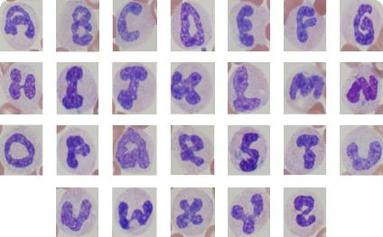
Objectives
Understand what is MDS
Understand the symptoms, signs and diagnosis of MDS
Review the clinical outcome prediction models we use for MDS including IPSS and IPSS-R
Understand the management options for lower risk MDS
Understand alphabet of MDS

Slide 4
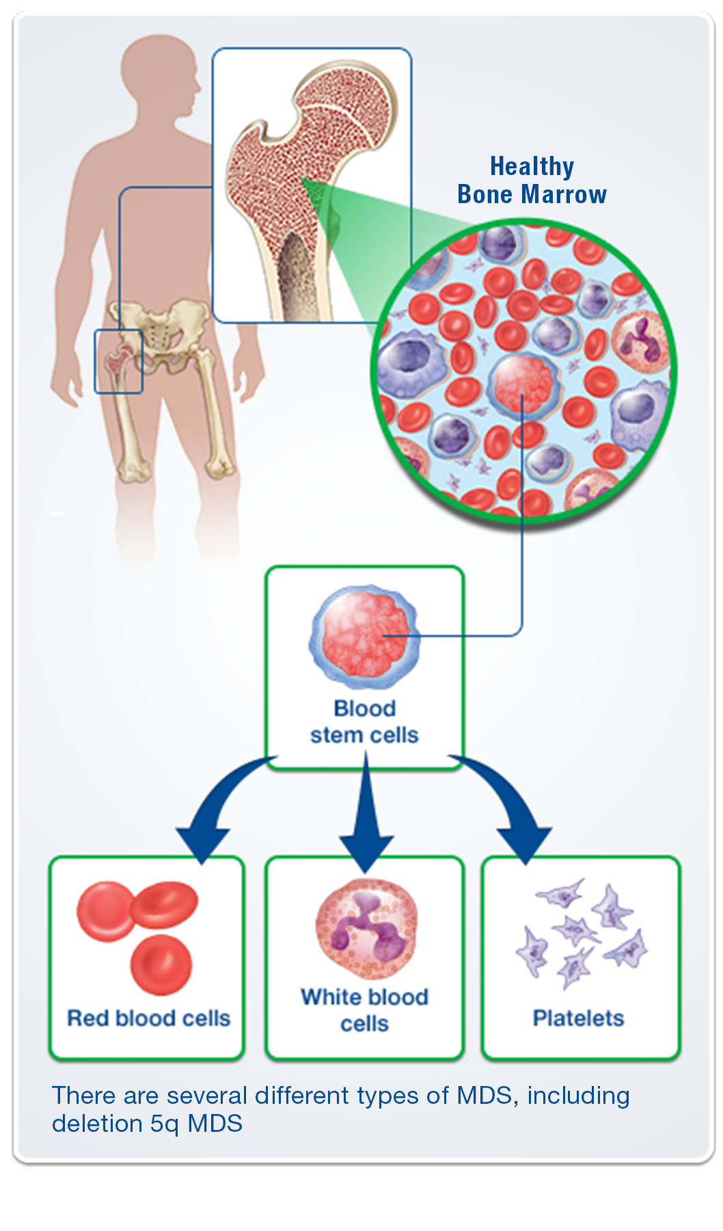
What is MDS
MDS is a heterogeneous group of malignant hematopoietic disorders
MDS is a form of bone marrow failure
Stem cells (immature blood cells) do not mature as expected resulting in ineffective blood cell production
MDS is characterized by one or more peripheral blood cytopenias: i.e anemia, neutropenia and or thrombocytopenia

Slide 5
Many conditions can mimic MDS

Slide 6
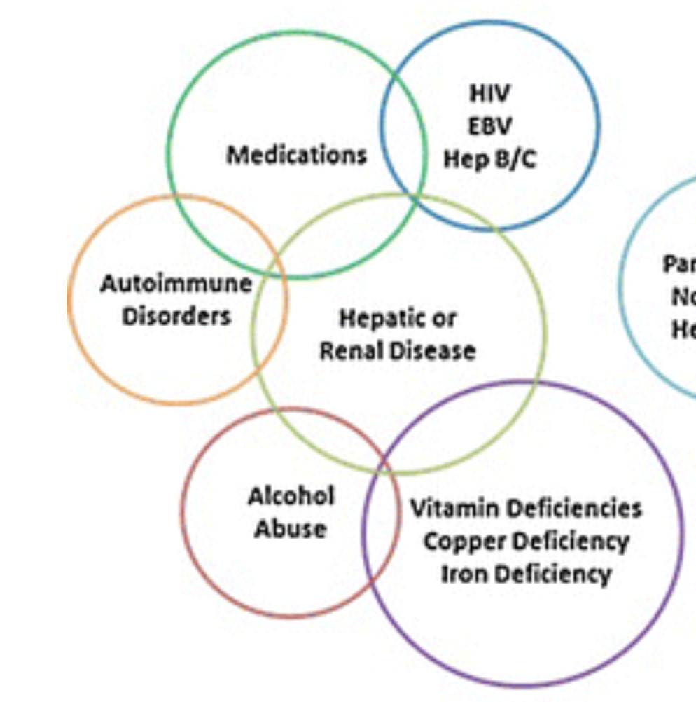
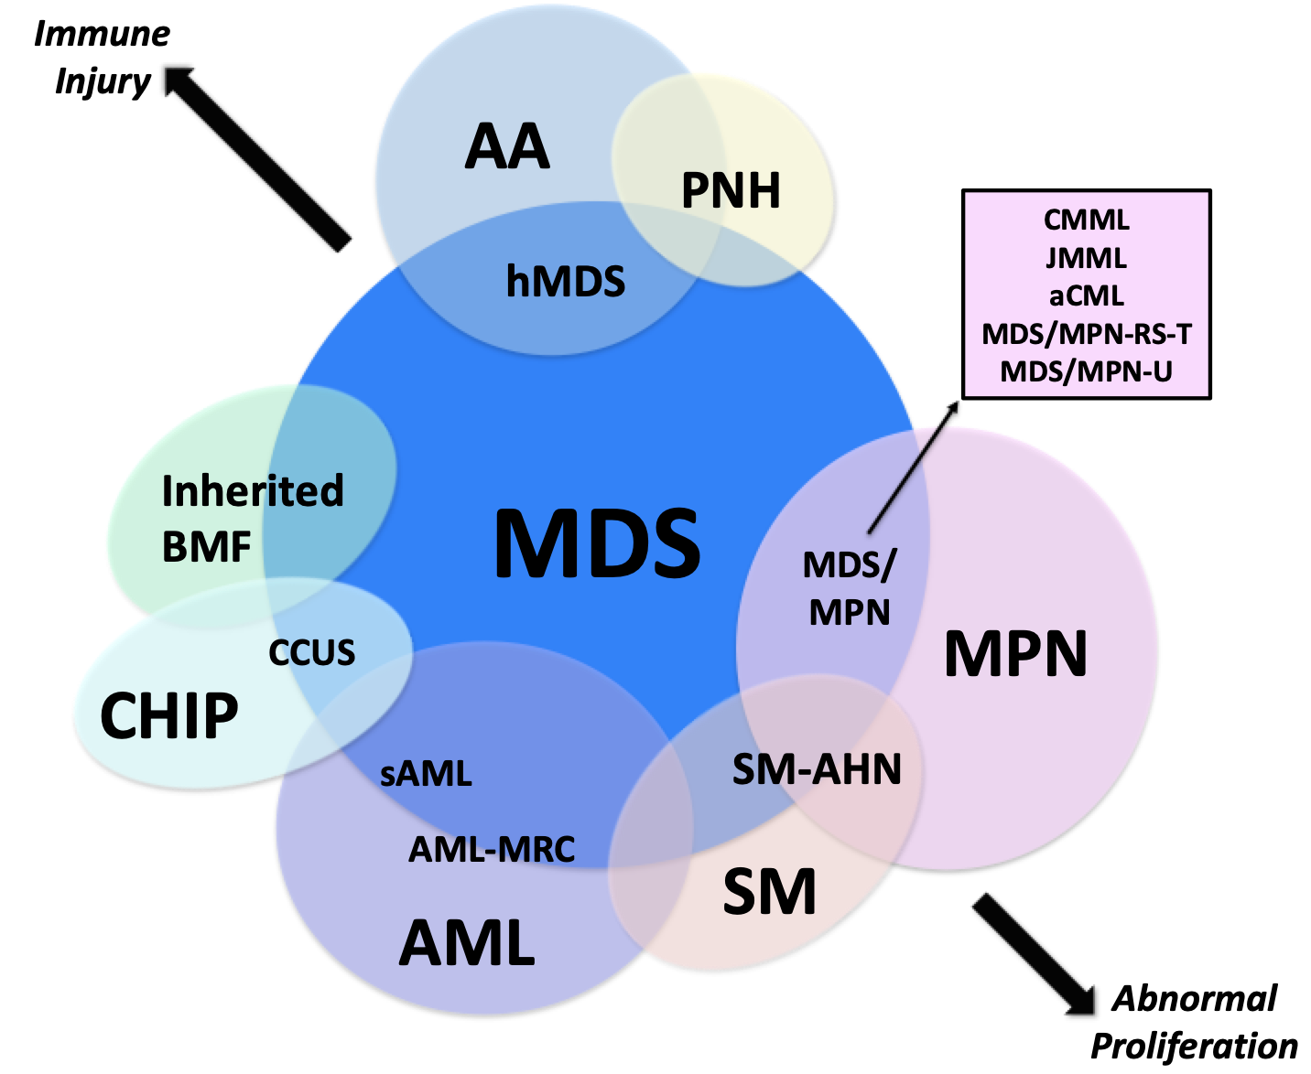
Diagnoses that look like MDS (but aren’t!)
Benign Causes
Non-Benign (“Clonal”) Causes
Bejar, Curr Hematol Malig Rep 2015
Tanaka, Bejar, Blood 2019

Slide 7
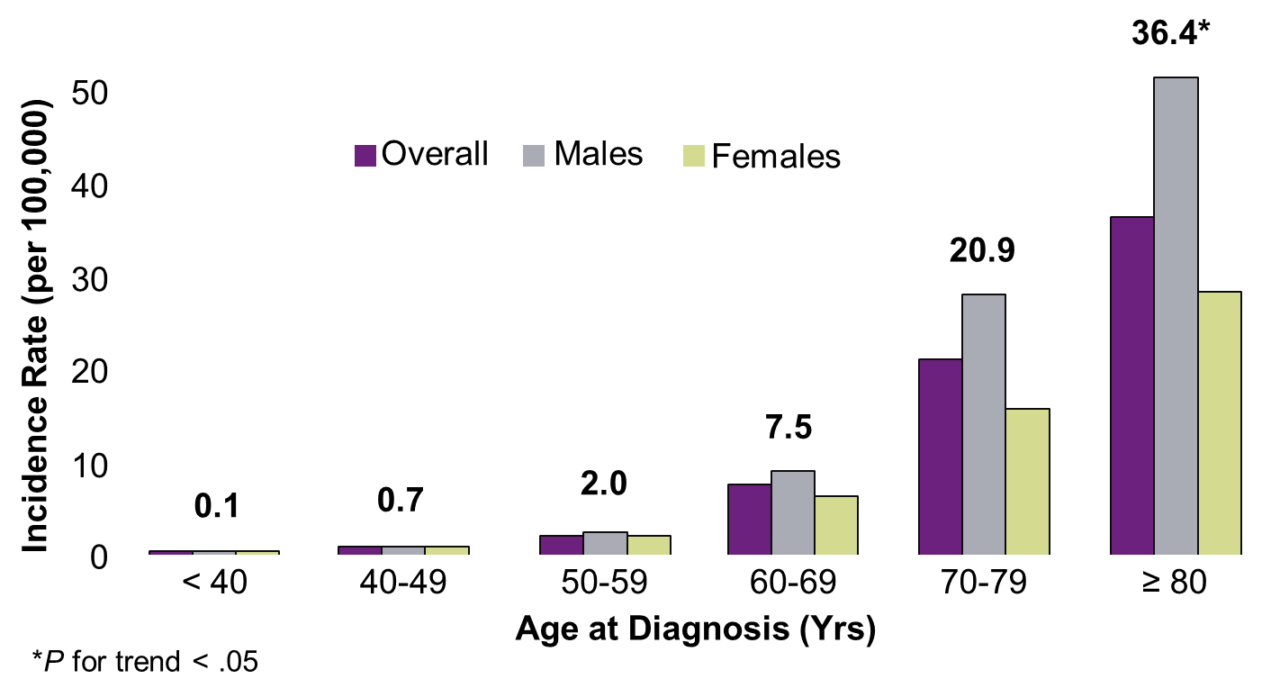
MDS most often occurs in older patients
Median age of diagnosis is 71-76 years
Approximately 20,000 people are diagnosed with MDS yearly
Disease course is variable from indolent to more aggressive and1/3 progress to acute myeloid leukemia (AML).

Slide 8
Types of MDS
Primary (de novo, idiopathic): 90% of all cases
No apparent cause
Secondary: Occurs as a result of damage to DNA from exposure to radiation or chemotherapy used to treat previous cancers or medical conditions
There is a variable time of onset of MDS following exposure, may be 2-10 years
Secondary MDS is often associated with more complex cytogenetic abnormalities

Slide 9
Symptoms
Some patients are asymptomatic and cytopenias are discovered on routine blood work
Others may exhibit symptoms but they vary in degree and are related to the cytopenia
Anemia (low hemoglobin) results in fatigue, pallor, shortness of breath and occasionally chest pain
Anemia is the most common cytopenia in the early stages of the disease

Slide 10
Symptoms (continued)
Neutropenia (low neutrophil count) may result in increased infections
Thrombocytopenia (low platelet count) results in easy bleeding or bruising; i.e. gum bleeding, nose bleeding and/or petechiae (small red spots under the skin)

Slide 11
How is MDS diagnosed?
Medical history
Physical exam
Laboratory studies including CBC, peripheral blood smear, B12, Folate, erythropoietin level, Ferritin and iron studies, copper and thyroid tests
Bone marrow biopsy and aspirate, flow cytometry, cytogenetics and molecular profiling

Slide 12
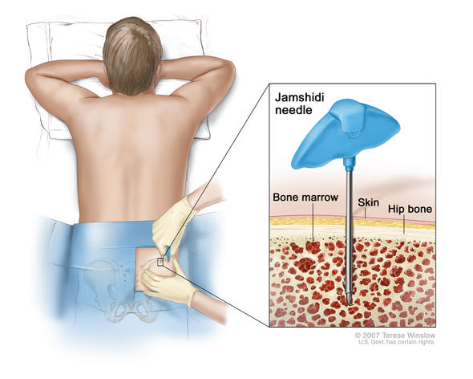
Diagnosing MDS
Ruling out other conditions
Microscopic examination of blood film and bone marrow
Cytogenetics
Molecular Diagnostics
Notes:
Perhaps it is not as relaxing as it looks but it can not be bad as it is done at bed side by a medical person. It is not a massage but usually it is reasonably well tolerated.

Slide 13
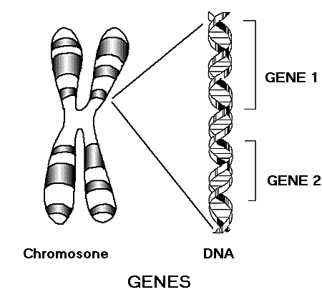
What is a genetic mutation?
A genetic mutation is an alternation in the DNA.
Mutations occur daily in our DNA but they are often fixed by repair enzymes or occur in parts of DNA that do not contain instructions for making a gene, so they are not harmful.
Two big groups of mutations:
- Somatic mutations: Occur in “body” of organism. Not passed down.
- Germ-line mutations: In cells producing gametes. Passed down.

Slide 14
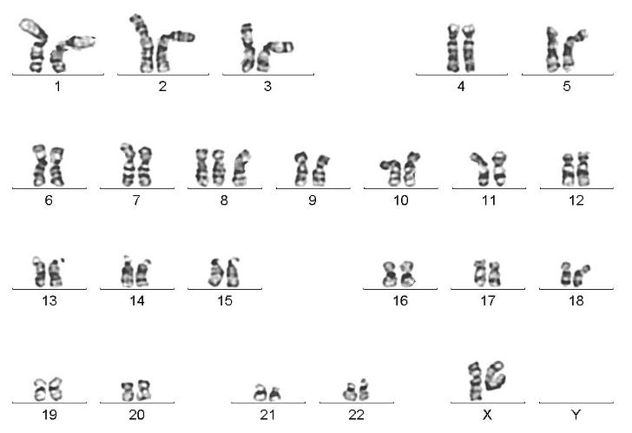
Karyotype Example: Trisomy 8

Slide 15
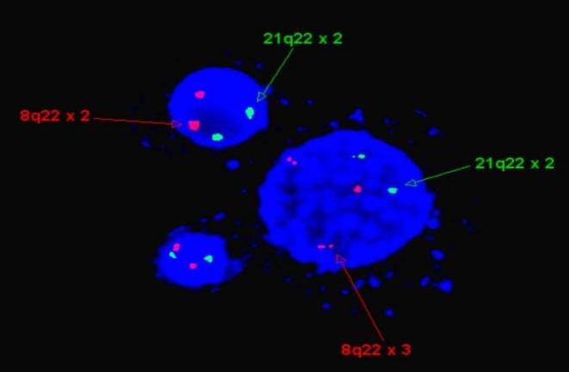
FISH Trisomy 8

Slide 16
Classification and Risk Stratification in MDS
FAB: French-American British
WHO: World Health Organization
IPSS: International Prognostic Scoring System
R-IPSS: Revised IPSS
WPSS: WHO Prognostic Scoring System

Slide 17
FAB Classification
Refractory Anemia (RA)
Refractory anemia with ringed sideroblasts (RARS)
Refractory Anemia with excess blasts (RAEB)
Refractory anemia with excess blasts in transformation (RAEB-T)
Chronic myelomonocytic leukemia (CMML)

Slide 18
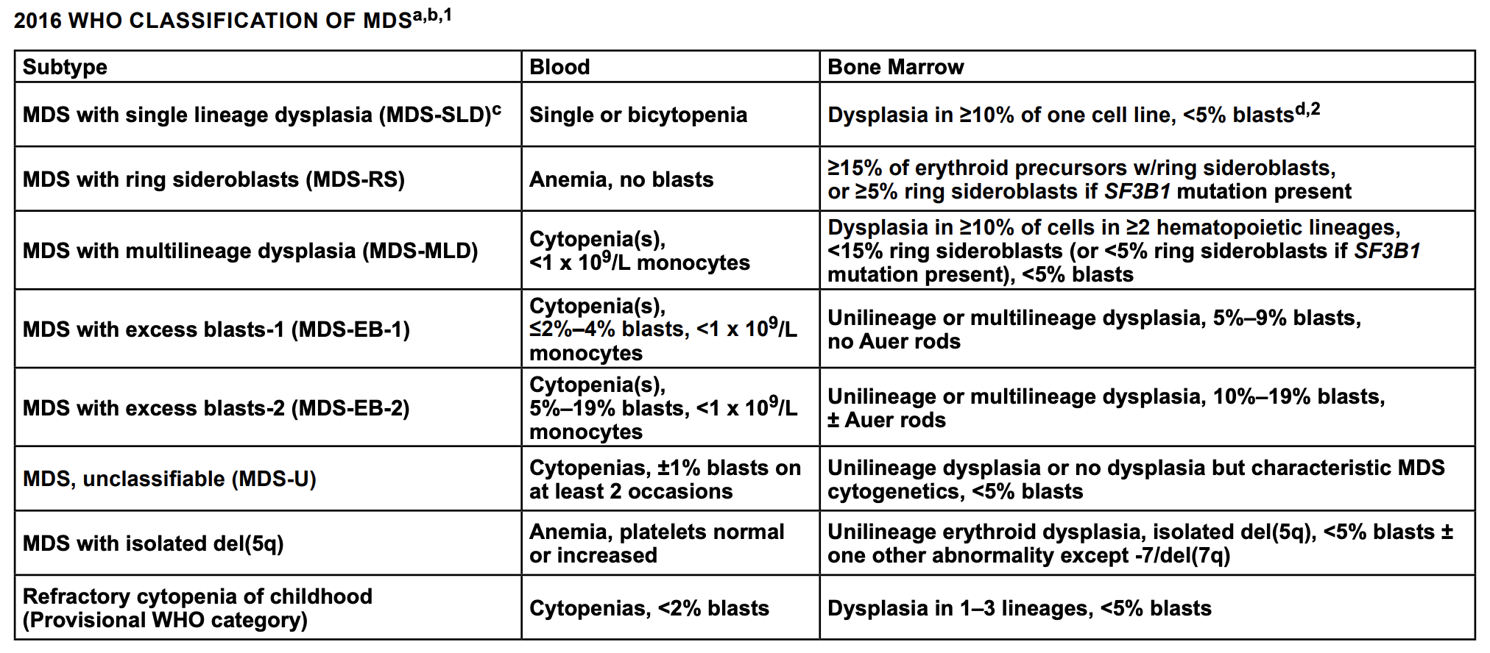
MDS WHO subtypes (based on bone marrow)
MDS patients have “dysplasia” in greater than 10% of bone marrow cells, and less than 20% blasts (leukemia cells)
Arber et al, Blood 2016

Slide 19
What is my MDS stage?
International Prognostic Scoring System, Revised (IPSS-R)
1. Hemoglobin
Red Blood Cells
2. Absolute Neutrophil Count
Type of White Blood Cell
3. Platelet Count
Clotting Cells
4. Bone Marrow Blasts
Leukemia Cells
5. Chromosome Abnormalities
Very Low Risk
Low Risk
Intermediate Risk
High Risk
Very High Risk

Slide 20
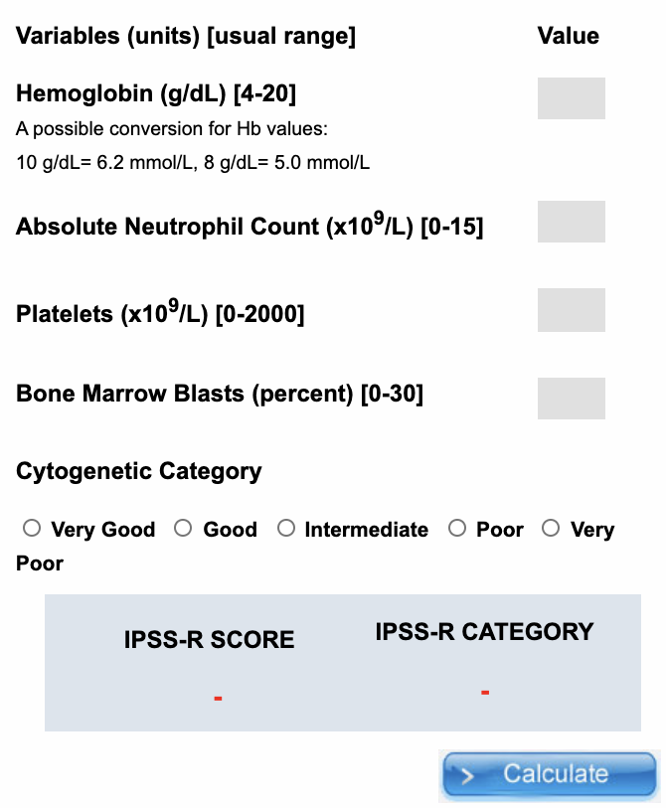
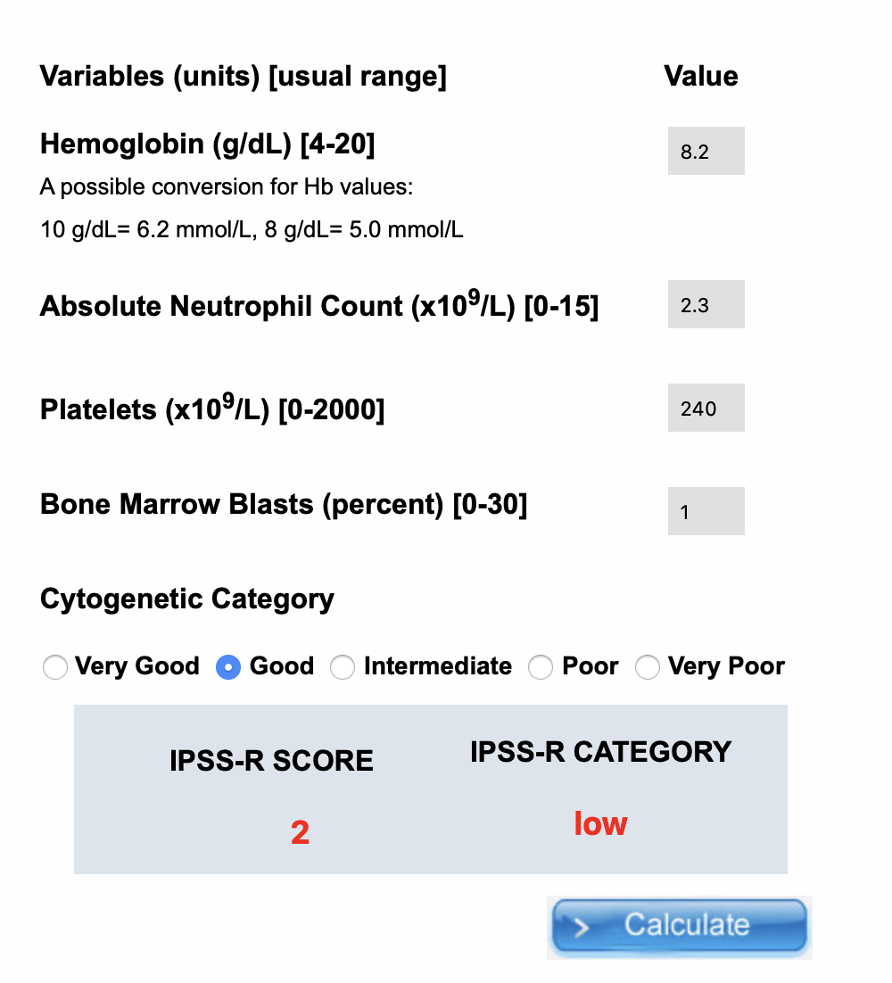
IPSS-R Calculator
Example Patient
Margie is a 78-year-old woman with:
Hemoglobin 8.2 g/dL
Neutrophils 2.3 x 10⁹/L
Platelet 240 x 10⁹/L
Bone marrow biopsy shows:
Blasts 1%
Chromosomes Normal
https://www.mds-foundation.org/ipss-r-calculator/
The lower the score, the better!

Slide 21
Lower Risk = Better Survival
VERY LOW
LOW
INTERMEDIATE
HIGH
VERY HIGH
Bejar et al. Haematologica 2014; Greenberg et al. Blood 2012

Slide 22
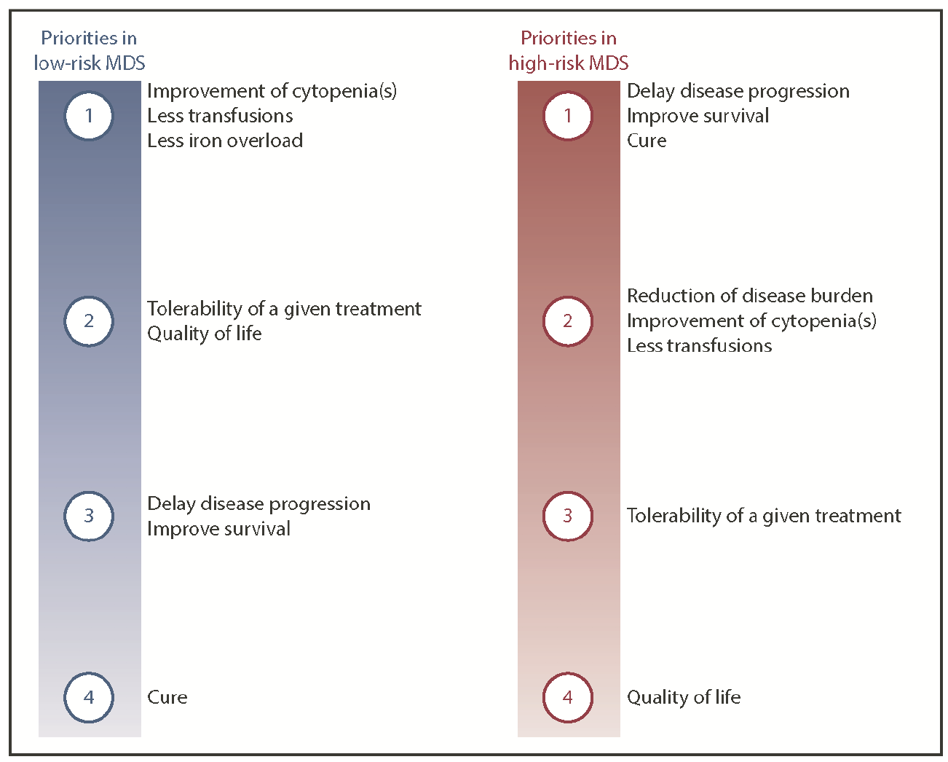
General Approach to Management
Platzbecker et al, Blood 2019

Slide 23
Treatments for Low Risk MDS
Close Monitoring
Supportive Treatment: Blood transfusions, Iron chelation
Erythropoiesis stimulating agents (ESA)
Lenalidomide for del(5q)
Luspatercept for MDS-RS Subtype
Hypomethylating Agents (Azacitidine, Decitabine) might be considered
Immunosuppressive Therapy (ATG, Cyclosporine) in select situations

Slide 24
Anemia
Red blood cell transfusions are often necessary
More than 80% of patients with MDS will need RBC transfusion throughout their lifetime
Transfusion needs vary per individual and may range from 1 unit every 4-12 weeks or 1-2 units weekly.
Transfusions improve patient symptoms and quality of life though chronic transfusions lead to elevated level of iron in the blood and tissues

Slide 25
Iron Chelation
The body has no mechanism to excrete excess iron
Iron chelation therapy (ICT) is the removal of excess iron from the body with the administration of special medications called chelating agents which bind to and promote removal of iron
Duration of chelation therapy may vary. Monitoring of serum Ferritin at least every 3 months is recommended during therapy.
Patient compliance to iron chelation is critical for optimal results

Slide 26
Treating Anemia
Anemia Only
Moderate/
Severe
No Del(5q),
Check Epo Level
Mild
Observe
500 or more:
Luspatercept
Del(5q) Only
Lenalidomide
Less than 500: Epo (ESA)
If no improvement, Luspatercept

Slide 27
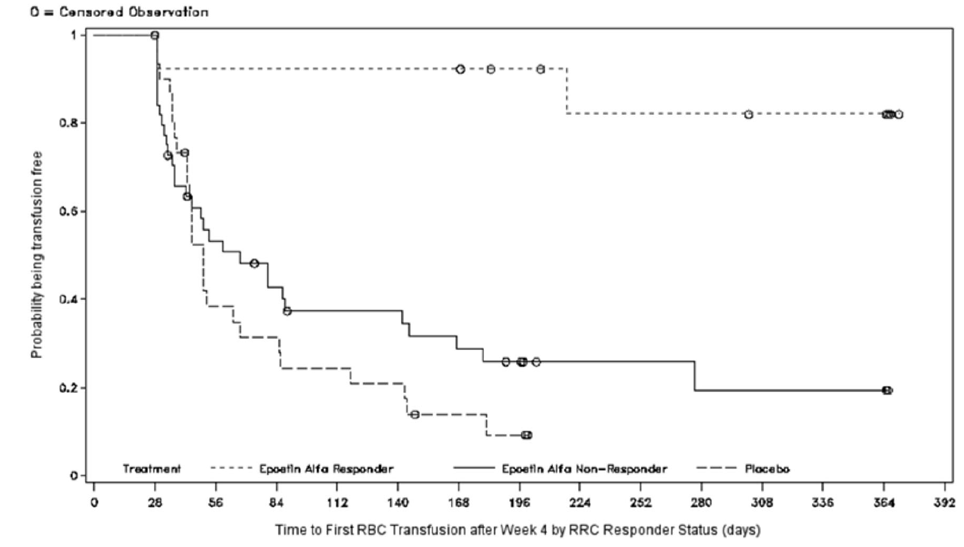
Erythropoiesis-Stimulating Agents (ESA)
Epoetin Alfa or Darbepoietin
Stimulate red blood cell production
Subcutaneous injections every 1-2 weeks
Side effects: headache, joint pain, high blood pressure, thrombosis (rare)
Patients with Epo level below 200 have better responses that last longer
Fenaux et al. Leukemia 2018

Slide 28
Lenalidomide
Lower-risk MDS with del(5q)
Oral (pill)
70% of patients no longer require transfusions
50% of patients experience “cytogenetic response,” where the del(5q) abnormality is no longer found
Side effects: Low blood counts, nausea, diarrhea, fatigue, itching
List et al. N Engl J Med 2006
ASH Image Bank – James Vardiman

Slide 29
Luspatercept
Lower-risk MDS with ring sideroblasts (MDS-RS)
No response to ESA or Epo level above 500
Subcutaneous injection every 3 weeks
38% of patients no longer required transfusions after 6 months
Side effects: Low back pain, fatigue, nausea, diarrhea, dizziness
Fenaux et al. N Engl J Med 2020
Acceleron Pharma

Slide 30
More than anemia?
Thrombocytopenia, Neutropenia, or
Bone marrow blasts
Hypomethylating Agents
(Azacitidine, Decitabine)
If favorable response, continue until progression
Supportive Treatments
No response:
Clinical trial or bone marrow transplant
Immunosuppressive Therapy

Slide 31
Hypomethylating (HMA) Therapy
Azacitidine, Decitabine
IV, SQ (*oral decitabine-cedazuridine)
Blood counts initially worsen, more transfusions needed
Slow responses in most (4-6 months)
Treatment schedule
Azacitidine day 1-7, every 28 days
Decitabine day 1-5, every 28 days
Side effects: nausea, constipation, worsened blood counts
Fenaux et al. Lancet Oncol 2009
Fenaux et al., Lancet Oncol 2009
Fenaux et al., Lancet Oncol 2009
Fenaux et al., Lancet Oncol 2009

Slide 32
Things you can do to manage symptoms
Fatigue (anemia)
Allow for rest periods. Ensure a good nights sleep
Exercise, take short walks
Allow others to help with tasks
Use additional services when available such as grocery shopping, ie Peapod
Bleeding (thrombocytopenia)
Use a soft toothbrush
No flossing if platelet count is low
Use an electric razor
Avoid injury and clutter as not to bump into things
Do not take supplements that can increase risk of bleeding

Slide 33
Things you can do to manage symptoms (continued)
Infection (neutropenia)
Good hand washing
Keep intimate space
Do not share utensils or drinking glasses
Eat foods that are well washed and well cooked
Avoid crowds
Monitor temperature
Take preventative antibiotics as prescribed

Slide 34
How about treatment?
There are several treatment options but the mainstay of treatment is supportive care
Goals of treatment are to manage symptoms, improve quality of life, improve overall survival, avoid complications and reduce progression to AML
Treatment decision are varied based on severity of disease, age, performance status, comorbidities, and an individual persons goals and lifestyle.

Slide 35
You should be a full partner in your care
Know your blast count, blood counts, classification of MDS, and your IPSS/ IPSS-R risk category
Ask about different treatment options, risks and benefits including possibility of bone marrow transplant and clinical trials
Look for resources and support groups: YOU ARE NOT ALONE—Family, friends, AAMDSIF, MDS Foundation, Leukemia and Lymphoma Society, etc

Slide 36
Acknowledgements
Questions?
adp9002@med.cornell.edu
MDS Clinical Research Consortium
Dennis Cooper Award

