Slide 1
Understanding High Risk MDS to AML: 2021
Dale G. Schaar, MD, PhD Heme Malignancies & Stem Cell Transplant Rutgers Cancer Institute of New Jersey

Slide 2
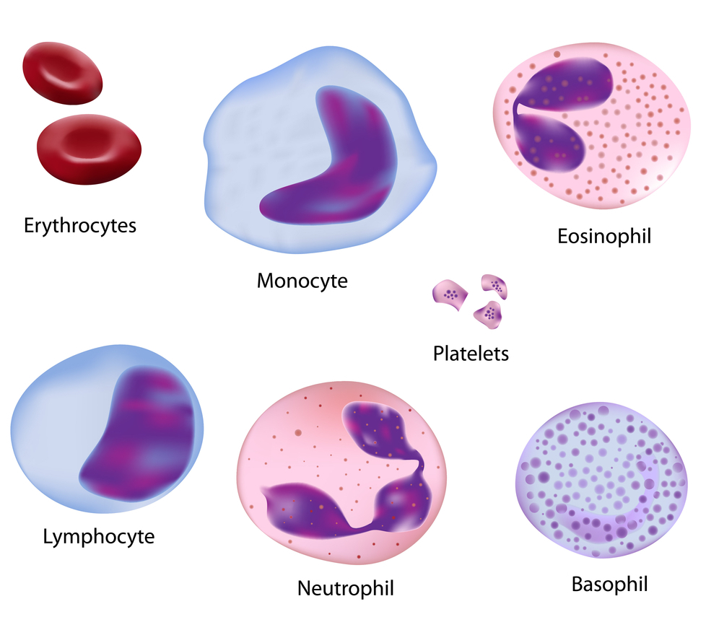
Normal blood cells
MDS/AML Background
https://www.medicalsciencenavigator.com/physiology-of-self-renewal/

Slide 3
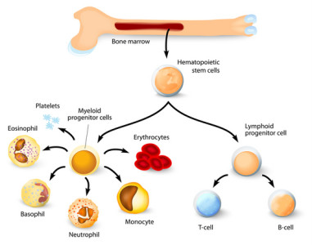
MDS/AML Background
https://www.medicalsciencenavigator.com/physiology-of-self-renewal/

Slide 4
High Risk MDS to AML

Slide 5
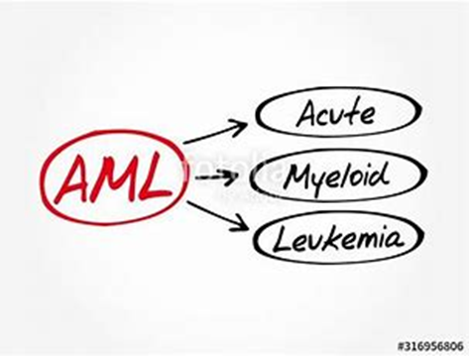
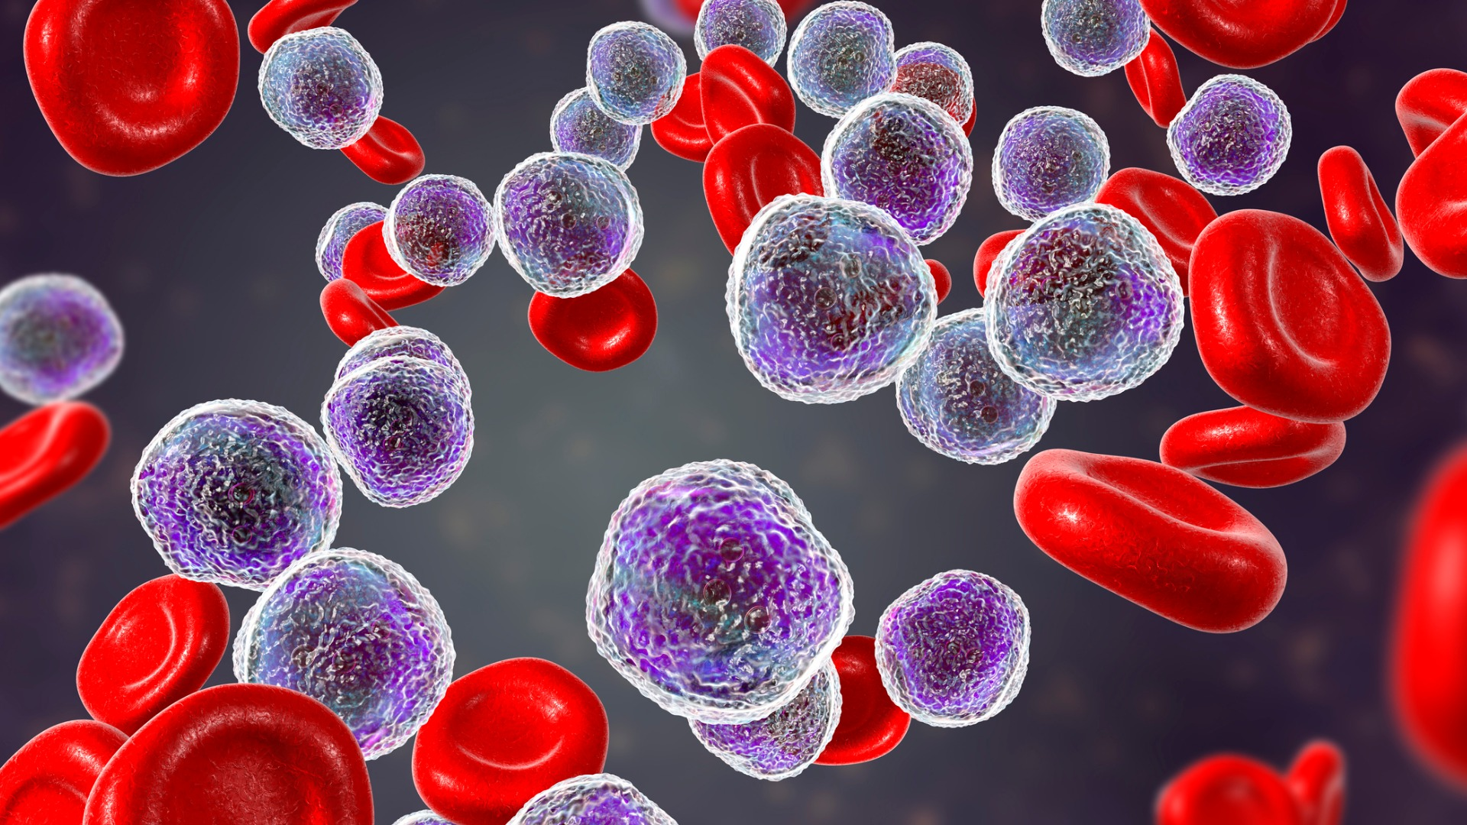
AML
MDS/AML Background
Normal blood cell types and numbers changed significantly by leukemia cells (blue)

Slide 6
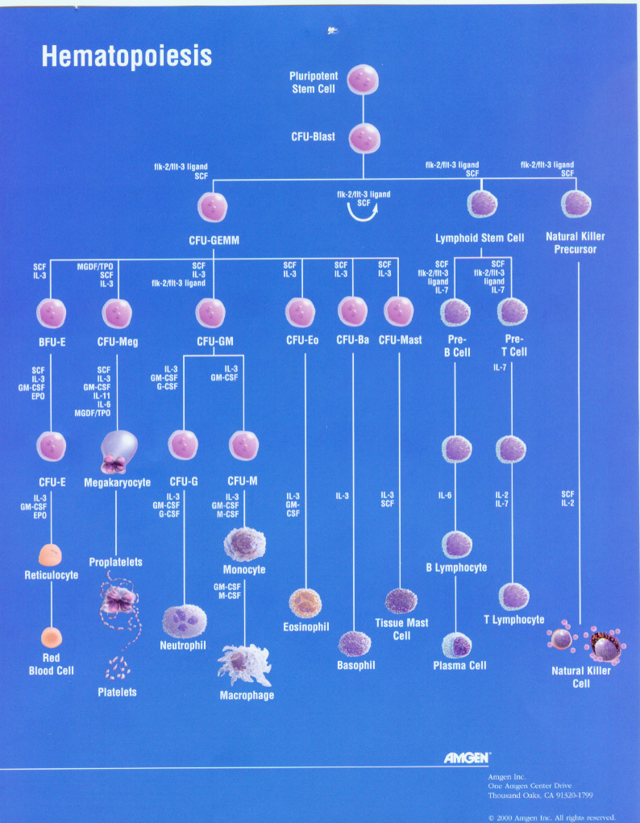
MDS/AML Background

Slide 7
How did I get this?
There are a few known causes of MDS and AML
A handful of germline mutations (DDX41, RUNX1, GATA2)
Familial syndromes (Li Fraumeni syndrome-autosomal dominant disorder caused by TP53 mutations)
Prior chemotherapy
Prior radiation
Treatment for autoimmune disorders
Prior hematologic disorders (Myelodysplasia, myeloproliferative disorders)
Implicated exposures to DNA-damaging agents (occupational, environmental)
Causes mostly not clear

Slide 8
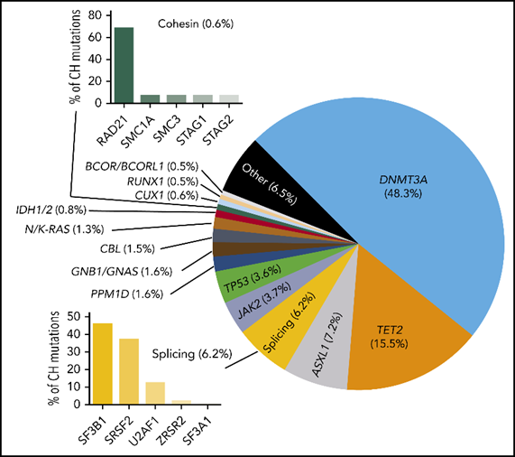
Developing a dominant stem cell: ARCH and CHIP
How did I get this?
ARCH- Age-related clonal hematopoiesis, part of aging process, most do not lead to a blood cancer
Risk for accumulating more mutations or “mistakes”.
Therefore risk factor for developing a blood cancer.
Also increased risk for cardiovascular disease (in concert with other risk factors such as smoking, HTN).
CHIP= clonal hematopoiesis of indeterminate potential
Mutation in a leukemia-associated gene; VAF= 2%.
CHIP present in 10-20% people by age 70.
Detected in nearly everyone by 50 with highly sensitive sequencing methods
Absolute risk estimated between 0.5 and 1% per year
Blood. 2020 Oct 1;136(14):1623-1631. doi: 10.1182/blood.2019004291.

Slide 9
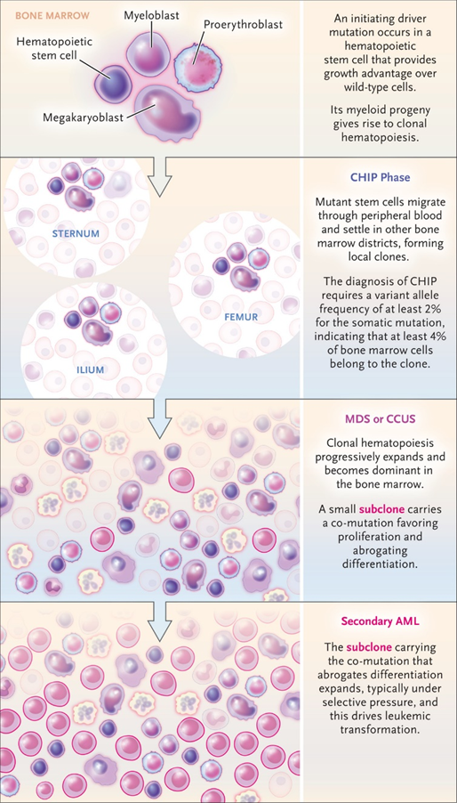
M Cazzola. N Engl J Med 2020;383:1358-1374.
How did I get this?

Slide 10
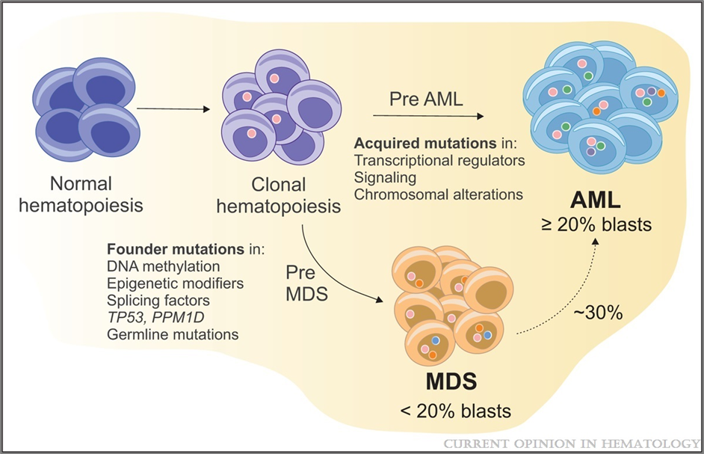
MDS/AML Background
Current Opinion in Hematology. 28(2):101-109, March 2021. doi: 10.1097/MOH.0000000000000629

Slide 11
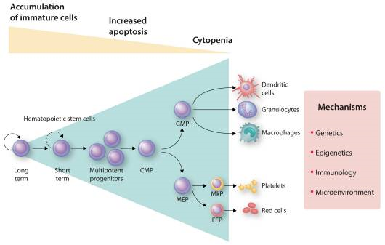
MDS/AML Background
Haematologica. 2020 Jul;105(7):1765-1779. doi: 10.3324/haematol.2020.248955. Epub 2020 May 21.

Slide 12
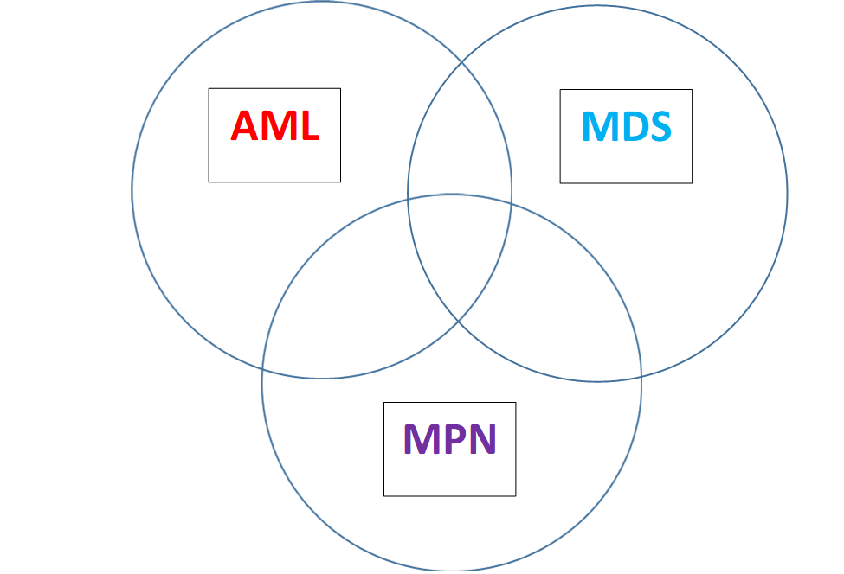
MDS/AML Background

Slide 13
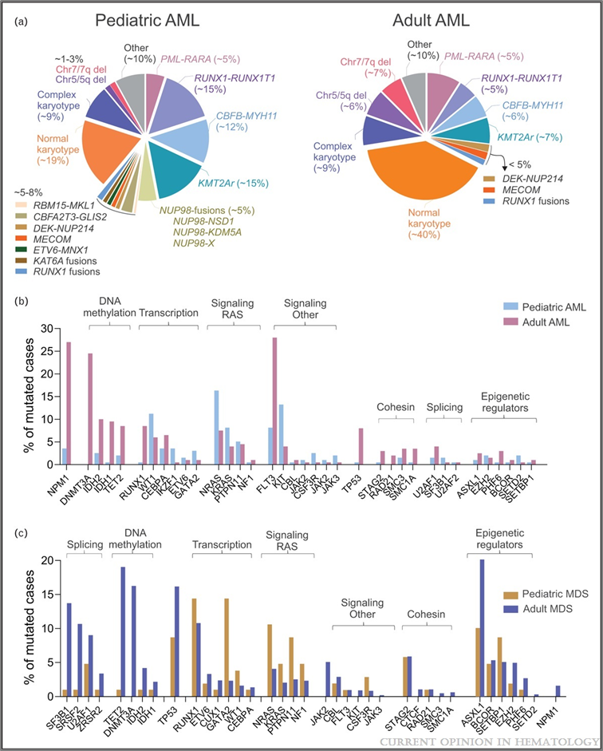
MDS Background
Current Opinion in Hematology. 28(2):101-109, March 2021. doi: 10.1097/MOH.0000000000000629

Slide 14
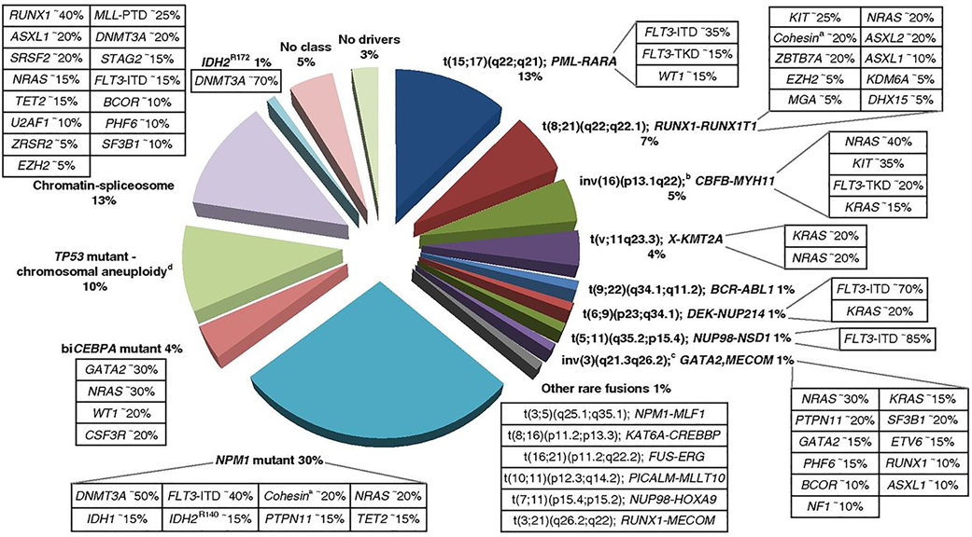
MDS/AML work up

Slide 15
International Prognostic Scoring System-Revised (IPSS-R)
Doctors also use the IPSS-R score, a recent update of the IPSS, assigning patient risk into 5 groups.
The IPSS-R covers the same disease factors as the IPSS, but the factors are identified in a more detailed way.
The IPSS-R shows 5 disease factors (blasts, cytogenetics, hemoglobin, absolute neutrophil count, and platelet count.
Very low
Low
Intermediate
High
Very high

Slide 16
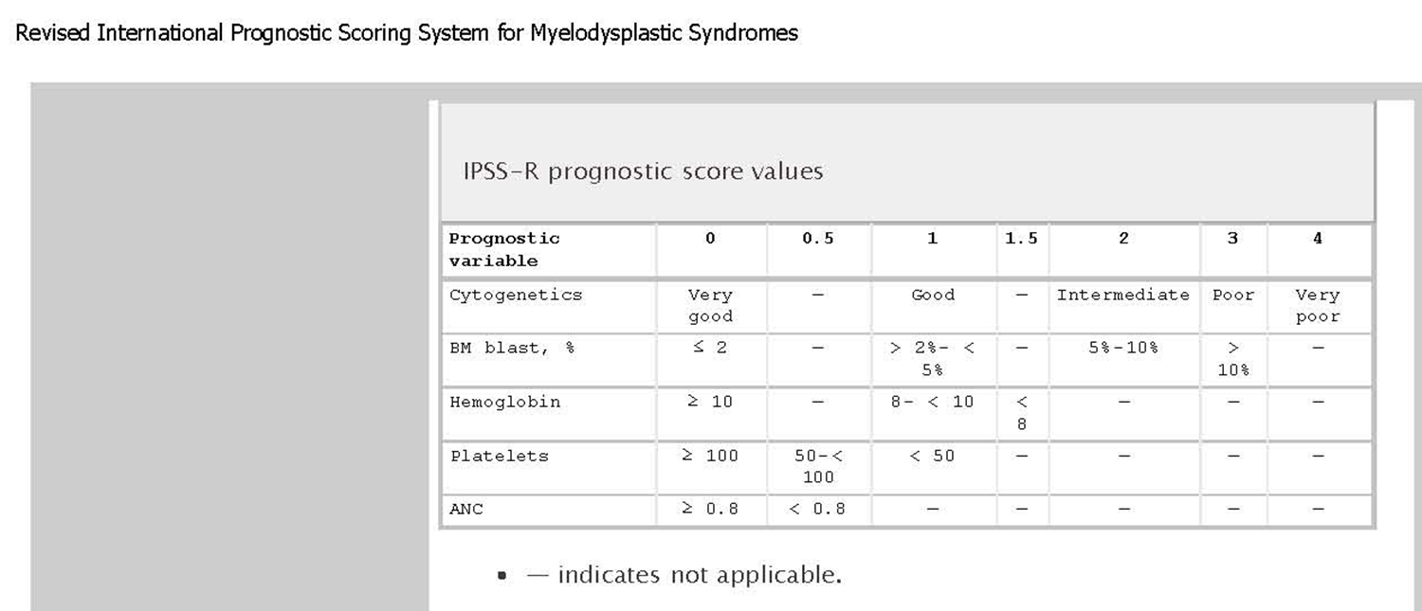
MDS work up
Greenberg, et al. (2012) Blood 120:2454-2465.

Slide 17
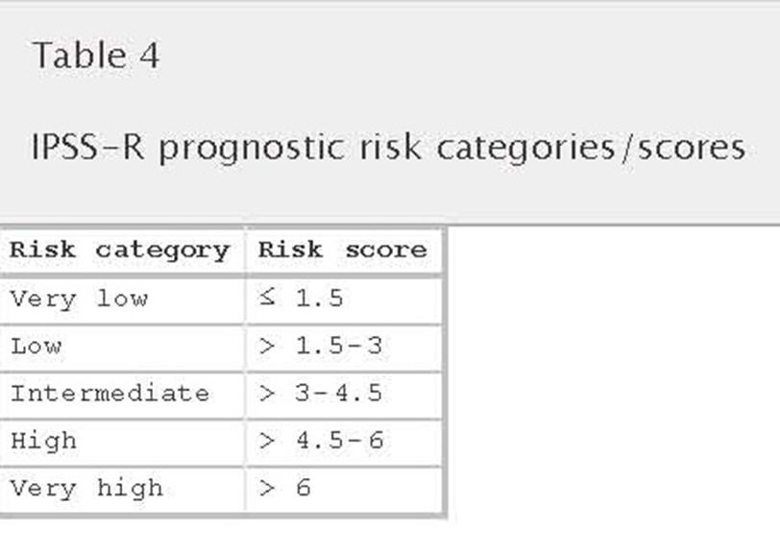
MDS work up
Greenberg, et al. (2012) Blood 120:2454-2465.

Slide 18
MDS/AML Work up: the next level
Laboratory work up to identify characteristics that impact treatment choice
Evaluation for mutations that are targetable
IDH1 or IDH2 mutations
Chromosome 5q deletion

Slide 19
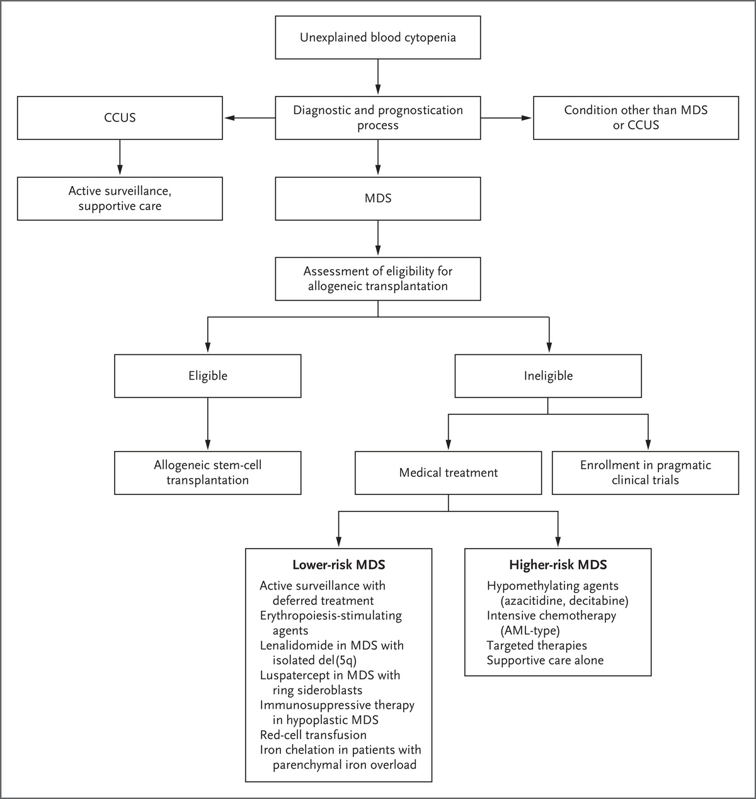
Overview of MDS Management
M Cazzola. N Engl J Med 2020;383:1358-1374.

Slide 20
MDS Treatment Modalities
Indication to treat: symptomatic cytopenias.
Supportive
Transfusions, antibiotics
Low intensity
Growth factors, hypomethylating agents, immunosuppressive therapy.
Improve symptoms, quality of life; not curative.
High intensity
Combination chemotherapy
Allogeneic transplant
Capacity to alter disease course.
High-very high IPSS-R scores.
Summarized in UpToDate.com and NCCN guidelines

Slide 21
High Risk MDS to AML

Slide 22
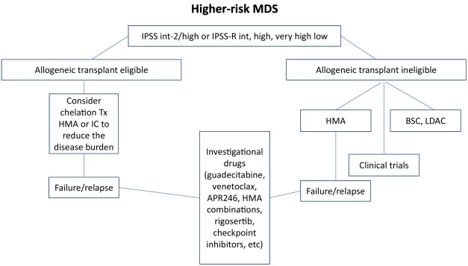
AML work up and treatment
MDS/AML Treatment
Blood Rev. 2021 Jan;45:100689. doi: 10.1016/j.blre.2020.100689. Epub 2020 Mar 31.

Slide 23
Hypomethylating Agents (HMA)
Azacitidine- first to significantly impact MDS
Significantly better median overall survival
Significantly better two-year survival rates
Less toxicity (eg, grade 3 to 4 cytopenias and length of hospitalization)
Survival benefit seen in all prognostic groups, age>75.
Unclear if there is a difference between AZA or decitabine

Slide 24
Hypomethylating Agents (HMA)
Decitabine- very similar to azacitidine; question schedule
Guadecitabine, a second-generation DNA methylation inhibitor (more stable drug)
Oral decitabine and cedazuridine (ASTX727; INQOVI®) is a unique fixed-dose combination of the hypomethylating agent decitabine, the active ingredient in Dacogen ®, and the novel cytidine deaminase inhibitor, E7727 (cedazuridine)
Oral azacitidine (Onureg®)

Slide 25
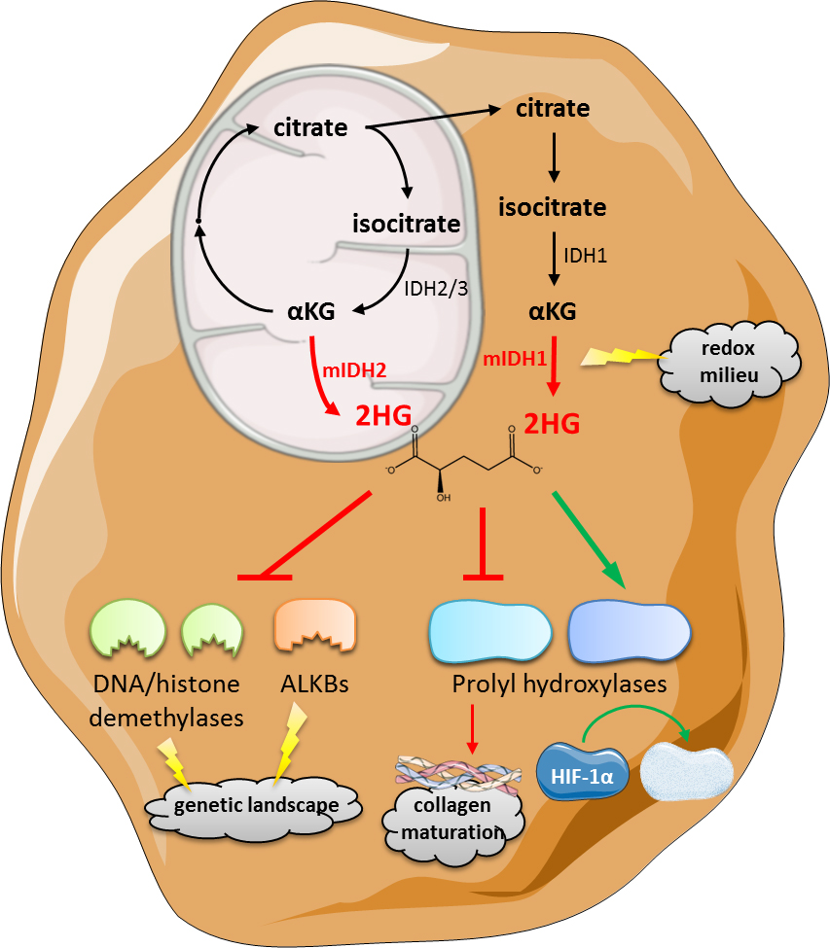
New Developments in MDS/AML
Isocitrate Dehydrogenase (IDH) 1 and 2 Inhibitors
Ivosidenib (IDH1 inhibitor)
Enasidenib (IDH2 inhibitor)
Developed for relapsed/refractory AML
Overall response 30-40% (CR, CRp, less transfusion dependence)
Bridge to transplant
Future adding in combination (ie. HMA)
Immunometabolism.2019;1:e190007.https://doi.org/10.20900/immunometab20190007
Reviewed in Clin Lymphoma Myeloma Leuk. 2020 Jun;20(6):341-350.

Slide 26
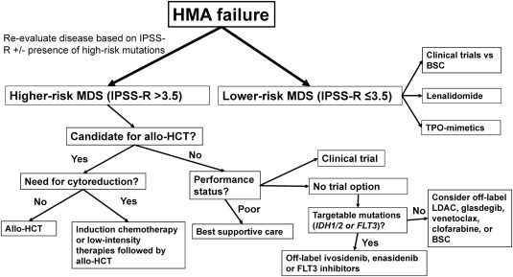
Hypomethylator (Vidaza®/Dacogen®)Failure
Best Pract Res Clin Haematol. 2021 Mar;34(1):101245. doi: 10.1016/j.beha.2021.101245

Slide 27
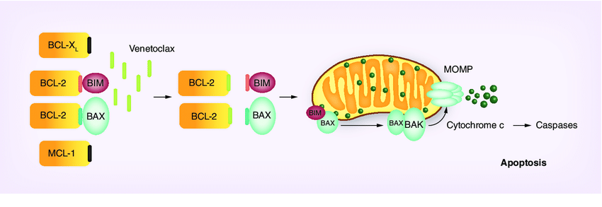
New MDS/AML Developments: Venetoclax
Venetoclax- huge advance
First shown to be important in chronic lymphocytic leukemia (CLL)
Studied in AML due to BCL2 over-expression in resistant disease.
“Elderly” AML- age>60. Very difficult to treat for various reasons that both disease-specific and patient-specific.
For patients not candidates for intensive induction chemotherapy
Impressive results when conbined with low dose cytarabine, decitabine or azacitidine.
Studies ongoing adding venetoclax to upfront therapies and in younger patients.
Reviewed in Clin Lymphoma Myeloma Leuk. 2020 Jun;20(6):341-350.

Slide 28
New developments in AML
3+7 induction has been standard of care in AML induction for >4 decades
A handful of new drugs have been successfully added to this back bone
After several years of scientific advancement and development at least 8 new drugs have been approved for AML therapy
Future work directed towards incorporating these new drugs into existing AML therapies (ie. upfront, as maintenance and in which populations that would derive the most benefit)

Slide 29
Advanced MDS/AML Treatment: Induction
Intensive:
3+7
CPX-351
FLAG-ida
Less intensive:
Venetoclax plus hypomethylators (Decitabine or azacitidine)
Venetoclax plus low dose cytarabine
Ivosidenib (IDH1)/Enasidenib (IDH2)
Glasdegib (hedgehog inhibitor) plus low dose cytarabine

Slide 30
New Developments in advanced MDS/AML
CPX-351 (Vyxeos®).
Drug is an optimized ratio of 5:1 cytarabine and daunorubicin in 100 nm diameter liposomes.
Preferentially taken up by leukemic cells.
Longer drug exposure.
Older patients (60-75 years) with therapy-related AML, prior MDS or CMML and de novo AML with MDS-related changes benefited.
People treated with CPX-351 got to transplant and post-transplant survival was higher.
Studies ongoing to see if larger populations will benefit from CPX-351
Reviewed in Clin Lymphoma Myeloma Leuk. 2020 Jun;20(6):341-350.

Slide 31
Hematopoietic Stem Cell Transplant
MDS patients with a high (>4.5 to 6 points) or very high (>6 points) IPSS-R score merit assessment for allogeneic transplant
Timing of HSCT?
For low and Int-1risk:
appearance of new cytogenetic abnormality
development of clinically significant cytopenia
progression to a higher IPSS group.
For Int-2 and high risk: at time of diagnosis.

Slide 32
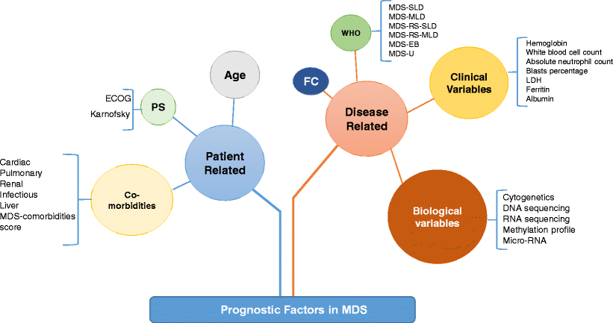
Hematopoietic Stem Cell Transplant
Curr Hematol Malig Rep. 2017 Aug 26. doi: 10.1007/s11899-017-0407-9. [Epub ahead of print]

Slide 33
Hematopoietic Stem Cell Transplant
Evaluation for hematopoietic stem cell transplant
Disease response (typically need a decrease in the number of bone marrow blasts)
Availability of a suitable donor.
Support- financial/psychosocial
The ability to follow up (physically and mentally).
Underlying medical problems.
Performance status
Age

Slide 34
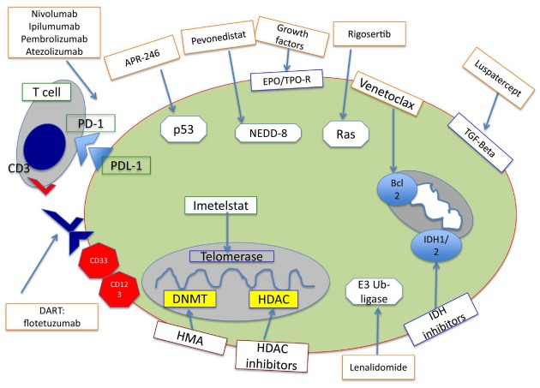
Possible New Therapeutic Approaches
Blood Rev. 2021 Jan;45:100689. doi: 10.1016/j.blre.2020.100689. Epub 2020 Mar 31.

Slide 35
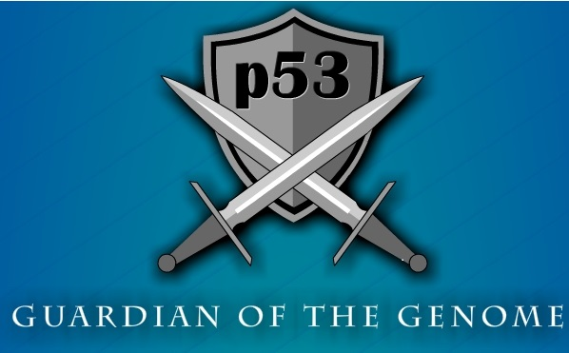
TP53: The Guardian of the genome
https://ricochetscience.com/infographic-p53-guardian-genome/

Slide 36
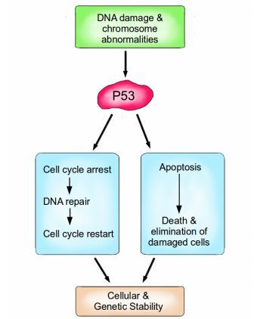
TP53 Mutations
These mutations common in secondary MDS
Also in some patients with deletion 5q
Very serious marker
Associated with resistance to standard chemotherapy
https://www.ewg.org/research/hallmarks-cancer
https://blogs.scientificamerican.com/guest-blog/introduction-to-the-hallmarks-of-cancer/

Slide 37
p53- Directed Therapies
APR-246- a drug that corrects mutated (damaged) p53 by restoring its original conformation.
Need a p53 mutation
Won’t work in p53-deleted disease
ALRN-6924- a drug that interferes with p53 interactions with inhibitors of it’s function, thereby re-activating p53’s tumor suppression in MDS/AML cells.
Reviewed in Haematologica. 2020 Jul;105(7):1765-1779. doi: 10.3324/haematol.2020.248955. Epub 2020 May 21.

Slide 38
“Do not eat me" Signal: CD47
Immunotherapies being developed in MDS and AML
Two arms of the immune system
Adaptive immune system (B cells, T cells)
Innate immune system (phagocytic- ie. Macrophages, granulocytes)
Macrophage checkpoint- CD47
Molecule/antibodies being developed to block CD47
Front Oncol. 2020 Jan 22;9:1380. doi: 10.3389/fonc.2019.01380. eCollection 2019.

Slide 39
“Do not eat me" Signal: CD47
Initial study done in patients with solid tumors and refractory AML.
Monoclonal antibody that blocks the CD47 signal.
MDS/AML cells express high levels of CD47 making it a therapeutic target for these diseases.
Early results in clinical trials show very promising responses in MDS.
Patients with p53 mutations or loss also responded strongly.
Trials ongoing for untreated MDS patients.
Transfusion. 2019 Jul;59(7):2248-2254. doi: 10.1111/trf.15397. Epub 2019 Jun 10
J Clin Oncol. 2019 Apr 20;37(12):946-953. doi: 10.1200/JCO.18.02018.

Slide 40
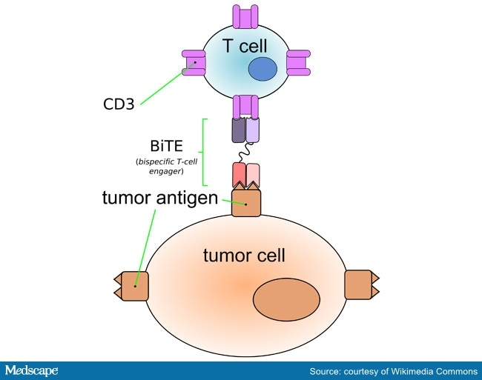
Therapies on the MDS/AML Horizon
Flotetuzumab- a bispecific dual-affinity retargeting (DART) antibody-based molecule to CD3ε and CD123.
Overall response (CR/CRh/CR with incomplete hematological recovery) of 30%
BITE antibodies seeing positive results in other blood cancer, such as lymphoma.
Important advancement in chemotherapy-refractory disease
Blood. 2021 Feb 11;137(6):751-762. doi: 10.1182/blood.2020007732.

Slide 41
Immune check point inhibitors
Blood Rev. 2021 Jan;45:100689. doi: 10.1016/j.blre.2020.100689. Epub 2020 Mar 31.

Slide 42
New Approaches: Combinations
Azacitidine plus venetoclax
Azacitidine plus magrolimab
Azacitidine plus APR-246
Azacitidine plus Ipilimumab
Azacitidine plus Nivolumab
Azacitidine plus Pevonedistat
Azacitidine plus MBG543
Reviewed in Guillermo Garcia-Manero,et al .https://doi.org/10.1002/ajh.25950

Slide 43
The End!

