Slide 1
Understanding Transplant for Bone Marrow Failure Diseases
Celalettin Ustun, MD
Rush University
Division of Hematology-Oncology-Cell Therapy
Director, Section of Cell Therapy
The Aplastic Anemia and MDS International Foundation A virtual patient and family conference September 11, 2021

Slide 2
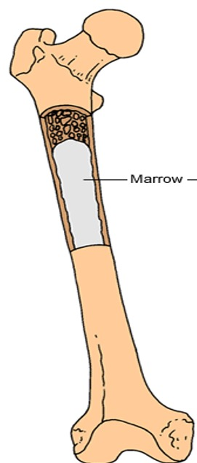
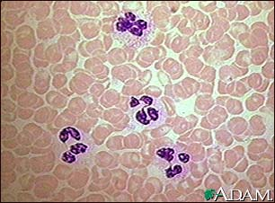
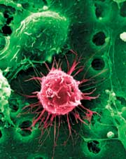
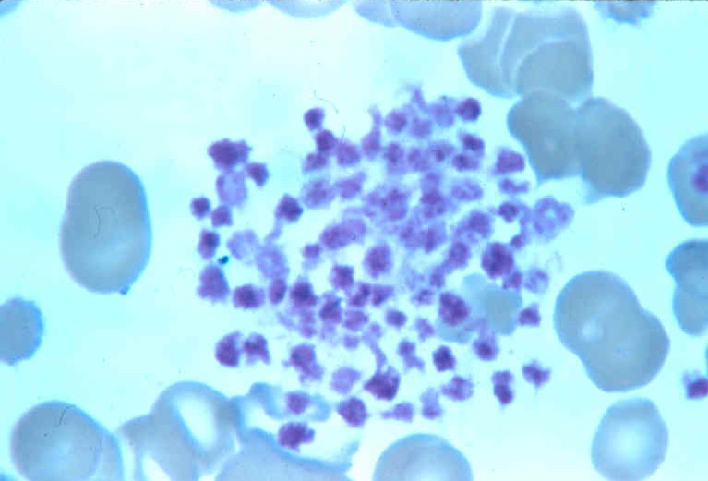
Bone Marrow, Stem Cells, Blood Cells
Weakness. SOB-Red Blood cells
Infection-White Blood cells
Bleeding-Platelets

Slide 3
N. Alkhouri and S. Ericson. Semanticscholar.org

Slide 4
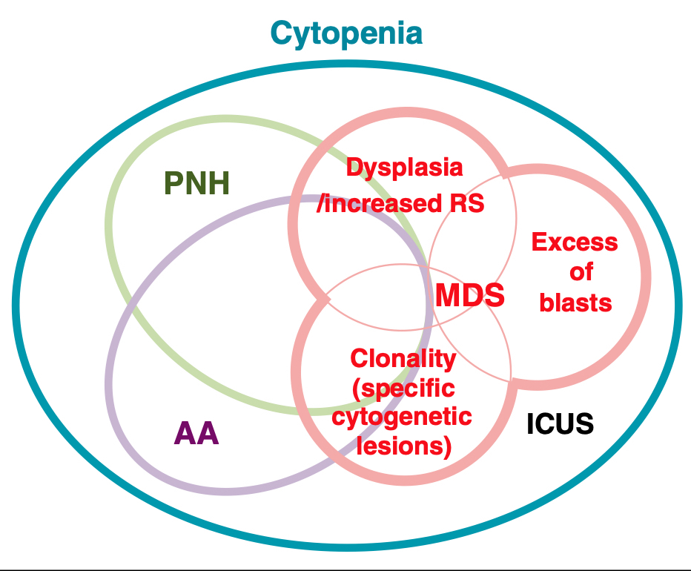
BMF Syndromes
MLL.com 2021
S Ogawa Blood 2016.

Slide 5
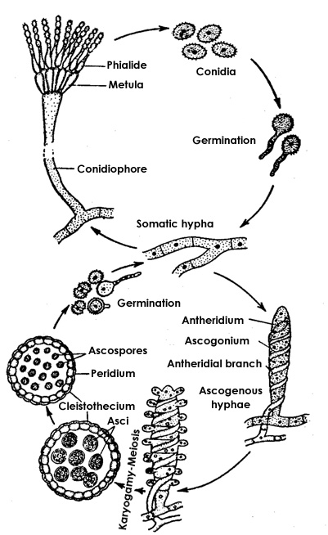
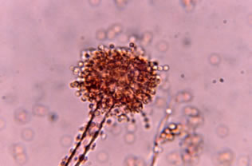
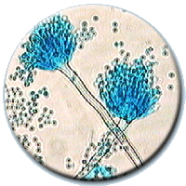
Aspergillus at various stages of its life cycle:
More specific

Slide 6
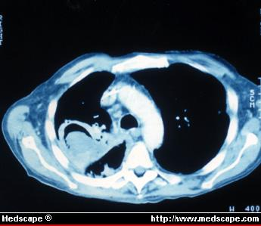
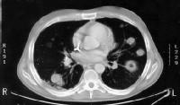
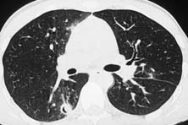
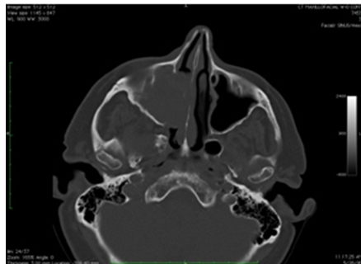

Slide 8
Allogeneic Transplantation: Stem Cell Source
Bone Marrow Harvest
Stem Cell Collection from Blood

Slide 9
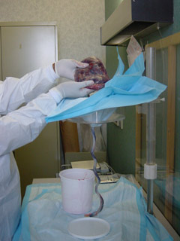
Allogeneic Transplantation: Donor Source, UCB
Is there another source of stem cells?
Yes, Cord Blood

Slide 10
Allogeneic HCT Recipients in the US, by Donor Type
Notes:
Slide 4: Upon further stratifying the number of allogeneic transplants recipients in the US by donor type, recipients of unrelated donor transplants represent the largest group. The number of unrelated donor (URD) transplants has surpassed the number of allogeneic transplants from related donors after 2006 and the gap between these two types of approaches peaked in 2012. After 2012, the numbers of URD and HLA-identical siblings transplants has shown a downward trend in absolute numbers. Transplants performed with alternative donors is increasing. From 2003 to 2011, there were a steady increase in the numbers of transplants using umbilical cord blood as a result of several published studies demonstrating its benefit in both children and adults. From 2012 onward, there was an increase in the numbers of transplants from ‘Other Relatives’, likely due to the use of haploidentical donors with post-transplant cyclophosphamide strategy. In 2014, the numbers of transplants using ‘Other Relatives’ surpassed the total numbers of umbilical cord transplant performed in the US, accounting for 11% of all allogeneic transplants performed in the US. In 2016, this is the only group of donor type that is increasing with all other donor types showing decline or stability in use.

Slide 11
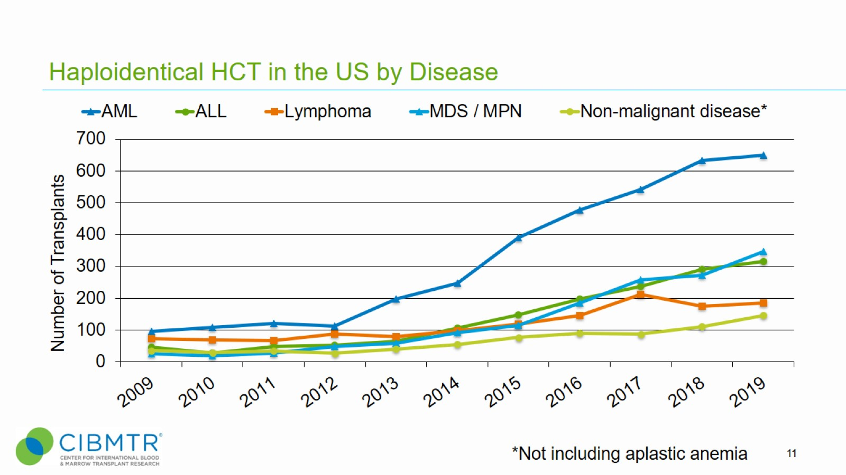
Haploidentical HCT in the US by Disease
Notes:
Slide 11: Diseases for which haploidentical transplant use is increasing include acute myeloid leukemia, acute lymphoblastic leukemia, myelodysplastic syndromes/myeloproliferative neoplasms, and non-malignant diseases.

Slide 12
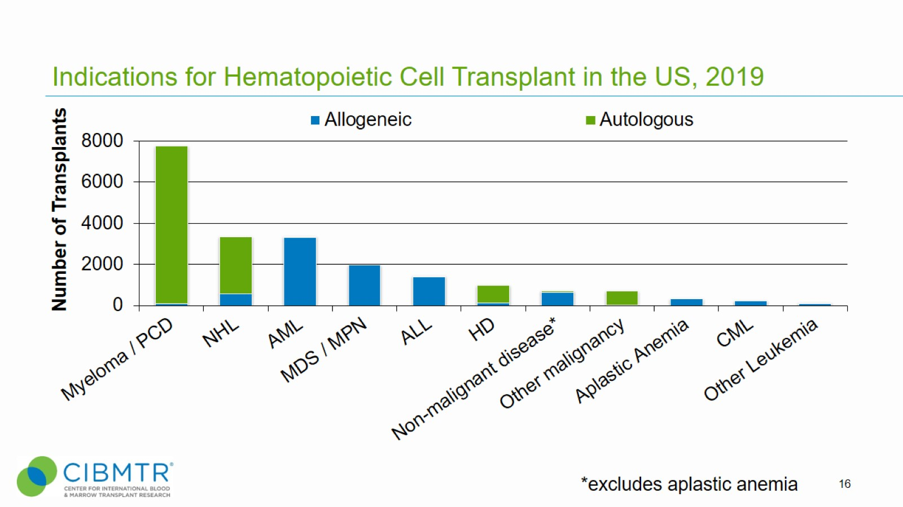
Indications for Hematopoietic Cell Transplant in the US, 2019
Notes:
Slide 16: The most common indications for HCT in the US in 2019 were multiple myeloma and lymphoma (NHL and HD) accounting for 37% of all HCTs. Acute leukemias (AML, ALL) and MDS (combined with MPNs) are the most common indications for allogeneic transplants accounting for 76% of allogeneic HCTs. MDS/MPN transplants have increased after the availability of Centers for Medicare and Medicaid Services (CMS)-approved Coverage with Evidence Development studies allowing allogeneic HCT in Medicare-insured patients for MDS (since 2010) and myelofibrosis (since 2017).

Slide 13
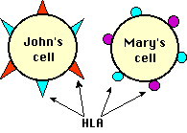
Allogeneic Transplantation: Patient-Donor HLA Matching

Slide 15
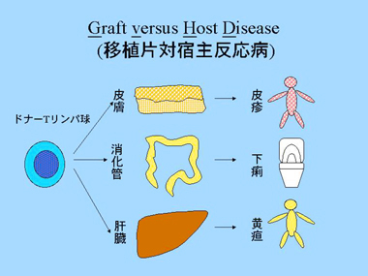

Slide 16
Allogeneic Transplantation: Late Complications
Growth retardation (children)
Infertility (sperm banking, egg banking)
Cataracts (Radiation, steroids)
Osteoporosis (steroids)
Thyroid dysfunction (radiation)
Development of secondary cancers

Slide 17
MDS is a Progressive, Spectrum of Diseases
MDS
Low Risk High Risk (Pre-Leukemia) AML

Slide 18
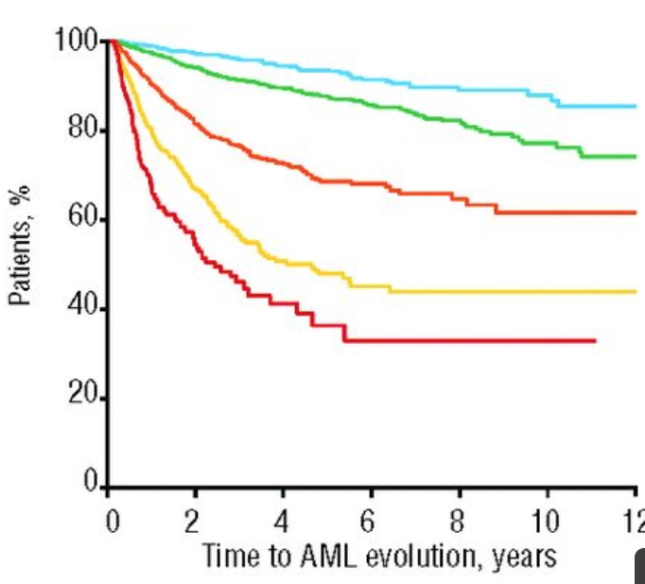
Greenberg et al Blood 2012

Slide 19
Greenberg et al Blood 2012

Slide 20
Koreth et al JCO 2013.

Slide 21
AlloHCT vs. Chemotherapy
Age 50-75 years
Intermediate-2 or high-risk de novo MDS.
The primary outcome was OS at 3 years.
Between January 2014 and November 2018, 384 enrolled subjects at 34 centers.
Patients were assigned to the Donor or No-Donor arms according to the availability of a matched donor within 90 days of study registration.
Donors: HLA-matched Siblings or URD
Nakamura et al JCO 2021

Slide 22
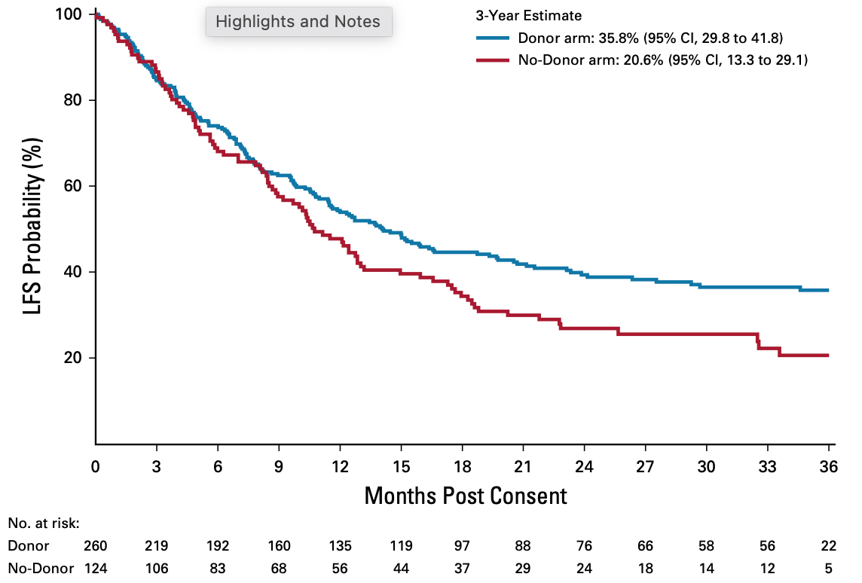
OS LFS
47.9%
47.9%
26.6%
47.9%
Nakamura et al JCO 2021

Slide 23
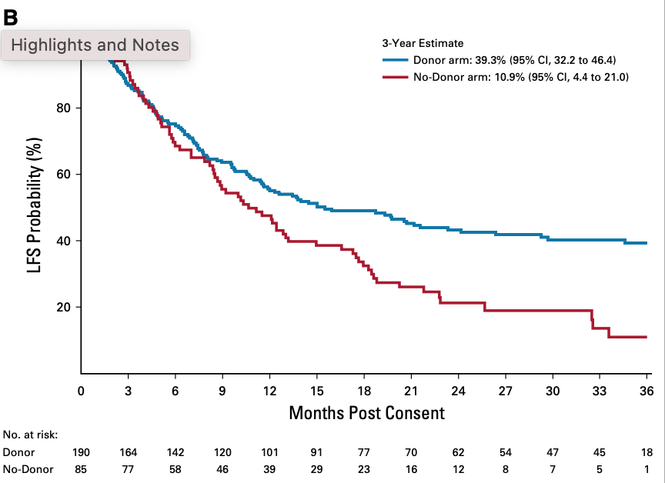
Survival was Even Better with AlloHCT Among Patients Actually Who Have Received Therapy
Nakamura et al JCO 2021

Slide 24
AlloHCT was Superior in almost all Subgroups
Nakamura et al JCO 2021

Slide 25
Major AlloHCT Complications
TRM
At 100 day was 7.4%
At 1-year was 15.5%
Severe acute graft-versus-host disease (grade III-IV acute GVHD) at day 100 was 17%
chronic GVHD was observed in 63 patients, only 23 had severe chronic GVHD.
Despite chronic GVHD in some patients, at all time points, the quality of life (QOL) scores were similar in each cohort.
Nakamura et al JCO 2021

Slide 26
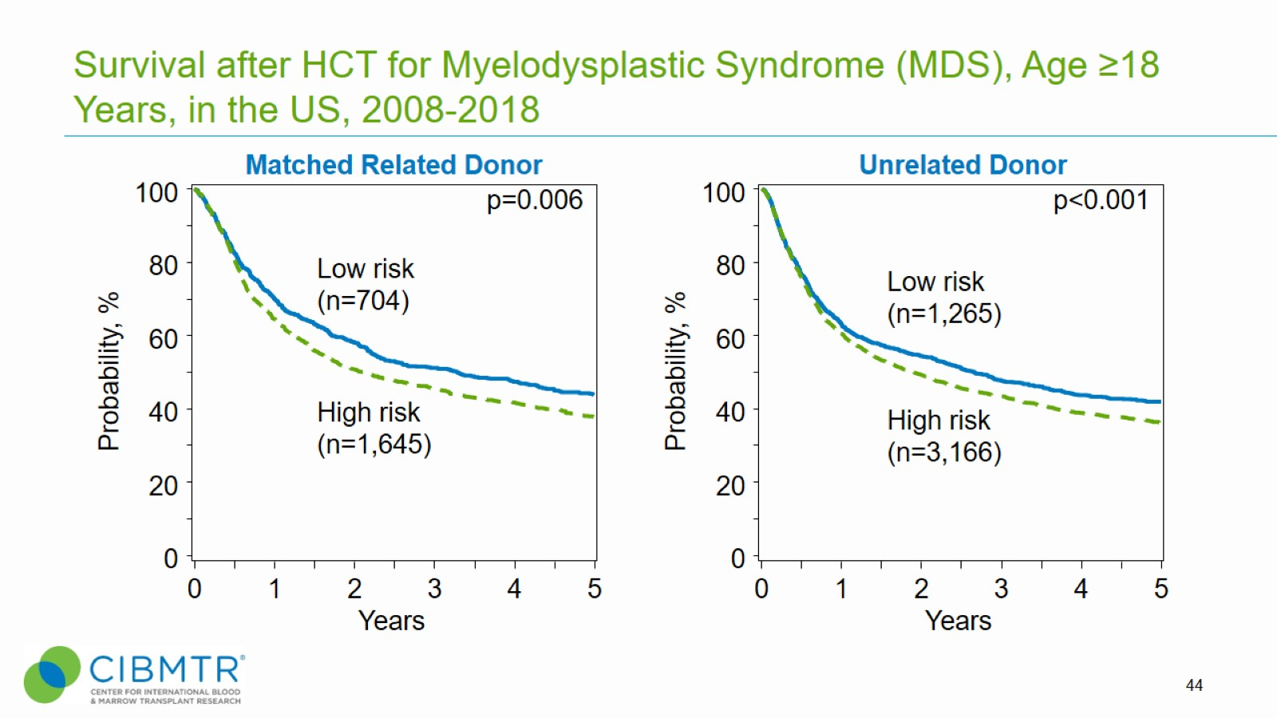
Survival after HCT for Myelodysplastic Syndrome (MDS), Age ≥18 Years, in the US, 2008-2018
Notes:
Slide 44: Allogeneic transplant is a potentially curative treatment for myelodysplastic syndrome (MDS). Outcomes differ according to disease status at the time of transplant. The CIBMTR has data on 6,780 patients receiving an allotransplant for low risk (n=1,969) and high risk (n=4,811) MDS performed between 2008 and 2018. The 3-year probabilities of survival were 51% ± 2% and 44% ± 1% for recipients of sibling and unrelated donor transplants for low risk MDS, respectively. Among patients with high risk MDS, corresponding probabilities were 46% ± 1% and 43% ± 1%.
Reference for MDS classifications:
https://higherlogicdownload.s3.amazonaws.com/ASBMT/43a1f41f-55cb-4c97-9e78-c03e867db505/UploadedImages/ASBMT_RFI_2018B_CIBMTR_Disease_Classifications.pdf

Slide 27
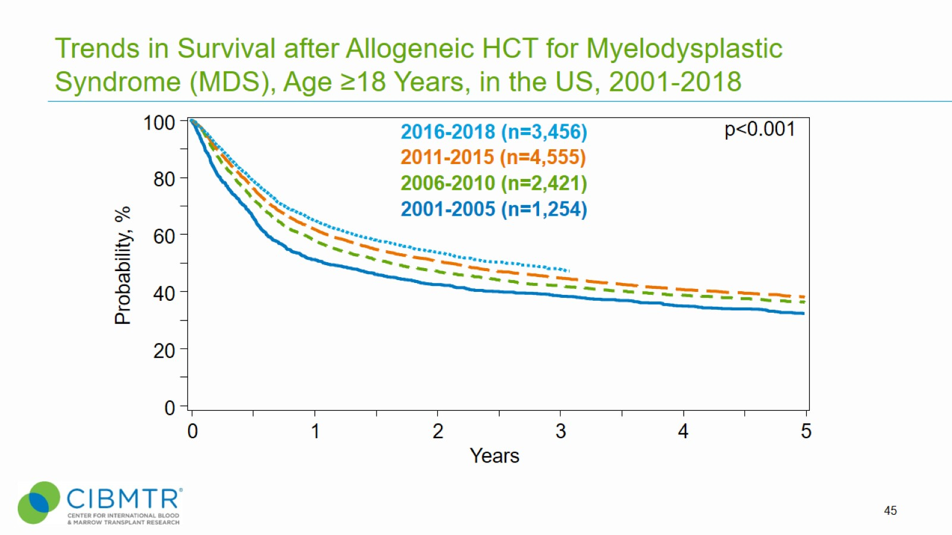
Trends in Survival after Allogeneic HCT for Myelodysplastic Syndrome (MDS), Age ≥18 Years, in the US, 2001-2018
Notes:
Slide 45: Survival after allogeneic HCT for MDS shows slight improvements over time in the early 0-3 years post-transplant phase. The 3-year survival was 38% ±1, 42% ±1, 45% ±1, and 48% ±1 of the transplants that were performed in 2001 to 2005, 2006 to 2010, 2011 to 2015, and 2016 to 2018, respectively.

Slide 28
Why Aren’t We Doing Much More HCT in MDS?
Provider-perceived challenges
Lack of awareness of the indications, age and comorbidity criteria, donor options and process of transplant among community hematologists/oncologists
Potential revenue loss if patient is sent to the tertiary center; patient may choose to get all treatment including hypomethylating agents at that center
Lack of care coordination
Financial barriers to transplantation and need for in-network insurance
Lack of clarity on posttransplant care when patient transitions back to hematologist and/or oncologist
Patient-perceived challenges
Perceptions about high risks of transplantation without putting them in context for benefits
Social barriers: language, cultural, literacy issues in understanding complex care plans; lack of trust in the system
Need for transportation and lodging benefits especially if distant from transplant center
Lack of caregiver
Lack of insurance/undocumented patients
Lack of optimal donors especially for patients with underrepresented racial and ethnic backgrounds
Warlick/Khera et al Cancer 2021

Slide 29
How to Improve?
Warlick/Khera et al Cancer 2021

Slide 30
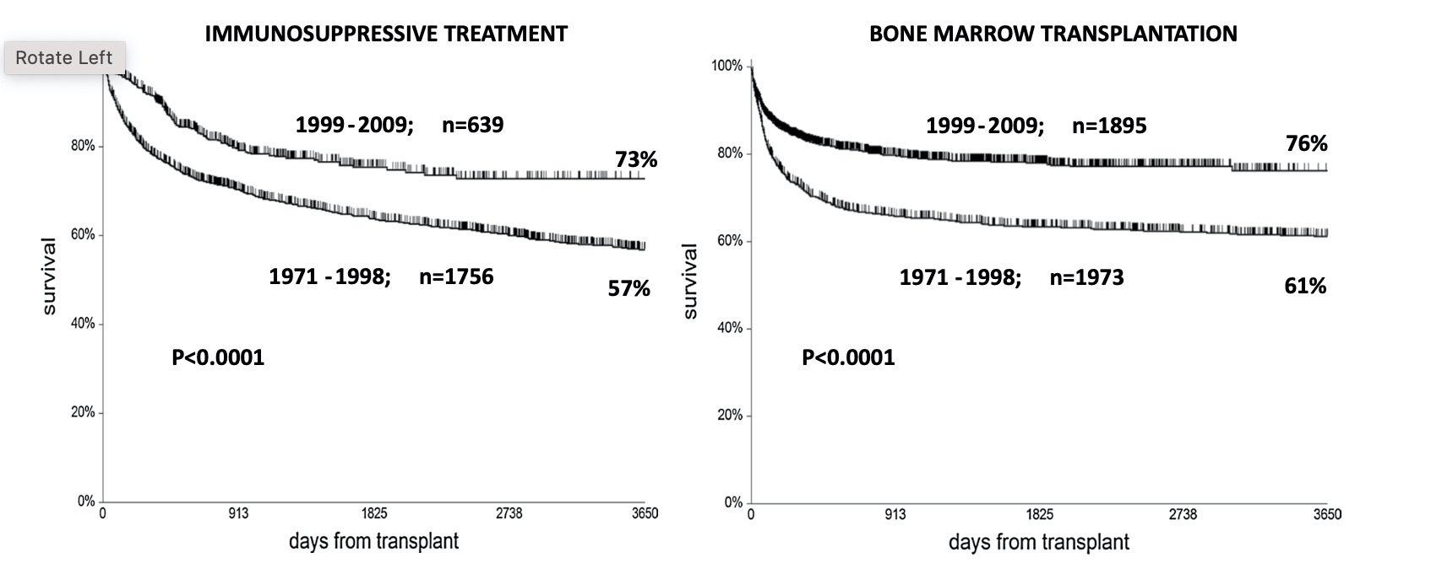
Treatment Outcomes Have Improved Over Time
Bacigalupo et al Int J Haem 2016

Slide 31
ISP or BMT (HCT) in More Recent Era?
An EBMT Study of 6293 patients with SAA
Of Note: Definition of AA Severity
Very severe (vSAA) (<0.2 neutrophils/10^9/L),
Severe (SAA) (0.2–0–5 × 10^9/L),
Non-severe (nSAA) (>0.5 × 10^9/l).
Bacigalupo et al Int J Haem 2016

Slide 32
SAA patients treated with either IST or BMT First-Line –An EBMT study
Subsequent HCT increased in IST group
First HCT increased
Bacigalupo et al Int J Haem 2016

Slide 33
Comparison of IST vs. BMT in patients Age 1–20 years
Bacigalupo et al Int J Haem 2016

Slide 34
Comparison of IST vs. BMT in patients Age 21-40 years
Bacigalupo et al Int J Haem 2016

Slide 35
Comparison of IST vs. BMT in patients Age >40 years
Bacigalupo et al Int J Haem 2016

Slide 36
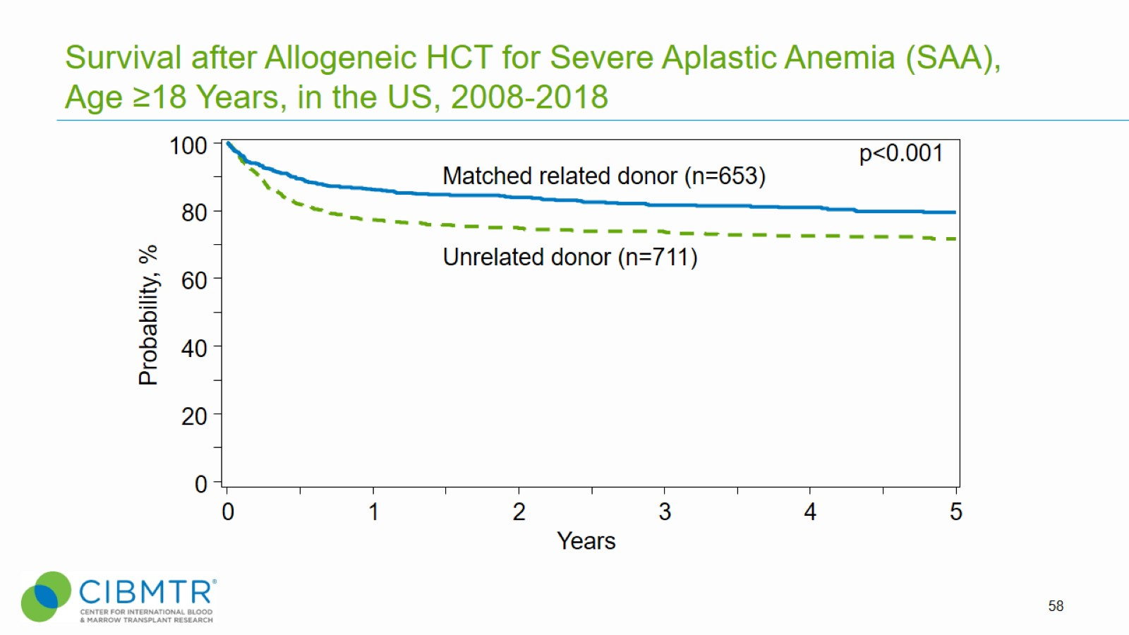
HCT Outcomes: Related vs. Unrelated Donor Matters
Related
The 5-year probabilities of survival after Sib HCT was 80-91%
Unrelated
The 5-year probabilities of survival after URD HCT was 72-80%
Bejanyan et al BlodAdvances 2019

Slide 37
Survival after Allogeneic HCT for Severe Aplastic Anemia (SAA), Age <18 Years, in the US, 2008-2018
Notes:
Slide 57: Allogeneic HCT is the treatment of choice for young patients with severe aplastic anemia who have an HLA-matched sibling donor. Among 503 patients receiving HLA-matched sibling donor HCT for severe aplastic anemia between 2008 and 2018, the 3-year probability of survival was 97% ±1% for those patients younger than 18 years . Among 450 recipients of unrelated donor HCT during the same period, the probabilities of survival were 85% ± 2% for severe aplastic anemia patients under 18 years.

Slide 38
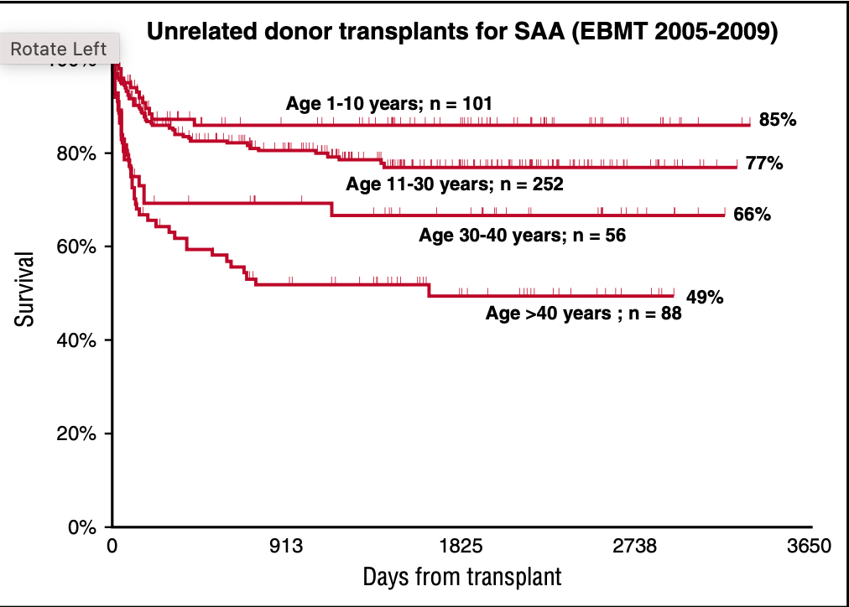
HCT Outcomes: Donor Type and Age of Recipient Matter
SIBLING UNRELATED
Bagigalupo Blood 2017

Slide 39
HCT Outcomes: Age and Conditioning are matter
Bejanyan et al BlodAdvances 2019

Slide 40
Bagigalupo Blood 2017

Slide 41
HaploHCT in SAA
37 SAA,
20 relapsed/refractory (R/R), and
17 treatment-na ̈ıve (TN) SAA patients.
Median follow-up is 32 months
The median age was 25 (range, 4-69) years.
The cumulative incidence of grade II-IV acute GVHD at day 100 is 11%.
The cumulative index of chronic GVHD at 2 years is 8%.
DeZern et al BloodAdvances 2020

Slide 42
HaploHCT in SAA
Better results in R/R
Primary or Secondary GF more common in treatment naïve
TBI dose was increased
DeZern et al BloodAdvances 2020

Slide 43
PNH
-a unique form of BM failure
-resulted from somatic mutation involving the
PIGA gene
-characterized by
Acquired hemolytic anemia and
Thrombosis
Medicaljunction.com , 2021

Slide 44
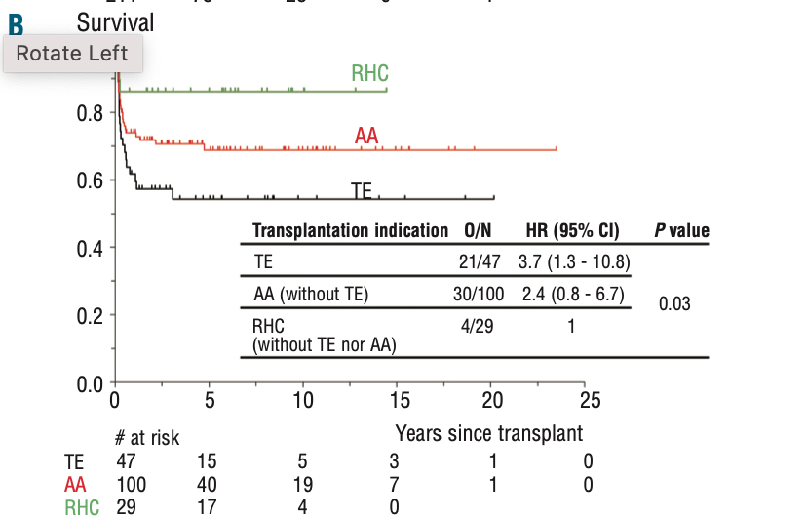
PNH
Recurrent Hem Anemia
Aplastic Anemia
Thrombotic Event
Peffault de Latour et al Hameatologica 2012

Slide 45
Antonio Maria Risitano and Regis Peffault de Latour Brit J Haem 2021

Slide 46
PNH BMT
Indicated
5–10% of patients, progressing to a myeloid malignancy (MDS or AML), even during anti-complement treatment
15–20% of patients evolving to BMF.
Not Indicated
During Eculizumab
2–4% of patients with recurrent thrombosis
34–51% of patients with clinically meaningful anemia
Antonio Maria Risitano and Regis Peffault de Latour Brit J Haem 2021

