Slide 1
Survivorship:
Life after Diagnosis
Rachael Schmidt, DNP, APRN, AOCNP
Program Director
Survivorship & Cancer Risk/Prevention

Slide 2


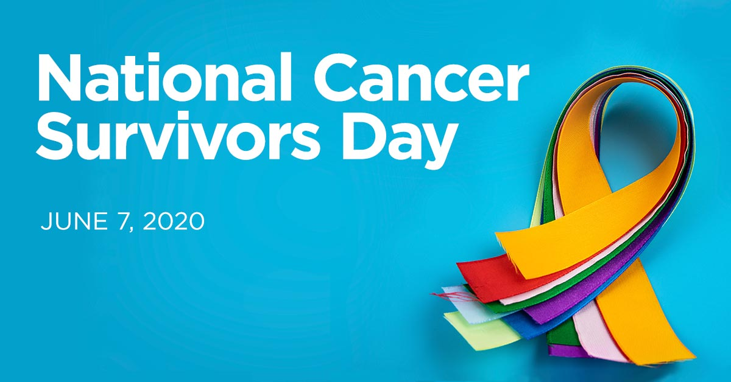

Let’s Talk Survivorship

Slide 3


Slide 4
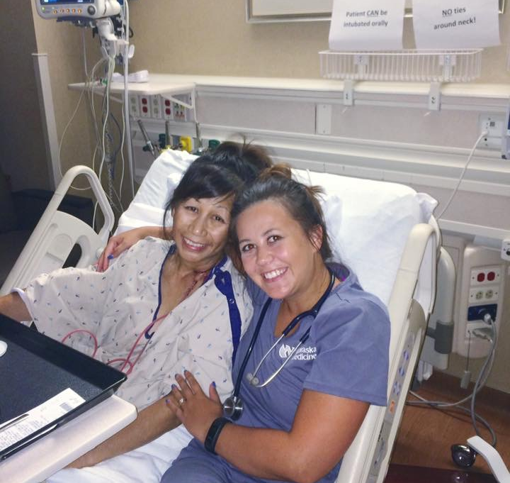
Who is a Cancer Survivor?
A survivor is anyone living with a history of cancer – from the moment of diagnosis through the remainder of life.
- Living with cancer
- Living through cancer
- Living beyond cancer
Notes:
Living With Cancer phase – also known as the acute phase of survivorship — when the person has been diagnosed with cancer and is undergoing active treatment.
Living Through Cancer phase – a transitional phase that follows the completion of treatment. During this time the patient is undergoing close monitoring for cancer recurrence and may be receiving maintenance treatment. The transitional phase can be one of the most stressful times for survivors.
Living Beyond Cancer phase – the period of extended cancer survival, at which point the focus of care is on the individual’s health and well-being and in dealing with the long-term effects of treatment.

Slide 5
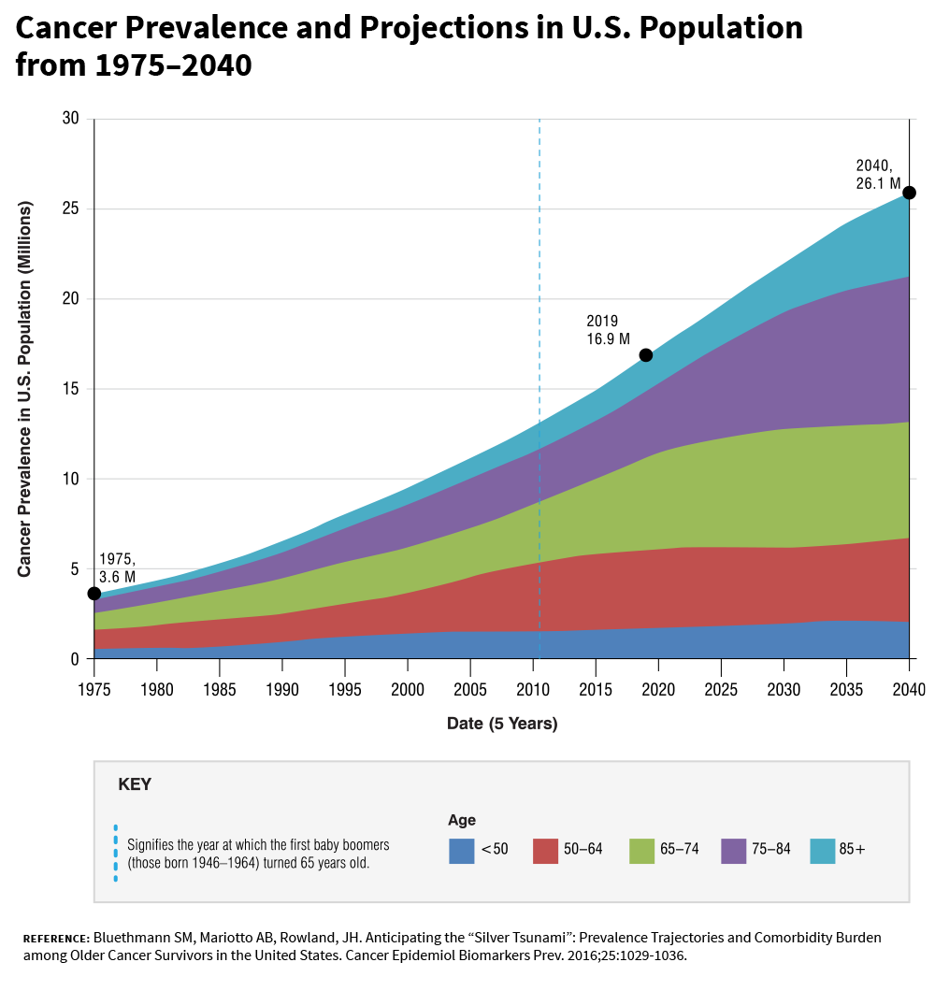
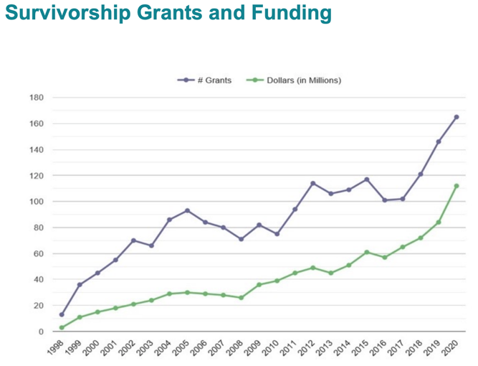
Cancer Survivorship

Slide 6
What we know about cancer survivors…
Most cancers have a decrease in risk of recurrence 5 years after diagnosis. This creates a shift in focus from risk of recurrence to surveillance of late/long term effects as those risks increase.
Therapy-related complications cause morbidity and mortality among survivors but may not be apparent for years after treatment
Early detection through screening and risk-reduction may lessen the impact of some late effects
Miller, Kimberly D., et al. "Cancer treatment and survivorship statistics, 2019." CA: a cancer journal for clinicians 69.5 (2019): 363-385.

Slide 7

Survivorship Challenges
  Felt lost in the transition
  Lack of communication between oncologist and patient
  Lack of communication between oncologist and primary care
  Health risks after treatment were not explained
  Difficulty in restarting work or school
Report by the Institute of Medicine in 2006

Slide 8
Survivorship Care Plan
This prompted a national initiative to redesign how cancer patients are cared for through the course of their disease and beyond active treatment.

Slide 9
Why is a survivorship care plan needed?
To summarize and communicate what transpired during cancer treatment
To describe known and potential late effects of cancer treatments, with expected time course
To communicate to the survivor and other members of the health care team what has been done and what needs to be done in the future
To promote a healthy lifestyle to prevent recurrence and reduce the risk of the other co-morbid conditions

Slide 13
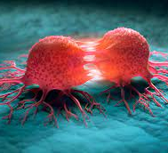



Surveillance in Survivorship
Long-Term Effects: Any persistent side effects or complications of cancer therapy after active treatment.
  Numbness and tingling in the fingers and toes
  Pain/Fatigue
Late Effects: toxicities that are absent or subclinical at the completion of active therapy but appear months to years later
  Cardiac toxicities
  Secondary Cancers

Slide 14

Second Cancers
Neoplasm that arises independently in a new site or tissue at least 2 months after the primary cancer is diagnosed
Lifetime risk for developing a SPM in cancer survivors is as high as 33%
Environmental exposures, lifestyle, genetics, or cancer treatment

Slide 15
Screenings for Second Cancers
Yearly CBC (hematologic cancers)
Yearly low dose chest CT (if significant smoking history)
Colonoscopy screening by age 45, earlier if had TBI or significant family history
Yearly skin exam by dermatologist
Women
Yearly mammogram starting at age 40
If received chest radiation between ages 10-30, would qualify for high-risk breast cancer screening starting 8 years after treatment, with mammogram + breast MRI
Routine age-appropriate PAP testing
Men
Routine age-appropriate prostate testing

Slide 16
Cancer Related Fatigue
Notes:
Fatigue is one of the most prevalent and distressing long term effects of cancer treatment
30% will endure persistent fatigue for a number of years following treatment
Often under-diagnosed
A majority of all patients will experience some level of fatigue during the course of treatment, however approximately 30% of patients will endure persistent fatigue for a number of years after treatment. Fatigue is one of the most prevalent and distressing long term effects of cancer treatment that significantly affects patients quality of life.

Slide 17

Psychological Challenges…
Anxiety – nearly 100%
Uncertainty/fear - 70%
Isolation
Altered body image
Depression
Notes:
Fear of recurrence 70%
Anxiety is the most common mental health issue among long-term cancer survivors

Slide 18

Cognitive Impairment
“Chemo-Brain or Brain Fog”
Estimated as high as 75% (non CNS cancers) to 90% (CNS cancers)
Notes:
Presentation:
Slower thinking, difficulty focusing, trouble with short term memory, word finding, task planning and completion, and juggling multiple tasks.
Assessment:
NCCN recommends acknowledging patient reports of CI and assessment of cognitive function (no specific tool)
Rule out other causes and co-morbidities (stress, anxiety, depression, etc)
Referral to a neuropsychologist for further testing

Slide 19
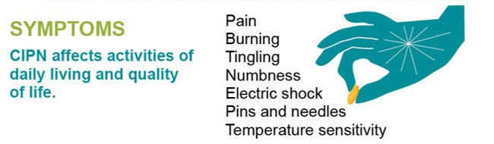
Chemotherapy Induced Peripheral Neuropathy
1/3 will develop CIPN
Can be reversible but also could lead to long term effects on quality of life
Evaluate balance
Protect hands and feet from harm. Wear shoes and gloves. Use care when cooking, using the oven, and handling objects that are hot or cold.
Be careful with sharp objects so you don’t cut yourself.
Don’t expose yourself to water that is too hot since you may not feel how hot it is.
Remove throw rugs so you don’t trip on them.
Be careful in the shower so you don’t slip and fall.
Stay as active as you can so you keep your muscles working.
Notes:
Over 1/3 of cancer survivors will develop chemotherapy induced peripheral neuropathy
Platinum agents, vinca alkaloids, taxanes, and bortezomib have a higher risk for CIPN
Can be reversible, but could also lead to long-term effects on quality of life

Slide 20
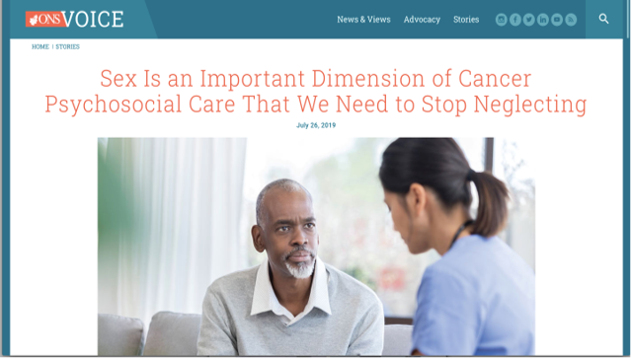
Sexual Dysfunction
40% to 100% of cancer survivors experience some form of sexual dysfunction after cancer treatment

Slide 21
Osteopenia/Osteoporosis
Adequate Calcium and Vitamin D supplementation
Checking Vitamin D levels
DEXA scan
Lifestyle modifications:
  Weight bearing exercises
  Smoking cessation
  Limiting alcohol use
Notes:
Common long term effect, especially among breast and prostate cancer patients
These patients are typically on some type of hormone therapies or who experience early menopause.
They are at higher risk of developing fractures, osteopenia (lower than normal bone density) and osteoporosis {loss of bone density).
AI
ADT – Advanced Prostate cancer
Methotrexate – CNS lymphomas,
doxorubicin Sarcomas,
Cytoxan BMT, Breast, others
Steroids – MM, Leukemias/Lymphomas

Slide 22
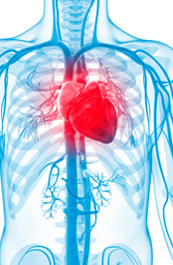
Cardiovascular Toxicity
When compared to general population, survivors >50 years old have twice the number of CV complications; 5x more severe CV conditions
Recommend Aggressive Management of CV Risk Factors:
  Blood pressure
  Cholesterol
  Diabetes
  Weight
  Exercise
  Tobacco Use
Cardio-Oncology - efforts to prevent or treat patients with cancer who face heart problems caused by cancer treatments
Notes:
Cardiotoxicity is damage to the heart muscle by a toxin such as chemotherapy. As a result of this damage, the heart is unable to pump enough blood to supply the body with essential oxygen and nutrients. Although several chemotherapy drugs may cause cardiac toxicity, the most common cause of cardiac toxicity in cancer patients is treatment with chemotherapy drugs called anthracyclines .
-Usually this is a very late effect of treatment, 10 – 20 years down the road.
-Typically we do not screen with echos or ecgs unless they are at very high risk.
-When patients are on Herceptin we screen with echos every 3 months.
Patients who are older, young children, and women have a greater risk for cardiac toxicity. In addition, patients who have other health conditions at the same time as cancer are at increased risk. This is especially true for patients with signs of heart trouble before cancer.
Oral agents – chemo teaching sessions – encouraging close f/u with PCP for tight control of BP, cholesterol, diabetes screening to decrease risk of heart attack/CVA etc.

Slide 23
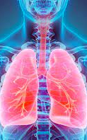
Pulmonary Toxicity
Baseline pulmonary function tests for patients who received:
Radiation to chest wall
Treated with bleomycin
Notes:
Symptoms:
Breathlessness during exercise
Fatigue
Dry cough
Shortness of breath
Discomfort or worsening symptoms when lying on your back
Cancers that may be treated with radiation to the chest cavity include breast cancer, lung cancer, and Hodgkin’s lymphoma. Symptoms may not occur until 2-3 months after radiation treatment
PFTs
Radiation – can cause fibrosis, pleuritic, pneumonitis
Symptoms caused by acute radiation pneumonitis usually develop approximately 4 to 12 weeks following irradiation, whereas symptoms of late or fibrotic radiation pneumonitis develop after 6 to 12 months.
Typical symptoms for both types of lung injury include dyspnea, cough, chest pain, fever, and malaise

Slide 24
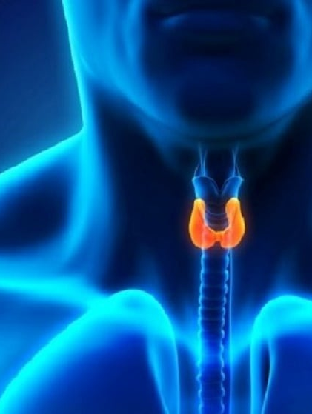
Endocrine
Thyroid Dysfunction (neck radiation) - estimated 30-60% within first 5 years
Signs/Symptoms:
  Fatigue
  Increased sensitivity to cold
  Constipation
  Dry skin
  Weight gain
  Check TSH/Free T4 yearly

Slide 25

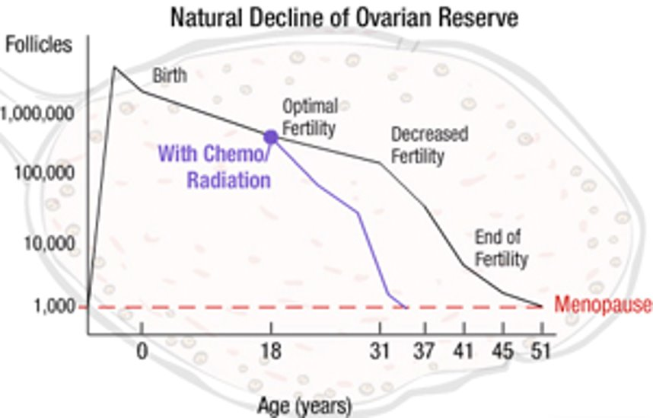
Ovarian function and pregnancy success are comparable to general population if no alkylating chemotherapy and/or pelvic radiation
Rates of premature ovarian failure was 60% in those treated with alkylating chemotherapy
High risk
Cyclophosphamide
Ifosfamide
Melphalan
Busulfan
Nitrogen mustard
Procarbazine
Chlorambucil
Intermediate risk
Cisplatin with low cumulative dose
Carboplatin with low cumulative dose
Adriamycin
Low risk
Treatment protocols without alkylating agents
Bleomycin
Actinomycin D
Vincristine
Methotrexate
5-Fluorouracil (5FU)

Slide 26

Social/Financial
Changes in interpersonal relationships/family
Concerns regarding health or life insurance
Job loss/Loss of income
Challenges with returning to work or to school
Loss of savings

Slide 27
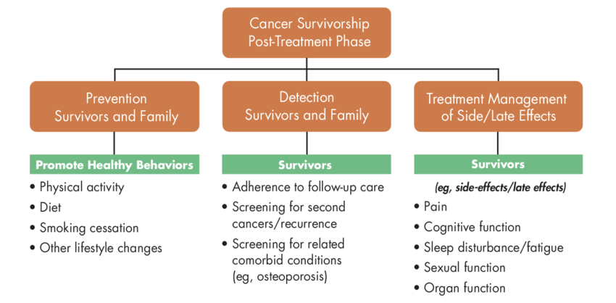
Survivorship Visit Components
Notes:
Surveillance: as a provider I need to understand risk of new primary cancers, local/metastatic recurrences but with my patients I have to educate them on these things
Late/long term effects: be aware of and assess for potential consequences of cancer treatment of various age groups, know the best practices for symptom management, and manage these effects with co-morbidities
Psychosocial care: be able to identify problems in the post treatment period and make appropriate referrals
Health promotion: know that cancer survivors are at increased risk for co-morbid health conditions, encourage survivors to establish a relationship with their primary care provider because we know that this population is less likely to receive recommended screenings and preventative services
Cancer diagnosis may shift attention away from important non-cancer problems
Communication/coordination of care – facilitate a transition from oncology to primary care that includes a patient-centered discussion and written documentation (survivorship care plan)

Slide 28

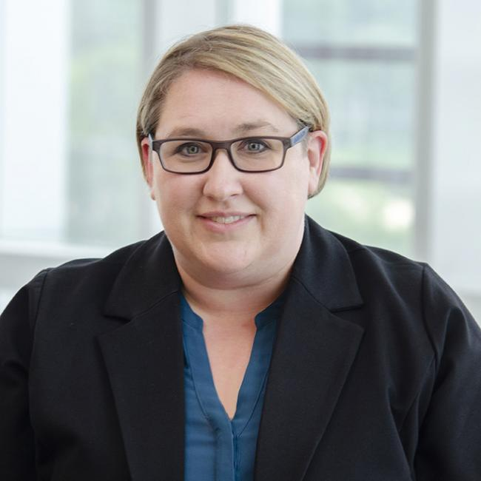



Laura Tenner, MD
Medical Director
Solid Tumors
Vijaya Bhatt, MD
Medical Director
Transplant
Rachael Schmidt, APRN
Program Director
Amanda Bond, PA

Slide 29
Nebraska Medicine Survivorship Program
General Survivorship Clinic
Allogenic PSCT Long Term Follow Up Clinic
Adult Survivors of Childhood Cancer Clinic
Notes:
There are two ways for survivors to access the Survivorship Center (SC) at Roswell. The first starts as a one-time consultation at the beginning of the post-treatment period, where they can be immediately immersed in an array of support services. The second is a transfer of care to survivorship for continued surveillance of their primary cancer(s), to monitor for residual effects of treatment, to restart preventive cancer screening and to re-establish the connection with the primary care provider (PCP). Frequency of surveillance visits is based on NCCN guidelines for their cancer type, the tumour staging and response to treatments.

Slide 30
Survivorship in the
Cancer Continuum
Diagnosis
(Living With Cancer)
Oncofertility / Fertility Preservation
Contraception Counseling
Prehabilitation
During Treatment
(Living Through Cancer)
Screening for Side Effects / Symptom Management
After Treatment
(Living Beyond Cancer)
Treatment Summary / Survivorship Care Plan
Screening and Management of Late/Long Term Effects
Health Promotion
Cancer Screenings

Slide 31

Screening Questions
All Survivors:
NCCN Survivorship Assessment
Cardiotoxicity
Anxiety/Depression
Cognitive Dysfunction
Fatigue
Lymphedema
Pain
Hormone Related Symptoms
Sexual Function
Sleep
Immunizations
Healthy Lifestyle Behaviors
  Exercise
  Diet
  Weight
  Supplements
Special Groups:
Short Physical Performance Battery
Blessed Test
Brief Sexual Symptom/Sexual Health Inventory
STOP Bang – OSA screening

Slide 32
Survivorship =
Supportive Care Services
Oncofertility
Genetic Testing
Physical / Occupational Therapy
Psychiatry / Psychology
Support Groups
Social Work
Nutrition
Smoking Cessation
Cardio-Oncology
Endocrine-Oncology
Financial Services
Notes:
Quality survivorship care includes prevention and surveillance for recurrences and new cancers, surveillance and management of physical effects, and surveillance and management of psychosocial effects and chronic conditions, and it emphasizes health promotion and disease prevention

Slide 33
Cancer Survivorship and Lifestyle Behaviors
Smoking Cessation
  17% of cancer survivors are current tobacco users
Exercise regularly
  31% of cancer survivors are obese vs 28% in the general population
  38% report no physical activity
Avoid weight gain
Eat a healthy diet
  84% of cancer survivors were not following the ACS nutrition recommendations
Drink alcohol in moderation – linked to several cancers
Get screening tests and go to check-ups
Sun safety
Vitamin D

Slide 34
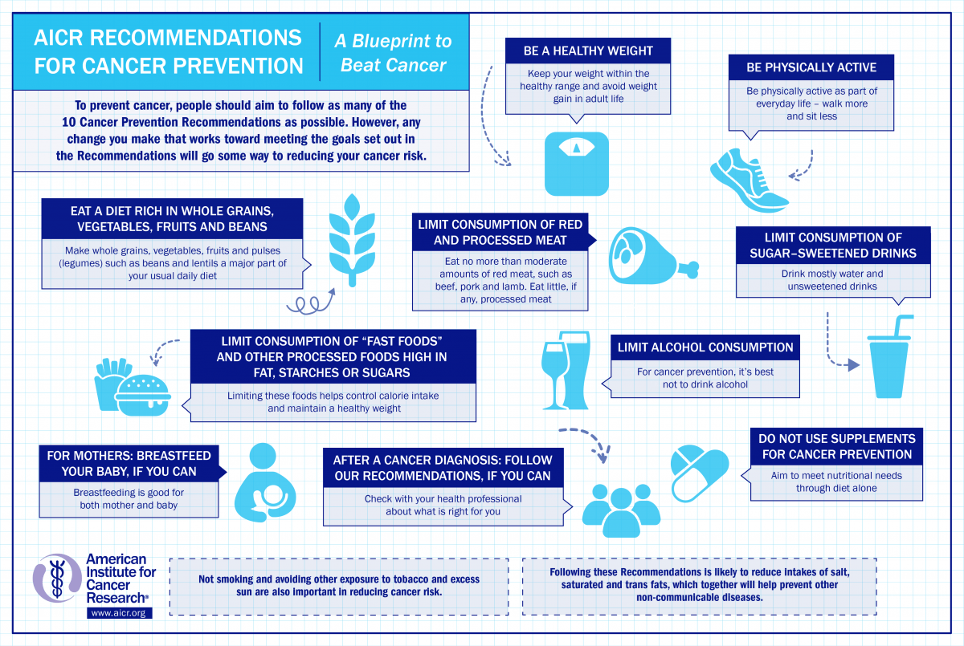

Slide 35
Risk-Stratified/
Personalized Care
High Risk - complex case management where patients are followed by a multi-disciplinary team long term (oncologist, survivorship, and PCP)
Pending Crisis:
Growing survivorship population
Clinician shortages
Clinician knowledge gaps
Cost of care
Lack of time
Stratified Care (one size does not fit all):
Low Risk – self management with transition back to PCP
Moderate Risk - a shared care model to briefly manage survivorship needs with PCP
Notes:
- Clinician shortages are evident in oncology, primary care, nursing, and across the specialties needed to provide ongoing care for cancer-related issues
In addition to capacity, clinician knowledge gaps are also a problem: most clinicians, especially the primary care workforce, receive little training on how to care for the ongoing problems experienced by cancer survivors
In additional problem is the need to control the increasing costs to patients and families and to health-care systems and payers of cancer care and survivorship care
The lack of clinical time available to address survivors’ needs coupled with the lack of provider training in how to address these needs and patients’ inability to afford care is contributing to the continuing unmet needs reported by cancer survivors
New models of care delivery are needed to equitably improve patient outcomes, overcome workforce shortages and knowledge gaps, and constrain costs and burden on patients and care teams
growing recognition that the US needs to build new models of survivorship care that pivot care from “one size fits all” to more personalized, stratified survivorship care pathways where the intensity of care, the care setting, and the providers required for that care vary with survivors’ needs
Patients are triaged to 1 of 3 stepped-care pathways based on their overall risk and need profile determined by risk of recurrence, new cancers, or late effects, the severity of their ongoing cancer toxicities, their functional ability, and overall psychological health and ability to self-manage their health

Slide 36
Utilize Survivorship to Improve Access
Alternate visits with survivorship to address quality of life issues
Fatigue
Nutrition
Exercise
Fear of recurrence
Allows oncologist to see more new patients and patients on treatment

Slide 37
Utilize Survivorship for Health Promotion
Hypertension, heart attack and stroke
(twofold increase in comparison to general population)
Increased risk for cardiovascular disease due to shared lifestyle risk factors
>65 years old
At least 1 comorbidity
Obesity
Survivors with one or more comorbidity at baseline had double the risk of cardiovascular disease at 10 years after diagnosis compared to patients with no comorbidities
Majority of cancer survivors die of heart disease (not their cancer diagnosis)

Slide 38
Utilize Survivorship for Health Promotion
20% of cancer survivors will get a second cancer
Long-term cancer survivors are NOT more likely to receive follow-up screening for second cancers
Improving compliance to other cancer screenings including:
Mammography / Breast MRIs
Colonoscopy
PAP
PSA
LDCT

Slide 39
Cancer Risk Factors
Treatment-Related Second Cancers
  Chemotherapy
  Radiation
  Hormonal therapy (Tamoxifen)
Lifestyle, Environmental, and Medical History Factors
  Tobacco Use
  Diet
  Alcohol
  Physical Inactivity
  Obesity
  Environmental Risk Factors
  Genetics
  Age

Slide 40

Survivorship Conference

Slide 41
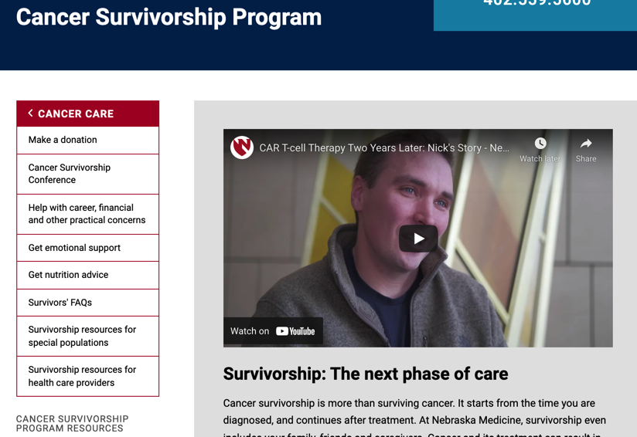
Survivorship Website

