Slide 1

Paroxysmal Nocturnal Hemoglobinuria (PNH) and Non-Transplant Therapies
Charles Parker, M. D.
Professor of Medicine
University of Utah School of Medicine
Salt Lake City, Utah

Slide 2
PNH
Pathophysiology
Diagnosis
Management
What’s on the horizon for treatment of PNH

Slide 3
What Is PNH?
(more than a hemolytic anemia)
A disorder of the hematopoietic stem/progenitor cell (HSPC)
PNH is a consequence of nonmalignant clonal expansion of one or several HSPCs that have acquired a somatic mutation of PIGA
Because of mutant-PIGA, progeny of affected HSPC’s are deficient in all glycosyl phosphatidylinositol-anchored proteins (GPI-APs) that are normally expressed on hematopoietic cells
Major clinical manifestations in addition to hemolytic anemia: bone marrow insufficiency or failure and thrombophilia
PIGA = phosphatidylinositol glycan class A
Parker C et al. Blood. 2005;106:3699-3709.

Slide 4
Deficiency of Glycosyl Phosphatidylinositol Anchored Proteins Is a Defining Characteristic of PNH
GPI-anchored protein
Transmembrane protein
protein core
Protein
ectoplasmic
domain
EtN
Man
Man
EtN
Man
EtN
PNH defect
GlcN
I
fatty acid
anchor
transmembrane
domain
Lipid bilayer
cytoplasmic
tail
Notes:
GPI is a glycolipid that can be attached to the C-terminus of a protein during posttranslational modification. It is composed of a phosphatidylinositol group linked through a carbohydrate-containing linker (glucosamine and mannose glycosidically bound to the inositol residue) and via an ethanolamine phosphate (EtNP) bridge to the C-terminal amino acid of a mature protein. The two fatty acids within the hydrophobic phosphatidyl-inositol group anchor the protein to the cell membrane.
Glypiated (GPI-linked) proteins contain a signal sequence that direct them to the endoplasmic reticulum (ER). The protein is co-translationally inserted in the ER membrane via a translocon and is attached to the ER membrane by its hydrophobic C terminus; the majority of the protein extends into the ER lumen. The hydrophobic C-terminal sequence is then cleaved off and replaced by the GPI-anchor. As the protein processes through the secretory pathway, it is transferred via vesicles to the Golgi apparatus and finally to the plasma membrane where it remains attached to a leaflet of the cell membrane.

Slide 5
Pathophysiology of PNH
GPI-anchored proteins
transmembrane protein
CD55
CD59
Normal Hematopoietic Cell
Lipid bilayer
Mutant PIGA
x
UDP-GlcNAc + PI GlcNAc-PI
PNH Hematopoietic Cell
Lipid bilayer
active
inactive
XY
XX
male
female
PIGA on chromosome Xp22.1

Slide 6
Pathophysiology of PNH: Because of mutant PIGA, progeny of affected HSPC’s are deficient in all GPI-AP’s normally expressed on hematopoietic cells
Glycosyl Phosphatidylinositol-Anchored Proteins Deficient in PNH*
Complement Regulatory Proteins† •CD55 (decay accelerating factor, DAF) •CD59 (membrane inhibitor of reactive lysis, MIRL) Proteins with Immunological Significance •CD58 (lymphocyte function antigen-3, LFA-3) •CD16b (Fc receptor gamma IIIb, FcRγIIIb, CD16b) •CD14 (endotoxin binding protein) Receptors •CD87 (urokinase plasminogen activator receptor, uPAR) •Folate receptor •Cellular prion protein (on resting platelets) Enzymes •Leukocyte alkaline phosphatase •Acetylcholinesterase •5’-ectonucleotidase Miscellaneous Proteins •CD24 •CD48 •CD52 (Campath-1) •CD66c •CD66b (formerly CD67) •CD90 (Thy-1) •CD108 (JMH-bearing protein) •p50-80, GP109, GP157, GP175, GP500
* Partial list † Deficiency of complement regulatory proteins underlies the hemolytic anemia of PNH

Slide 7
The Hemolytic Anemia of PNH Is Mediated by the APC
eculizumab
The Alternative Pathway of Complement
C3
C5
membrane attack complex
C3 convertase
C3a
C5 convertase
C5a
C3bBbP C3bBbC3bP C5b-8-9n
pegcetacoplan
CD55†
CD55†
CD59†*
*CD59 also appears to participate in regulation of the APC C3/C5 convertase
†GPI-anchored complement regulatory proteins
Complement-Mediated Hemolysis
LDH
LDH
LDH
LDH
LDH
LDH
Normal RBC
PNH RBC

Slide 8
Pathophysiology of PNH*
*PNH is a consequence of nonmalignant clonal expansion of one or several HSPCs that have acquired a somatic mutation of PIGA
What is the basis of clonal selection and clonal expansion of PIGA-mutant HSPCs?
  Mutant PIGA does not appear to provide the affected HSPCs with an intrinsic proliferative or survival advantage
  In PNH, the survival advantage of PIGA-mutant HSPCs appears to be due to properties of the affected cells related to GPI-AP deficiency that protect them from destruction in the setting of immune attack on the bone marrow, perhaps by down-regulating HLA antigen expression
    This hypothesis is supported by the observation that PIGA-mutant, GPI-AP deficient hematopoietic cells are commonly present in patients with acquired aplastic anemia, an immune-mediated disease.

Slide 9
Hypothetical Model for Selection and Expansion of PIGA-Mutant, GPI-AP Deficient HSPC’s in Classic PNH
Normal Bone Marrow
Aplastic Bone Marrow
Stress hematopoiesis increases the probability that the PIGA mutant HSPC’s will acquire additional somatic mutations.
In aplastic anemia, immune attack on the bone marrow destroys most of the normal HSPC’s. PIGA mutant HSPC’s escape the immune attack because of deficiency of one or more GPI-AP’s, resulting in oligoclonal hematopoiesis.
The extent to which each PIGA mutant HSPC expands depends upon its intrinsic properties (including stochastic events and acquisition of other somatic mutations) with respect to the proliferation/survival characteristic of the affected cell.

Slide 10
PNH
Pathophysiology
Diagnosis
Management
What’s on the horizon for treatment of PNH

Slide 11
Characteristics of PNH
Once suspected, diagnosis of PNH is straightforward, however, PNH is a heterogeneous disease because the size of the PNH clones vary among patients
  The percentage of circulating PNH cells (determined by the size of the PNH clones in the marrow), along with the PNH phenotype of the RBCs, is the major determinant of the clinical manifestations of the disease

Slide 12
PNH – High Resolution Method
Flow Cytometric Analysis of Peripheral Blood for Diagnosis of PNH
Normal
PNH+ Patient
Normal Control
Small Population
PNH/BMF
Subclinical PNH
RBCs
0%
0.077%
3%
Granulocytes
PMNs
0.001%
0.747%
21%
The FLAR reagent can be used for analysis of GPI-AP expression on PMNs

Slide 13
Flow Cytometric Analysis of Peripheral Blood for Diagnosis of PNH
Normal Control
Classic PNH
Patient
Donor
RBCs
72%
Granulocytes
PMNs
96%
anti-CD55-FITC + anti-CD59-FITC
anti-CD55-FITC + anti-CD59-FITC

Slide 14
Characteristics of PNH
In addition to clone size, PNH phenotype impacts on the clinical manifestations
PNH Phenotype: PNH erythrocytes are either completely or partially deficient in GPI-AP’s
  Type I cells are residual normal cells
    Normal expression of GPI-AP’s
  Type II cells are partially deficient
  Type III cells completely deficient
Depends on PIGA genotype

Slide 15
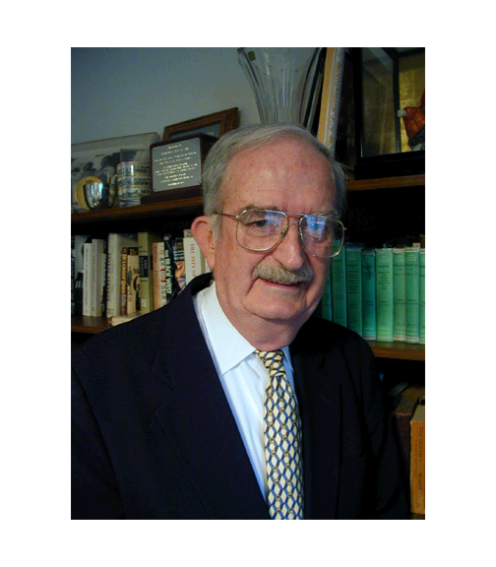
Wendell F. Rosse (Duke University)
28th President of The American Society of Hematology

Slide 16
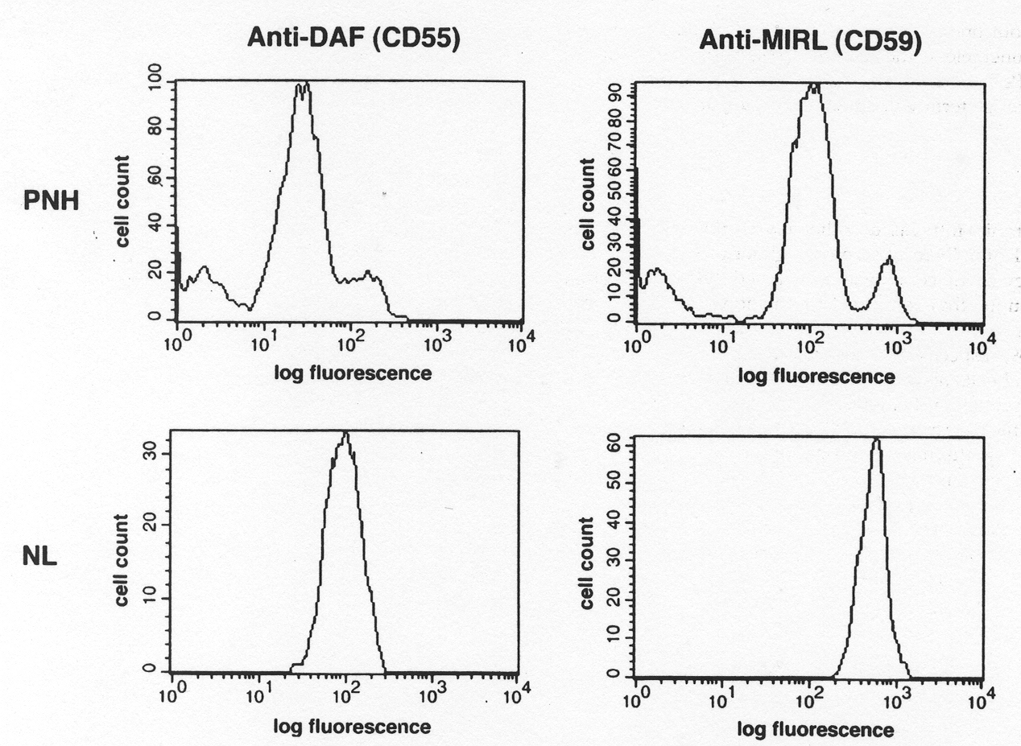
Phenotypic Mosaicism as Shown Using One-Color Flow Cytometry
PNH II
PNH I
PNH III
Threshold for clonal selection:~90% GPI-AP deficient
Endo et al. Blood 1996;87:2546-2557

Slide 17
Phenotypic Mosaicism Is a Consequence of Genotypic Mosaicism
Discrete PIGA mutations
Endo et al. Blood 1996;87:2546-2557

Slide 18
Clone Size and Phenotype Are Clinically Relevant
III
A
Patients with a high proportion of PNH III cells have disease characterized by brisk intravascular hemolysis
Cell count
I
1
10
100
Log fluorescence
B
II
Patients with a high proportion of PNH II cells have low-level chronic hemolysis, punctuated with episodes of brisk hemolysis when complement activation is enhanced (e.g., as a result of stress, trauma, infection)
Cell count
III
I
1
10
100
Log fluorescence
C
I
Patients with a small proportion of PNH III cells have low-grade chronic hemolysis
Cell count
III
1
10
100
Log fluorescence

Slide 19
PNH
Pathophysiology
Diagnosis
Management
What’s on the horizon for treatment of PNH

Slide 20
Basic Evaluation for PNH
Flow cytometric for evidence of a population of peripheral blood erythrocytes and granulocytes deficient in multiple GPI-Aps and for determination of PNH clone size and clone phenotype*
Complete blood count; reticulocyte count; biochemical markers of hemolysis [serum concentration of lactate dehydrogenase (LDH)†, bilirubin (fractionated) and haptoglobin]; determination of iron stores
Bone marrow aspirate, biopsy, and genetic analysis§
*PNH clone size is determined by the percentage of GPI-AP deficient PMNs, and phenotype is determined by analysis of peripheral blood RBCs †Clinically useful metric for assessing intravascular hemolysis and response to therapy §Bone marrow analysis is used to distinguish classic PNH from PNH in the setting of another bone marrow failure syndrome. Genetic analysis may help distinguish hypoplastic MDS from aplastic anemia.

Slide 21
Classification of PNH Guides Management
Classification of PNH*
Category | Rate of Intravascular Hemolysis† | Bone Marrow Characteristics | Flow Cytometry | Benefit from Eculizumab
Classic | Florid (markedly abnormal LDH, often with episodic macroscopic hemoglobinuria) | Cellular marrow due to erythroid hyperplasia and normal or near-normal morphology | Large population (>50%) of GPI-AP deficient PMNs | Yes
PNH in the setting of another bone marrow failure syndrome§ | Usually mild (often with minimal to modest abnormalities of biochemical markers of hemolysis) | Evidence of a concomitant bone marrow failure syndrome§ | Although variable, the percentage of GPI-AP deficient PMNs is usually modest (25-50%) | Variable. Some patients have clinically significant hemolysis and benefit from treatment
Subclinical | No clinical or biochemical evidence of intravascular hemolysis | Evidence of a concomitant bone marrow failure syndrome§ | Small (usually <1%) population of GPI-AP deficient PMNs detected by high-resolution flow cytometry | No
* Based on recommendations of the International PNH Interest Group (Blood 2005;106:3699-3709) † Based on episodes of macroscopic hemoglobinuria, serum LDH concentration, and reticulocyte count § Aplastic anemia or low risk myelodysplastic syndrome
Clinical PNH

Slide 22
PNH/AA, PNH/MDS
Subclinical PNH
  PNH in the setting of another BMF syndrome
    The association between PNH and aplastic anemia has been appreciated for more than 60 years (initially based on clinical criteria and Ham test) and was refined more recently using high-sensitivity flow cytometry
    The association between PNH and low risk MDS was characterized more recently using high-sensitivity flow cytometry (Nakao and colleagues)
Subclinical PNH
  A product of screening peripheral blood from patients with BMF using high-sensitivity flow cytometry (Nakao and collagues)

Slide 23
Clinical Relevance of PNH Cells in Aplastic Anemia and Low risk MDS
The presence of a PNH clone serves as a surrogate marker for immune pathology in patients with aplastic anemia and low-risk MDS
In an analogous way, detection of 6pLOH (identified by SNP microarray) resulting in HLA allele loss is a surrogate marker for immune pathology in the setting of bone marrow failure*
A growing consensus of clinical studies suggest that the presence of a PNH clone in the setting of aplastic anemia and low-risk MDS predicts a favorable response to immunosuppressive therapy
* HLA loss may also occur as a consequence of somatic mutation

Slide 24
Classification of PNH Guides Management
Classification of PNH*
Category | Rate of Intravascular Hemolysis† | Bone Marrow Characteristics | Flow Cytometry | Benefit from Eculizumab
Classic | Florid (markedly abnormal LDH, often with episodic macroscopic hemoglobinuria) | Cellular marrow due to erythroid hyperplasia and normal or near-normal morphology | Large population (>50%) of GPI-AP deficient PMNs | Yes
PNH in the setting of another bone marrow failure syndrome§ | Usually mild (often with minimal to modest abnormalities of biochemical markers of hemolysis) | Evidence of a concomitant bone marrow failure syndrome§ | Although variable, the percentage of GPI-AP deficient PMNs is usually modest (25-50%) | Variable. Some patients have clinically significant hemolysis and benefit from treatment
Subclinical | No clinical or biochemical evidence of intravascular hemolysis | Evidence of a concomitant bone marrow failure syndrome§ | Small (usually <1%) population of GPI-AP deficient PMNs detected by high-resolution flow cytometry | No
* Based on recommendations of the International PNH Interest Group (Blood 2005;106:3699-3709) † Based on episodes of macroscopic hemoglobinuria, serum LDH concentration, and reticulocyte count § Aplastic anemia or low risk myelodysplastic syndrome
Clinical PNH

Slide 25
Management of PNH Based on Disease Classification
Classify PNH based on flow cytometric characteristics, hemolytic parameter (reticulocyte count, serum LDH concentration), and bone marrow analysis
Subclinical PNH
No specific PNH therapy—focus on underlying bone marrow failure syndrome*†
*Some, but not all, studies suggest a favorable response to immunosuppressive therapy (IST).
Treatment with IST does not affect PNH clone size
†Hematopoietic stem cell transplant eradicates the PNH clone

Slide 26
Management of PNH Based on Disease Classification
Classify PNH based on flow cytometric characteristics, reticulocyte count, serum LDH concentration, bone marrow analysis
Subclinical PNH
PNH/BMF
No specific PNH therapy—focus on underlying bone marrow failure syndrome*†
Focus on bone marrow failure*†
Patients with large PNH clones may benefit from complement inhibitor therapy (CIT)¶
BMF, bone marrow failure (aplastic anemia and low risk MDS)
*Some, but not all, studies suggest a favorable response to immunosuppressive therapy (IST).
Treatment with IST does not affect PNH clone size
†Hematopoietic stem cell transplant eradicates the PNH clone
¶Approximately 50% of patients with PNH/BMF require treatment for hemolysis or thrombosis

Slide 27
Management of PNH Based on Disease Classification
Classify PNH based on flow cytometric characteristics, reticulocyte count, serum LDH concentration, bone marrow analysis
Subclinical PNH
PNH/BMF syndrome
Classic PNH
No specific PNH therapy—focus on underlying BMF syndrome*
Focus on BMF*†
Patients with large PNH clones may benefit from CIT¶
Treat with eculizumab/ravulizumab¥
BMF, bone marrow failure (aplastic anemia and low risk MDS)
*Some, but not all, studies suggest a favorable response to immunosuppressive therapy (IST).
Treatment with IST does not affect PNH clone size
†Hematopoietic stem cell transplant eradicates the PNH clone
¶Approximately 50% of patients with PNH/BMF require treatment for hemolysis or thrombosis
¥Pegcetacoplan(complement C3 inhibitor FDA approved, May 2021, for treatment of PNH)

Slide 28
Complement Inhibitory Therapy for Treatment of the Hemolysis of PNH

Slide 29
Eculizumab Is a Humanized Anti-C5 Antibody
Patients must be vaccinated against Neisseria meningitides
After initial loading dosing, given as an every two-week infusion continuously
Generally well-tolerated
Now largely replaced by ravulizumab (q8 week infusion)
Human Framework Regions
H & L Variable regions
CH1
Hinge
Kappa light chain constant region
CL
Complementarity Determining Regions
(murine origin)
CH2
Human IgG₄ Heavy Chain
Constant Regions 2 and 3
Human IgG₂ Heavy Chain
Constant Region 1 and Hinge
CH3
Modified from R. Rother (Alexion Pharmaceuticals)
Notes:
SOLIRIS is a first-in-class, humanized, anti-C5 monoclonal antibody
Very high binding affinity for human C5; each SOLIRIS molecule binds two C5 proteins
First therapy to specifically target complement-mediated hemolysis
SOLIRIS is unique among humanized monoclonal antibodies because germline human framework acceptor sequences were used to minimize immunogenicity
Human IgG_{2/4} heavy chain constant regions were used to eliminate the ability of the antibody to bind Fc receptors and activate complement

Slide 30
Mechanism of Action of Eculizumab/Ravulizumab
Eculizumab/
Ravulizumab
The Alternative Pathway of Complement
C3
C5
membrane attack complex
C3 convertase
C3a
C5 convertase
C5a
C3bBbP C3bBbC3bP C5b-8-9n
CD55†
CD55†
CD59†*
*CD59 also participates in regulation of the APC C3/C5 convertase
†GPI-anchored proteins deficient in PNH
Complement-Mediated Hemolysis
LDH
LDH
LDH
LDH
LDH
LDH
Normal RBC
PNH RBC

Slide 31
What Does Eculizumab Do?
  Blocks Intravascular Hemolysis†
  Ameliorates symptoms associated with chronic intravascular hemolysis
    malaise, lethargy, fatigue, asthenia, dysphagia, male impotence*
  Reduces transfusion requirements
    ~65% become transfusion independent
    Prolongs transfusion intervals in those who remain transfusion dependent
Reduces the Risk of Thrombosis
†Normalization or near normalization of serum LDH
*Symptom control improves quality of life (treatment can be transformative)

Slide 32
What Doesn’t Eculizumab Do?
Eliminate Transfusion Requirements in All Patients
Block Extra-Vascular Hemolysis Mediated by Complement Opsonization of PNH RBC’s
Affect the Underlying Disease Process
  Bone marrow failure persists
  Clonal hematopoiesis persists
  Symptomatic therapy in the form of eculizumab/ravulizumab is beneficial long-term because PNH is not a malignant, progressive disease

Slide 33
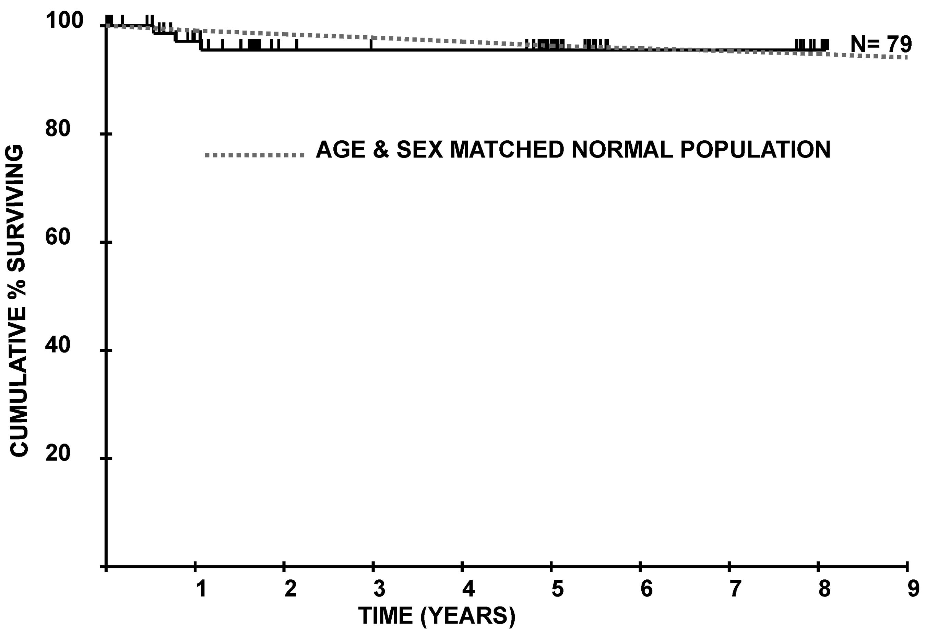
Survival of Patients with PNH Treated with Eculizumab
Kelly et al. Blood 2011: 117, 6786-6792

Slide 34
Allogeneic SCT for PNH
The PNH clone can be eradicated by allogeneic hematopoietic stem cell transplant
In the era of complement inhibitory therapy, what are the indication for allogeneic BMT?
  Uncontrolled hemolysis (eliminated by CIT)
  Uncontrolled thrombosis (eliminated by CIT)
  Patient preference. PNH is a chronic disease, often affecting patients in young adulthood. Despite effective therapy, quality of life is compromised by treatment burden.

Slide 35
Breakthrough Hemolysis
Definition: Patient on complement inhibitor therapy becomes symptomatic (fatigue, hemoglobinuria, symptoms of anemia, dysphagia, male impotence) and has laboratory evidence of worsening hemolysis (increase in LDH, fall in hemoglobin concentration)
Cause: Pharmacokinetic, due to underdosing of the complement inhibitor
  Most common with eculizumab (non-weight-based dosing)
  Uncommon with ravulizumab (weight-based dosing)
  Can occur in patient treated with pegcetacoplan
Cause: Pharmacodynamic, due to complement activating event [e.g., infection (Covid), trauma, surgery]
  Can occur with both C5 and APC inhibitors
Treatment: Pharmacokinetic; increase dose, shorten dosing interval
Treatment: Pharmacodynamic; add a dose or doses, add second inhibitor (e.g., patient on pegcetacoplan, add a dose of eculizumab)

Slide 36
PNH
Pathophysiology
Diagnosis
Management
What’s on the horizon for treatment of PNH

Slide 37
Suboptimal Response to Eculizumab
Extravascular Hemolysis in Patients Treated with Eculizumab
Although serum LDH concentration returns to normal or near normal in most PNH patients treated with eculizumab/ravulizumab, reticulocytosis and some degree of anemia persists in most patients with classic PNH and some remain transfusion dependent
  Extravascular hemolysis due to C3 opsonization of PNH erythrocytes contributes to the suboptimal response in eculizumab-treated patients

Slide 38
Eculizumab Does Not Inhibit the Alternative Pathway of Complement
eculizumab
Alternative Pathway of Complement
C3
C5
membrane attack complex
C3 convertase
C3a
C5 convertase
C5a
C3bBbP C3bBbC3bP C5b-8-9n
CD55†
CD55†
CD59†*
*CD59 also participates in regulation of the APC C3/C5 convertase
†GPI-anchored proteins deficient in PNH
Eculizumab/ravulizumab blocks activation of C5 and prevents formation of the cytolytic MAC, thereby inhibiting intravascular hemolysis
But inhibition of C5 by eculizumab/ravulizumab does not protect against aberrant C3 convertase activity due to deficiency of CD55 and CD59
Consequently, activation and degradation products of C3 accumulate on unlysed PNH cells leading to extravascular hemolysis

Slide 39
Generation of C3 Opsonins* on PNH Erythrocytes† In Patients Treated with Eculizumab/Ravulizumab
C3 Convertase
C3a
C3 opsonins
factor I
factor I
P
C3b
Bb
C3
C3b
iC3b
C3dg
factor H
CR1
GPA
GPA
*C3 opsonins, iC3b and C3dg, target RBCs for destruction by reticuloendothelial cells expressing complement receptors:
CR2 C3dg
CR3 iC3b
†In eculizumab-treated patients, the direct antiglobulin test (Coombs’ test) can become positive for C3 (but not IgG)

Slide 40
Inhibition of APC C3 Convertase Activity
Danicopan
C3 Convertase
MASP-3
fD
pegcetacoplan*
C3a
fD
P
C3b
fB
C3b
Bb
C3
C3b
Bb
Iptacopan
GPA
GPA
GPA
C3 Convertase Inhibitors
  APL-2 (pegcetacoplan, Empaveli), synthetic cyclic peptide inhibitor of C3
    May 2021 approved by FDA for treatment of PNH in adults
    ACH-4471/Danicopan, small molecule factor D inhibitor being developed for oral administration
    LNP023 (Iptacopan), oral factor B inhibitor
    OMS906, monoclonal antibody targeting MASP-3
    APC C3 convertase inhibitors appear safe but require vaccination against Neisseria and pneumococcus and prophylactic antibiotic therapy

Slide 41

The End
Thank You!
P. C. Vey, The New Yorker

