Slide 1
Complications of PNH
- Shristi Upadhyay Banskota,MBBS
Hematology/Oncology Fellow Physician

Slide 2
What is PNH or Paroxysmal Nocturnal Hemoglobinuria?
Rare disease: red blood cells tend to break apart. "hemolysis.“
When red blood cells break, hemoglobin inside is released.
Release of hemoglobin causes many of the PNH symptoms.

Slide 3
3 Basic Types of Blood Cells?
Red blood cells (RBCs): They make up almost half of blood. Filled with protein hemoglobin to pick up oxygen in the lungs and bring it to cells all around the body.
Platelets: They are small pieces of cells that help blood clot and stop bleeding.
White blood cells (WBCs): They fight disease and infection by attacking and killing germs that get into the body.

Slide 4
How are Blood Cells Formed?
Blood cells are made in the bone marrow, a spongy tissue located inside certain bones.
Marrow contains blood-forming stem cells that make copies of themselves to create all 3 types of blood cells.
When blood cells are fully mature and functional, they leave the bone marrow and enter the bloodstream.

Slide 5
Steps that lead to PNH in our body:
PNH occurs because of a genetic change (mutation) in the PIG-A gene of a single stem cell in your bone marrow.
The abnormal stem cell makes identical copies or "clones" itself.
The abnormal stem cells mature into abnormal red cells.
These are called PNH red blood cells. “ PNH clone”.

Slide 6
Understanding complement system and PIG-A mutation
PIG-A gene: protective shield that protect normal red blood cells from complement system.
Complements: proteins in the blood that support (complement) the work of white blood cells by fighting infections.

Slide 7
PNH red blood cells: open to attack by complements.
Chronic state of hemolysis. Exacerbated in stress situations e.g. surgery, trauma, or other triggers for inflammation.

Slide 9
What happens to someone with PNH?
The course and impact can vary.
Can range from only mild symptoms, to severe symptoms needing medicines or blood transfusions.
People who develop blood clots in key parts of the body, or also have MDS (myelodysplastic syndromes) or AML (acute myeloid leukemia), may have a shorter lifespan.
Recent research shows that life expectancy has been steadily climbing over the past 20 years.

Slide 10
What is Bone Marrow Failure?
When marrow does not produce enough blood cells, or the blood cells that are produced are damaged or defective.
This means the body cannot supply itself with the blood it needs.
Most patients with PNH have some degree of bone marrow dysfunction.
This can range from mild, asymptomatic cytopenias (acceptable low blood counts) to severe bone marrow hypoplasia(significant low blood counts) with recurrent infections or bleeding/bruising.

Slide 12
Complications of PNH
Although PNH is a rare condition, it has a significant impact on the quality of life of a patient.
A PNH diagnosis is complicated and the treatment options require a well-trained and experienced PNH expert.

Slide 13
Thrombosis: “Blood Clots”
About 40% patients experience thrombosis during their disease.
Leading cause of significant morbidity
Venous clots more common than arterial clots.
Cerebral and intraabdominal venous clots is commonly seen.
The hepatic vein is the most common site for clots.

Slide 14
Management of Current/Recent "blood clot"
We suggest anticoagulation(blood thinner) plus treatment with a complement inhibitor.
Anticoagulation alone is ineffective in preventing recurrent events.
Duration of anticoagulation: For patients whose PNH is well-controlled with a complement inhibitor and who have no other thrombosis-predisposing factors: 3-6 months.

Slide 15
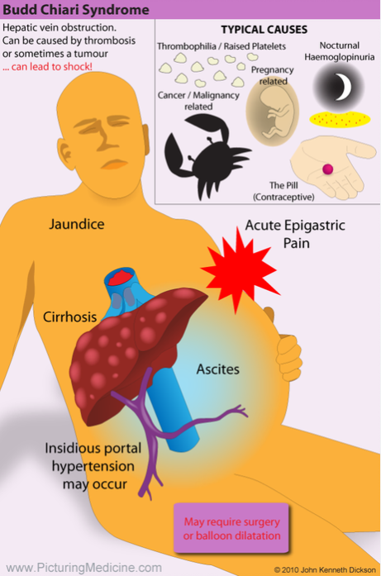
Budd-Chiari syndrome
Condition in which the hepatic veins (veins that drain the liver) are blocked or narrowed by a clot (mass of blood cells).
This blockage causes blood to back up into the liver, and as a result, the liver grows larger.
Variable presentation, asymptomatic to acute liver failure to chronic liver cirrhosis.
Sudden onset of abdominal pain or distension, some can present with jaundice and lower extremity swellings.
In addition to complement inhibitors: might need additional measures such as transvenous/surgical shunts or even liver transplantation in severe cases.

Slide 16
Thrombotic prophylaxis -"Blood thinner to prevent blood clots?"
We suggest not treating with prophylactic anticoagulation.
Lack of high-quality evidence that it effectively prevents blood clots.
Exception: pregnancy (we may start blood thinner at last trimester and continue treatment for 8 to 12 weeks postpartum)

Slide 17
RISK REDUCTION
Cigarette smoking
Diabetes
Obesity
Estro-progestin compounds
Pregnancy
Surgery
Prolonged immobilization

Slide 18
Prominent symptoms related to hemolysis
Fatigue
Dyspnea
Transfusion-dependence
Episodic hemoglobinuria
Pain
And/or organ dysfunction

Slide 19
Management of symptomatic PNH
We recommend treatment with a complement inhibitor, rather than supportive care alone.
Complement inhibitors are effective for symptom relief and prevention of thromboses and are associated with only modest toxicity.

Slide 20
Fatigue Management
Strategies perceived as helpful to extremely helpful (rated 3 through 5) in patient reported studies:
-preserving energy (86%)
-physical activity (70%)
-and naps (68%)

Slide 21
A timely diagnosis and subsequent treatment initiation can prevent the disease from worsening to an intolerable degree.
Use of surveys quantifying quality of life are regularly used during consultations.
Allows physicians to ask pertinent questions in orderly, comprehensive manner.
This opens up the space for honest dialogue and careful follow-up.

Slide 22
Anemia: Low Hemoglobin
Predominantly caused by hemolysis of red blood cells (RBC), but bone marrow failure (BMF), folate or vitamin B12 deficiency, chronic iron loss in urine, and other causes may also contribute.
Transfusions
Folate supplementation (for increased demands due to ongoing hemolysis
iron supplementation not routine; only if deficient

Slide 23
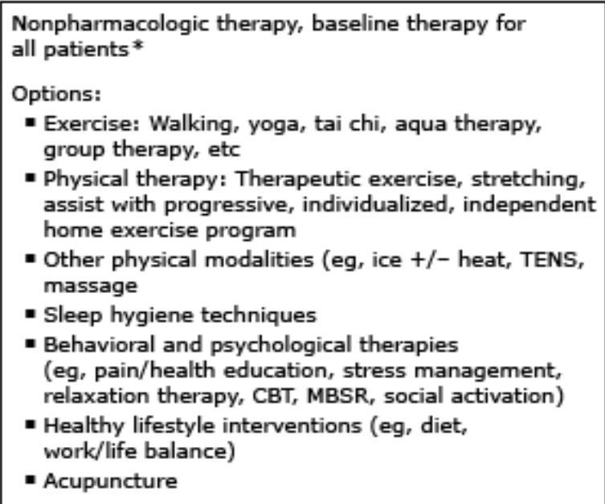
Pain control
Chronic pain may persist despite treatment with a complement inhibitor.
Pharmacologic and non-pharamacologic strategies.

Slide 24
Infectious complications
PNH can also be complicated by infectious events.
Either related to the coexistence of Bone Marrow Failure and immunosuppression, or to complement inhibition.
Anti-Neisseria meningitidis vaccinations are mandatory before eculizumab.
Addition of anti-Streptococcus pneumoniae and anti-Hemophilus influenzae vaccines is also recommended.

Slide 25
Other symptoms/complications:
Acute or chronic kidney disease
Pulmonary hypertension
Erectile dysfunction
Dysphagia/swallowing difficulty
Sudden episodic abdominal/muscle pains
Hemoglobin release can cause blood vessels to undergo spam: constrictions ; disrupting the natural tone of the muscles.

Slide 26
Special Precautions for PNH Patients
Long flights/rides: Get up and walk around every hour or two if it is safe to do so.
High Altitudes: Consult your doctor; might need blood transfusion for your anemia.
Pregnancy: look for a PNH specialist and an OB (obstetrician) who specializes in high-risk births. Patient has few healthy bone marrow and blood cells. More Chances to clot. Might need more transfusions. Increased risk of pre-ecclampsia. Complications in the baby.
Surgery: can have complications due to increased hemolysis, low counts, increased clotting.

Slide 27
Thank you

