Slide 1
Diagnosis and Management of PNH
Alex Nester, MD
Assistant Professor
University of Nebraska Medical Center
Department of Internal Medicine, Division of Hematology / Oncology
Benign Hematology

Slide 2
Objectives and Disclosures
Discuss PNH, including our current understanding of the disease, how we diagnose it, current treatments, and new up-coming therapies.
I have no financial disclosures

Slide 3
Paroxysmal Nocturnal Hemoglobinuria
A particular case

Slide 4
Paroxysmal Nocturnal Hemoglobinuria
~ 6 / million
Age ~30's
Often challenging to diagnose due to rarity

Slide 5
PNH - Hemolysis
Red Blood Cells are destroyed directly in the blood stream
Causes anemia
Hemoglobinuria
In AM
Dark coloring of urine
Fever, malaise, fatigue
Jaundice
Can be treated with transfusions, but increases iron burden

Slide 6
Thrombosis
"We can safely say that PNH is the most vicious acquired thrombophilic state known in medicine"
Major cause of mortality in PNH patients
Hemolysis / granulocyte /platelet activation
Can be seen in small populations
Often in atypical locations
Normally, Pulmonary Embolism or DVT
PNH: Cerebral Vein Thrombosis, visceral thrombosis (liver), skin
Treated with chronic anticoagulation, but generally not prophylactically
Notes:
Anita Hill, Richard J. Kelly, Peter Hillmen; Thrombosis in paroxysmal nocturnal hemoglobinuria. Blood 2013; 121 (25): 4985–4996.

Slide 7
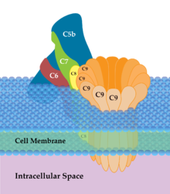
The Complement System
Immune system process with circulating proteins that activate to damage cells and promote inflammation
Stepwise activation
C3b -> C5
Antibodies
Bacterial sugars
Direct binding / autoactivation, esp with damaged tissues and inflammation
Highly regulated

Slide 8
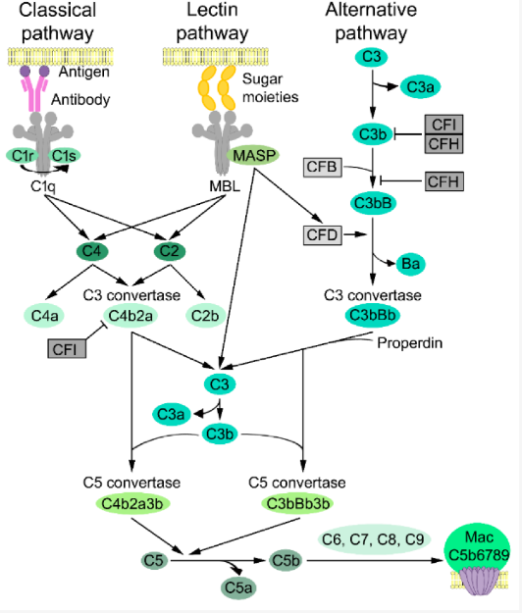

Slide 9
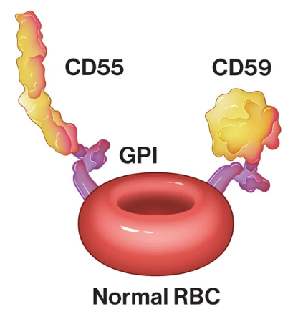
Cells are protected by CD55 (DAF) and CD59 (MIRL) which block and inactivate C3b, the active complement binder
Can detect loss of these proteins by FLOW cytometry
Clonal loss of the PIGA gene leads to unprotected cells
Usually in bone marrow cells passed down to mature cells
Notes:
Brodsky, "How I treat PNH" Blood Volume 137 March 2021
DIF = Decay Accelerating Factor / Membrane inhibitor of reactive lysis
Devalet, B., Mullier, F., Chatelain, B., Dogné, J.-M. and Chatelain, C. (2015), Pathophysiology, diagnosis, and treatment of paroxysmal nocturnal hemoglobinuria: a review. Eur J Haematol, 95: 190-198.

Slide 10
Flow cytometry
Addition of flourescently active markers to outside of cell surface, which than can be differentiated

Slide 12
Bone Marrow Biopsy
Bone marrow
Spongy bone
Hematopoietic cells
Adipose cells

Slide 13
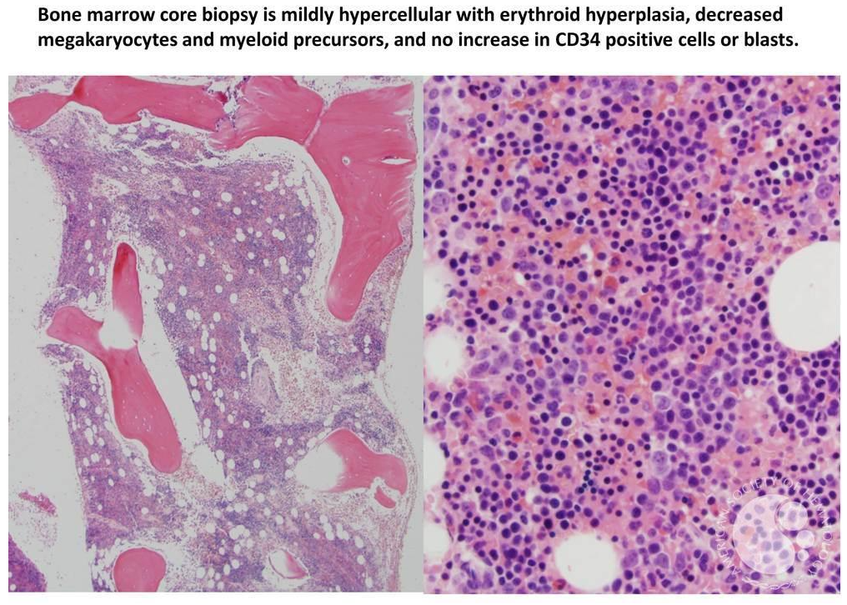
Notes:
Kristian T. Schafernak, M.D. ASH image bank

Slide 14
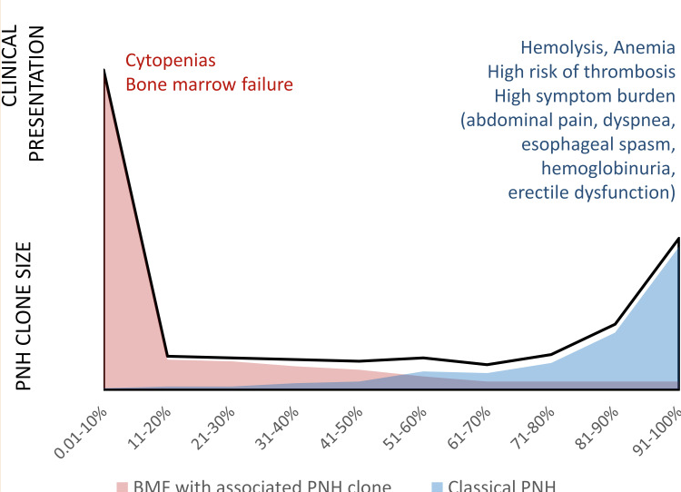
Bone Marrow Failure (AA) vs Classical PNH
Can change disease presentation
Can progress
Unsure mechanism
If bone marrow failure, generally treated per Aplastic Anemia guidelines

Slide 15
Treatment
If marrow failure, treated as AA
If anemic with low PNH clones, may receive supportive transfusions
Risk of Iron overload
Iron Chelation
Liver, auditory toxicity

Slide 16
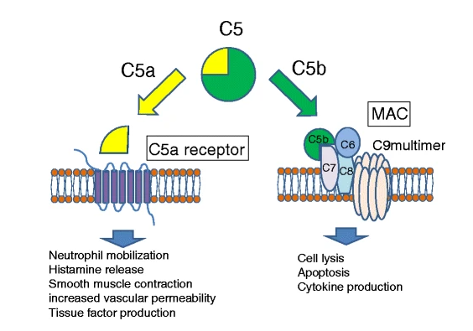
Complement (C5) Antibodies
Eculizumab - 2007
Ravulizumab - 2018
Intravenous
2 vs 8 weeks
Antibodies that bind to C5
Reduce hemoylsis and thrombosis risk

Slide 17
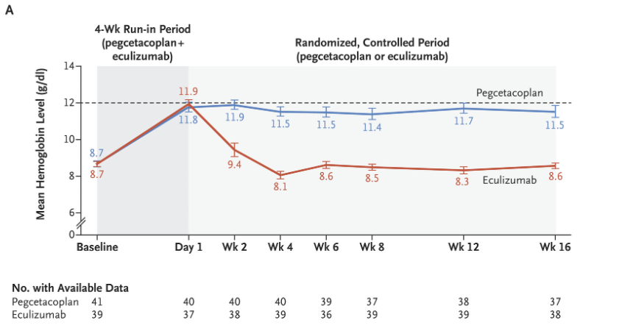
Complement (C3) inhibition
C3b can still be active and cause hemolysis
Pegcetacoplan - 2021
Binds to C3
Thought to improve hemolysis as C3b can coat cells to be later destroyed by immune cells without C5 and MAC
Subcutaneous pump weekly
Notes:
Hillmen, P, et al. Pegcetacoplan vs Eculizumab in PNH, NEJM March 18, 2021

Slide 18
Infection Risk
Loss of complement infers risk of infection from "encapsulated" organisms
A sugary (polysaccharide) that helps evade immune system
Neisseria meningitis
Headache, fever, photosensitivity, neck pain
Less so salmonella, streptococcus
Vaccination against meningitis are required
Prophylactic antibiotics at start of therapy if cannot be completed prior to start of therapy
Still a major risk, prompt evaluation needed

Slide 19
Pending oral complement inhibitors
Iptacopan – increases regulatory Factor B to decrease activation of C3 on C5 antibody
Danicopan – increases regulatory Factor D

Slide 20
Thank you!

