Slide 1
Transplant for MDS
Ryotaro Nakamura, MD
Division of Leukemia
Department of Hematology/HCT
City of Hope, Duarte, CA

Slide 2
Disclosure
Institutional research support: Miyarisan, Helocyte
Consultancy: Sanofi, bluebird bio, Ono pharmaceutical, Jazz Pharmaceuticals, Omeros

Slide 3
Who/when to transplant:
Retrospective statistical models
Prospective studies
Select subgroups
How to transplant
Conditioning intensity
GVHD prophylaxis
Donor sources
Transplant in MDS

Slide 4
Allogeneic HCT
The only potentially curative treatment
Eliminates malignant hematopoietic clones through conditioning chemo-radiotherapy and graft-versus-leukemia (GVL) effects
Restores hematopoiesis with donor-derived progenitor cells
Associated with significant risks of transplant-related mortality/morbidity (GVHD, infection, organ toxicity, graft failure)

Slide 5
Myelodysplastic Syndrome
Myelo (=bone marrow)
Dysplastic (=looks funny in shape/size)
Syndrome (=we don’t really know what it is)

Slide 6
Components of the syndrome
Clonal hematopoiesis
Cytopenia
Dysplastic morphology

Slide 7
Indolent Myeloid Hematopoietic Disorders
Idiopathic Cytopenias of Unknown Significance (ICUS)
Idiopathic Dysplasia of Unknown Significance (IDUS)
Clonal Hematopoiesis of Indeterminate Potential (CHIP)
Clonal Cytopenias of Unknown Significance (CCUS)
Feature | ICUS | IDUS | CHIP | CCUS | MDS
Somatic mutation | - | - | +/- | +/- | +/-
Clonal karyotipic abnormality | - | - | +/- | +/- | +/-
Marrow dysplasia | - | + | - | - | +
Cytopenia | + | - | - | + | +
Likely immune-mediated
Not a disease
Cloncal hematopoietic disease

Slide 8
Components of MDS diagnosis and spectrum
Clonal hematopoiesis
Cytopenia
Dysplastic morphology
CHIP
CCUS
MDS
ICUS
IDUS
Aplastic anemia with clonal hematopoiesis?

Slide 9
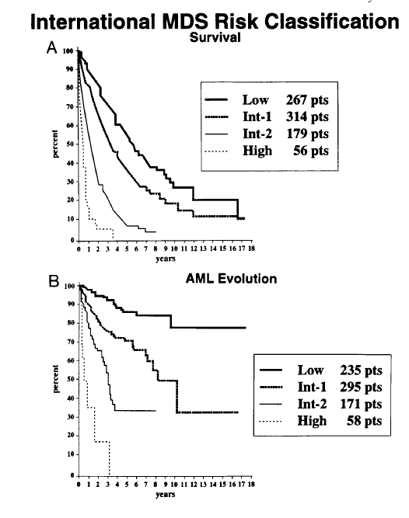
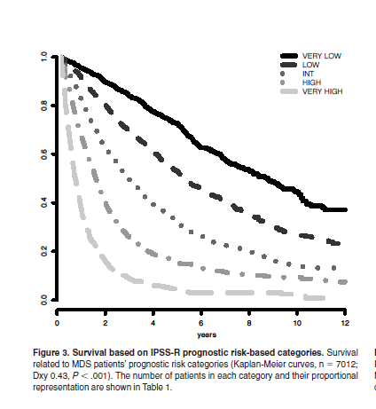
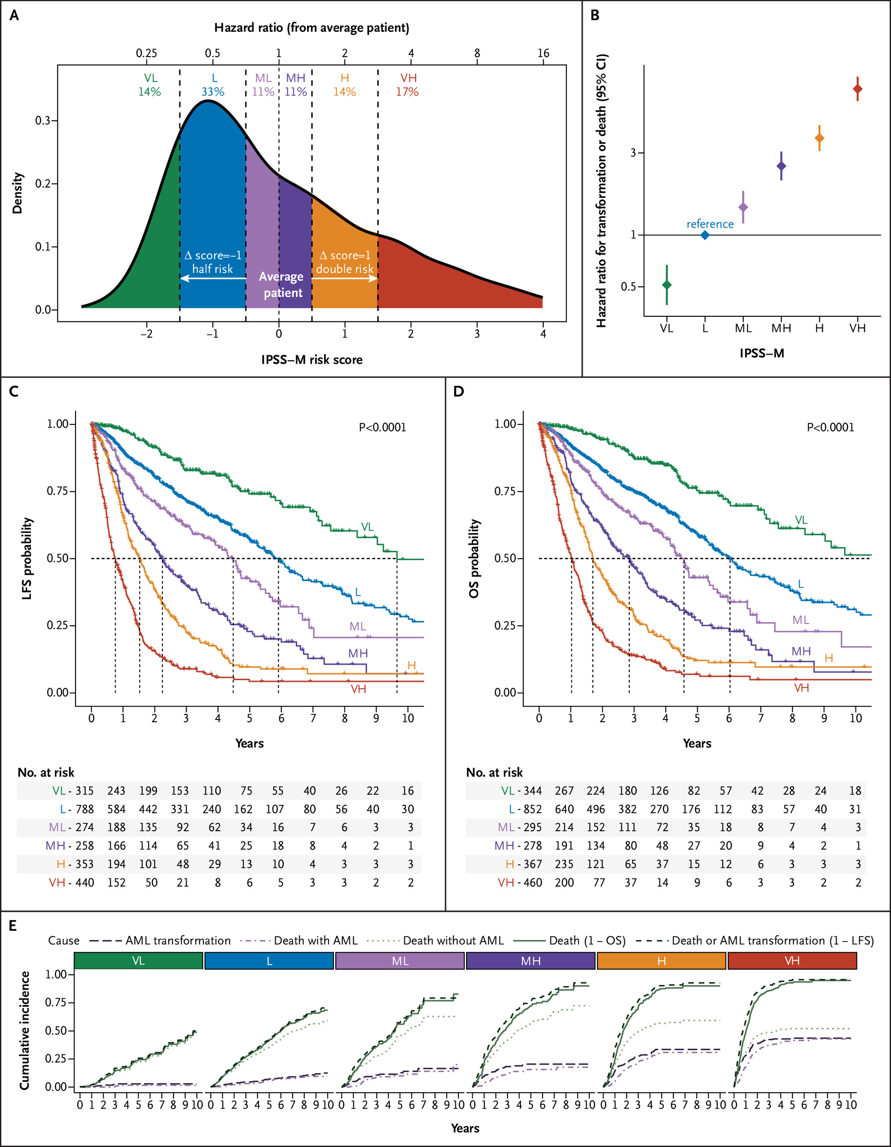
Prognosis: risk from MDS
IPSS
cytopenia, cytogenetics, %blasts
IPSS-R
cytopenia, cytogenetics, %blasts
IPSS-M
cytopenia, cytogenetics, %blasts
Somatic mutations
Blood 1997;89:2079–2088
Blood 2012;120:2454–2465
NEJM Evid 2022;1(7)
DOI: 10.1056/EVIDoa2200008

Slide 10
Survival outcomes from HMA trials
Design/Therapy |  | N | Overall Survival
 | Cohort: Outcome after AZA-failure(1) | 435 | 15% (2 year)
 | Cohort: Prognostic Factors in Compassionate Use AZA (2) | 282 | ~20% (3 year by survival curve)
 | Cohort: Compassionate Use AZA (3) | 282 | 17.5% (3 year)
 | Ph III: Low-Dose Decitabine vs. BSC (4) | 233 | 19% (2 year)
 | Ph III: European AZA-001: AZA vs. BSC (5) | 358 | 50.8% (2 year), ~30% (3 year by survival curve)
 | Ph III: CALGB AZA vs. BSC (6) | 191 | ~45% (2 year), ~25% at (3 year by survival curves)
 | Retrospective: HCT in 60-70 yo vs. No Donor + AZA (8) | 178 | 23% (2 year)
 | Decision Analysis (<60yo) (9) | 184 | <5% for high, ~20% for Int-2 (3 year by survival curve)
J Clin Oncol. 2011;29(24):3322-3327.
Blood, 2011; 117 (2): 403-411.
Blood. 2012;119(25):6172-6173.
J Clin Oncol. 2011;29(15):1987-1996.
5. Lancet Oncol. 2009;10(3):223-232.
6. J Clin Oncol. 2002;20(10):2429-2440.
7. Biol Blood Marrow Transplant. 2012;18(9):1415-1421.
8. Blood. 2004;104(2): 579-585.

Slide 11
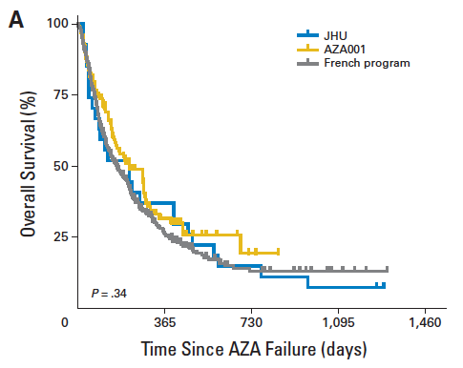
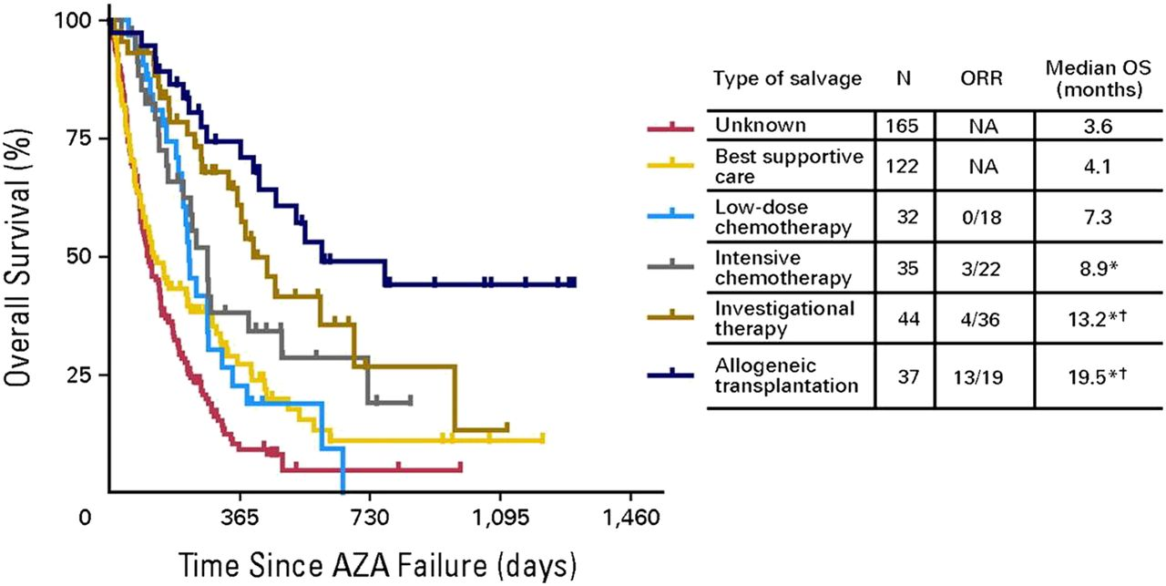
Poor outcome after azacitidine
treatment failure
Prebet et al. J Clin Oncol 2011; 29:3322

Slide 12
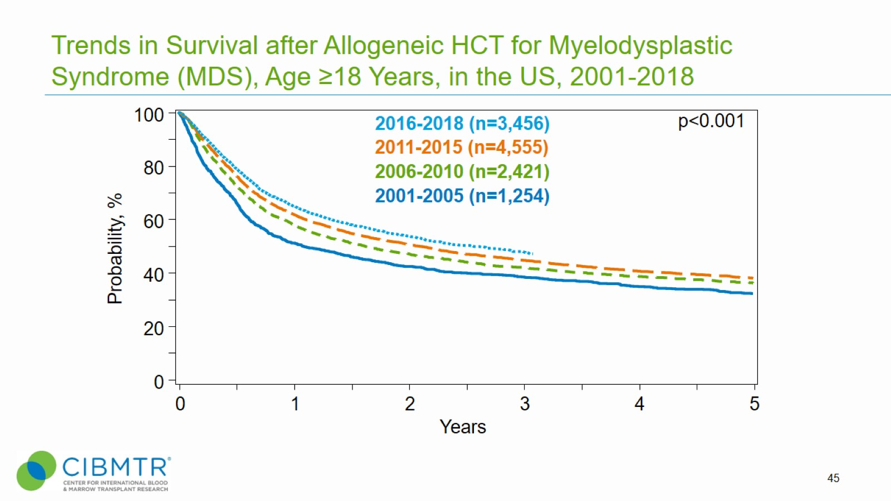
CIBMTR summary slides, 2020. Available at: http://www.cibmtr.org

Slide 13
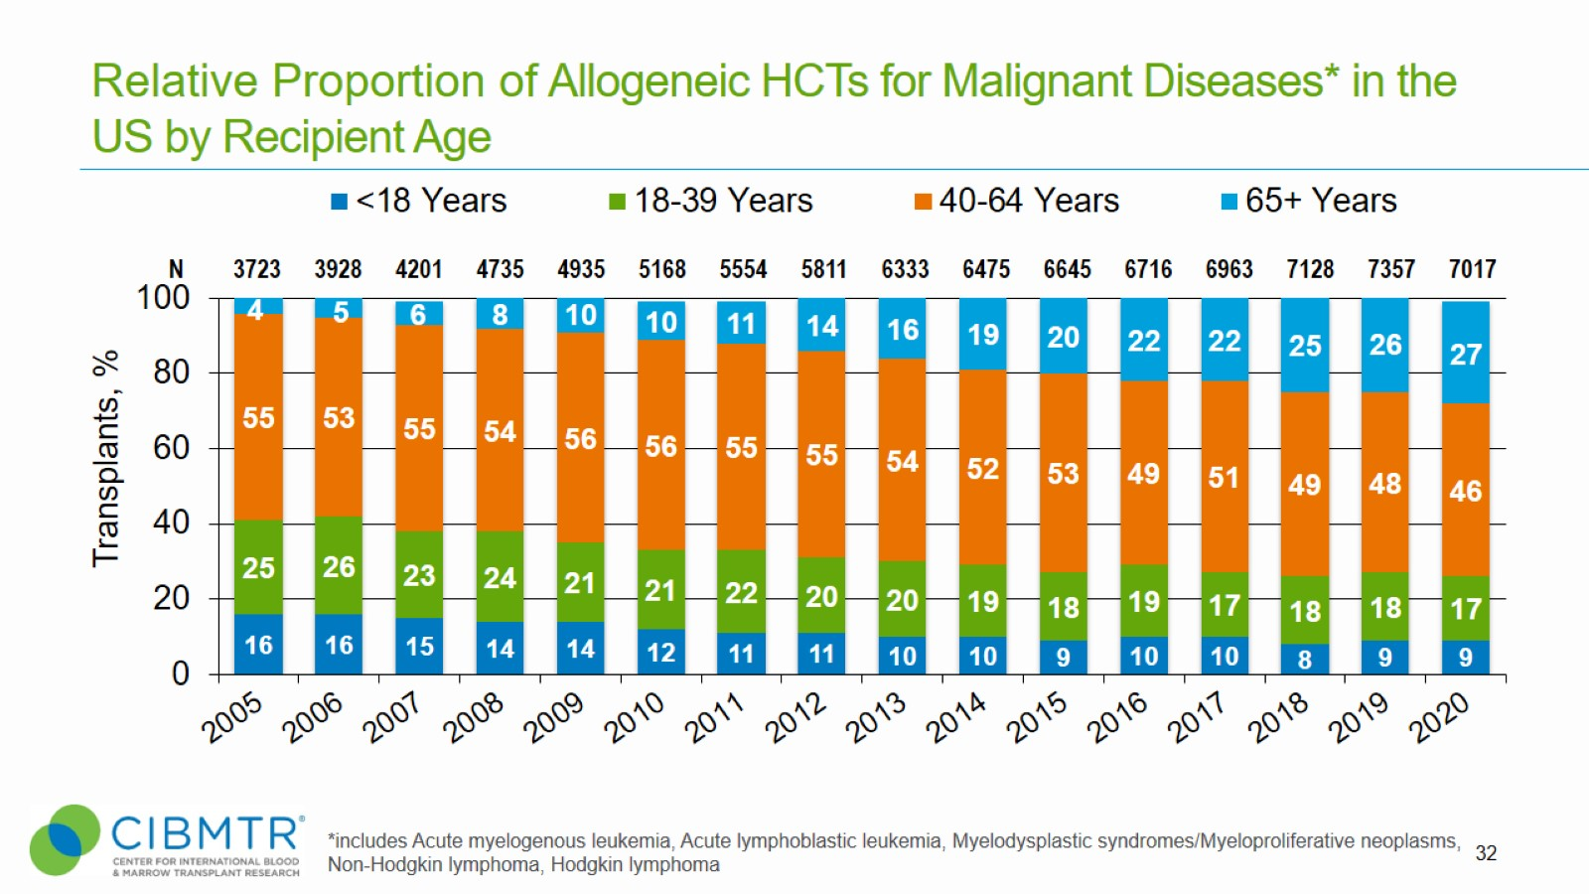

Slide 14
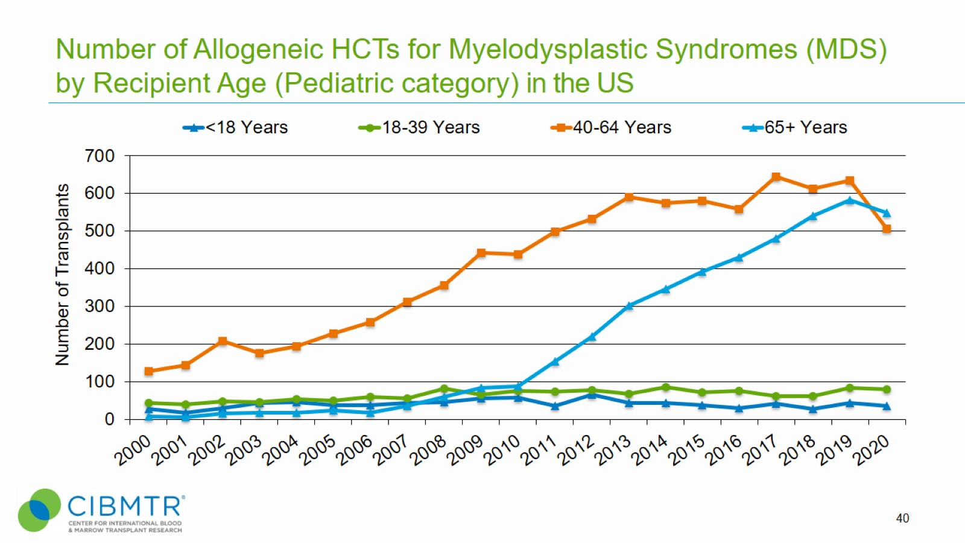

Slide 15
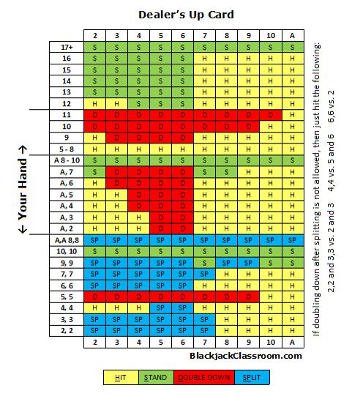

Transplant is not a gamble….

Slide 16
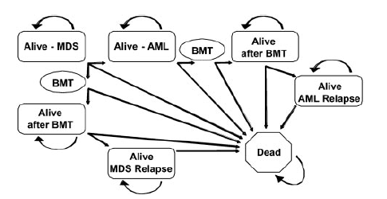
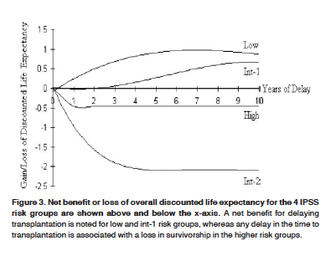
A decision analysis of allogeneic BMT for MDS
BMT cohort
- BM graft
- ablative conditioning,
- sibling donor, tacro-MTX
Non-BMT cohort
- IMRAW database
Markov decision model
Cutler et al. Blood. 2004;104:579-585

Slide 17
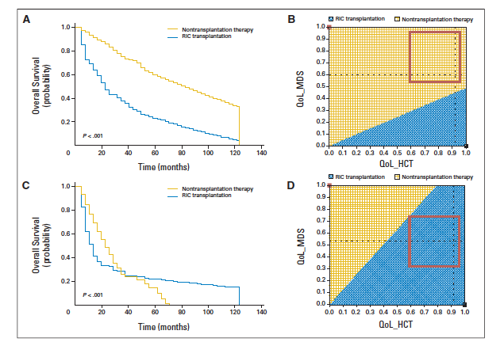
Decision analysis for older pts with MDS
De novo MDS
Age 60-70yo,
RIC from MUD/MRD
IPSS Low/Int-1
RIC transplantation (n=132) was compared with
best supportive care for pts with non-anemic low/int-1 IPSS (n=123),
hematopoietic growth factors for patients with anemic low/int-1 IPSS (n=94),
HMA for patients with int-2/high IPSS (n=165).
IPSS Int-2/High
Blue area: superior QALE
Koreth et al J Clin Oncol 2013; 31:2662-2670

Slide 18
The Centers for Medicare and Medicaid services (CMS)
Decision Memo on August 4th 2010
- Coverage for HCT for MDS through coverage with evidence development (CED)
Prospectively, compared to Medicare beneficiaries with MDS who do not receive HSCT, do Medicare beneficiaries with MDS who receive HSCT have improved outcomes?
  NRM, PFS, Relapse, Overall Survival
Prospectively, in Medicare beneficiaries with MDS who receive HSCT, how do IPSS score, patient age, cytopenias and comorbidities predict outcomes?
Prospectively, in Medicare beneficiaries with MDS who receive HSCT, what treatment facility characteristics predict meaningful clinical improvement in outcomes?
BMT CTN 1102
CIBMTR study: 10-CMS-MDS

Slide 19
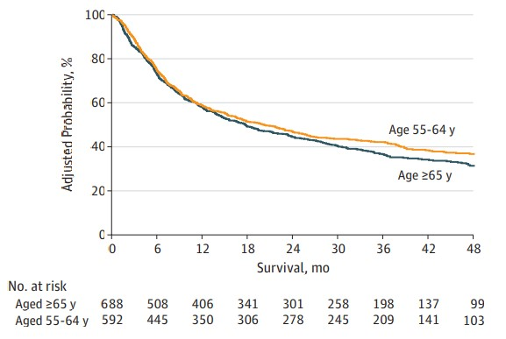
Comparison of Patient Age Groups in Allogeneic HCT for MDS:
The Medicare Coverage With Evidence Development Study
Overall survival by age
Compared outcomes of patients 55-64 years vs ≥65 years
Enrollment Dec 2010 to May 2014
Median follow-up of 47 months
Similar OS between younger and older patients
Atallah E, et al. JAMA Oncology. 2020; 6:486-493.

Slide 20
HLA-matched allogeneic HCT improves
outcome of higher risk MDS: SFGM-TC and GFM
Eligibility
age 50–70 years
de novo or therapy-related MDS
int-2 or high IPSS, or int-1 IPSS with poor risk cytogenetics or platelet transfusion-dependent thrombocytopenia
CMMoL
N=162 (50: no donor, 112: donor), median age 60
IPSS | no donor | donor
Int-1 | 5 (10%) | 8 (7%)
Int-2 | 28 (56%) | 75 (67%)
High | 12 (24%) | 22 (20%)
Robin et al. Leukemia (2015) 29, 1496–150

Slide 21
VidazaAllo Study
Comparison Between 5-Azacytidine Treatment and Allogeneic Stem-Cell Transplantation in Elderly Patients With Advanced MDS According to Donor Availability
Kro ̈ger et al. J Clin Oncol 39:3318-3327. © 2021

Slide 22
VidazaAllo Study
Kroger et al. J Clin Oncol 39:3318-3327. © 2021

Slide 23
BMT CTN 1102 Study Design
multicenter, biologic assignment study
Enrollment
Matched related or unrelated donor search for up to 90 days
Donor arm: RIC alloHCT within 6 months
No Donor arm: hypomethylating agent or best available non transplant care
Inclusion criteria
Primary MDS, IPSS-R Intermediate -2 or high risk
50-75 years
Any prior therapy
No prior unrelated donor search
Eligible for RIC alloHCT from a matched related or unrelated donor
Primary endpoint:
Overall survival at 3 years
Secondary endpoints:
Leukemia free survival at 3 years
Quality of life (QoL)
Cost effectiveness
NCT02016781
23
Nakamura, et al. J Clin Oncol 2021; 39:3328-3339
23

Slide 24
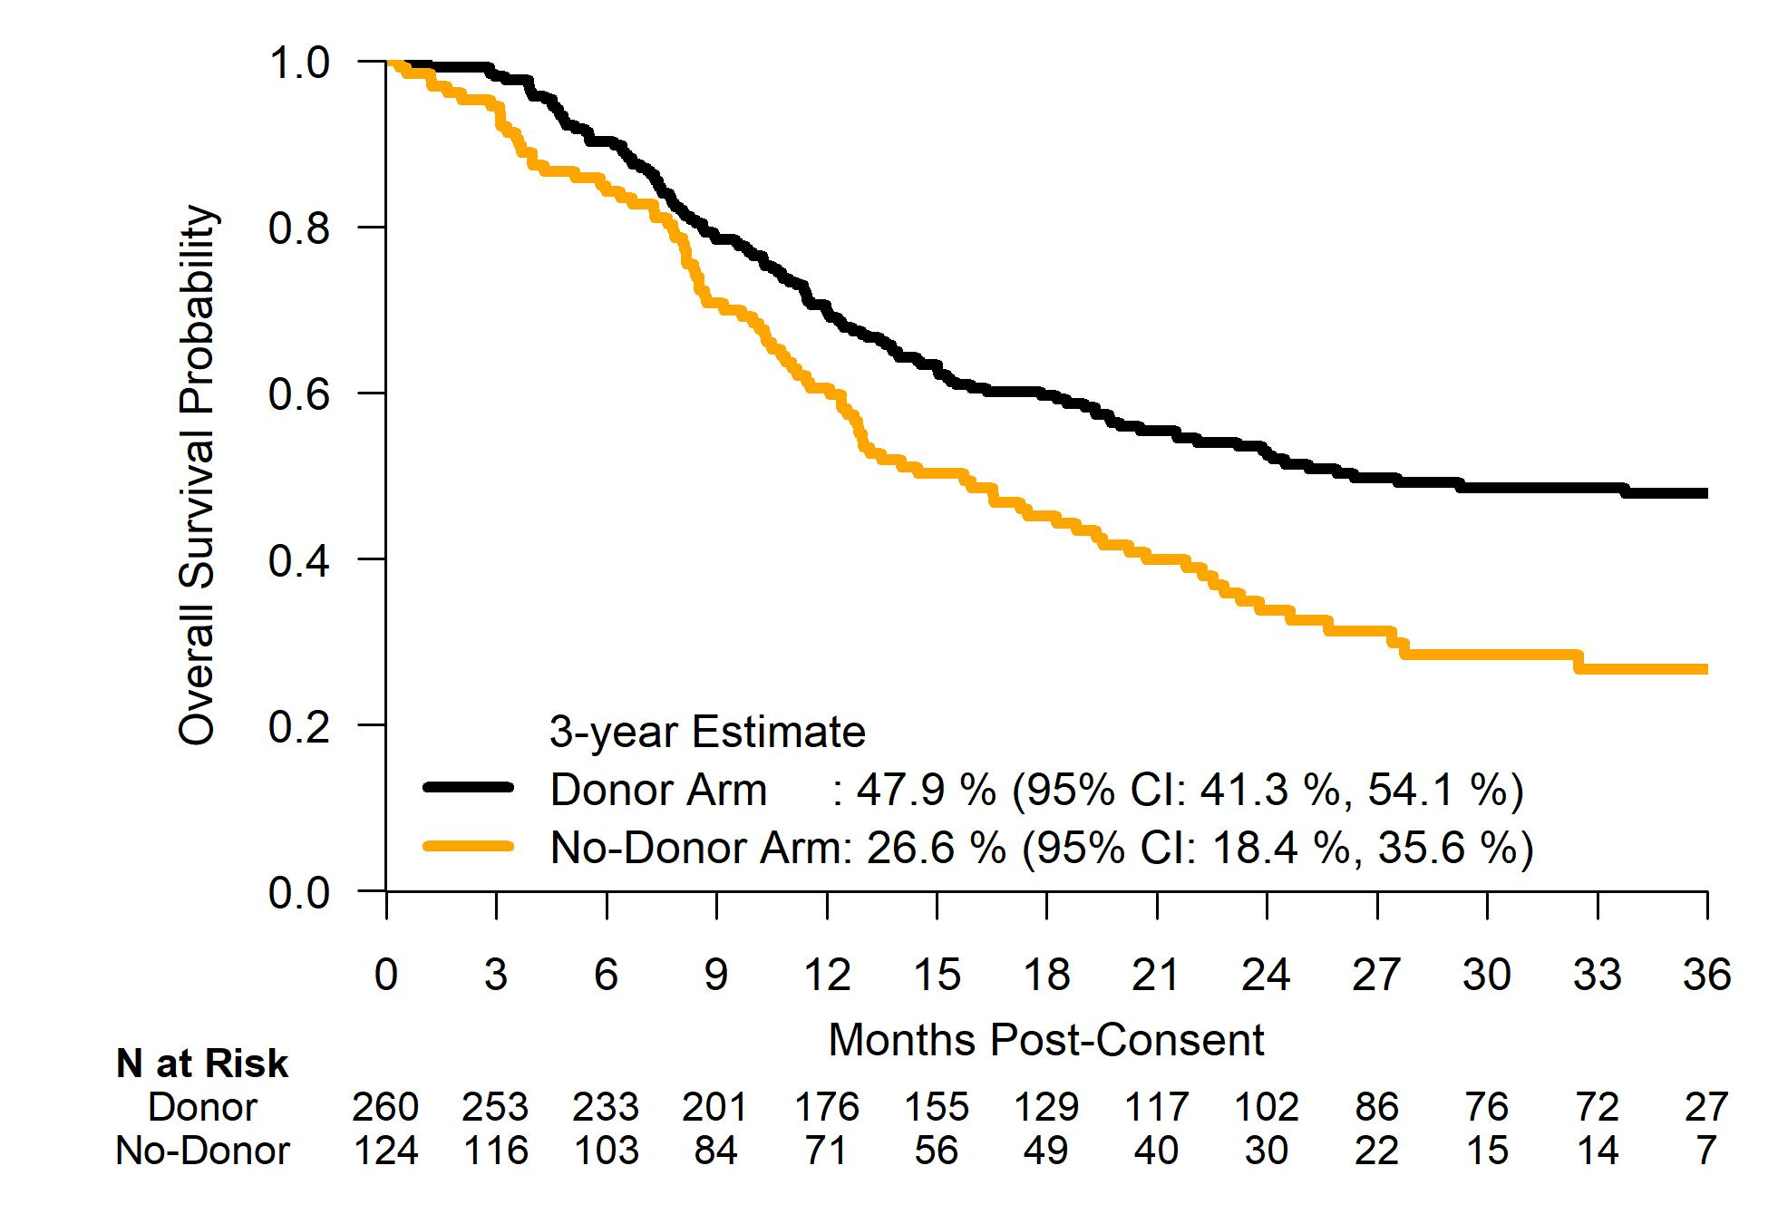
Primary Endpoint: Adjusted Overall Survival at 3 Years
Absolute Improvement
21.3%, p=0.0001
Sensitivity Analysis: Adjusted OS: 48.0% vs. 28.1%, p=0.0004
Nakamura, et al. J Clin Oncol 2021; 39:3328-3339
24

Slide 25
Leukemia-free Survival Advantage with Similar QoL
Nakamura, et al. J Clin Oncol 2021; 39:3328-3339
25

Slide 26
Conclusions – BMT CTN1102
Among higher-risk MDS patient aged 50-75, having a suitable donor leads to improved outcomes.
  Subjects > 65 (Medicare aged) had similar results to those < 65
  No decrease in QOL compared to No Donor arm
  As-treated analyses suggest strong advantage for HCT vs. non-HCT therapy
HCT should be included as an integral part of MDS management plans for patients with higher-risk disease.
Early referral to an HCT center and coverage by Medicare is recommended.
26

Slide 27
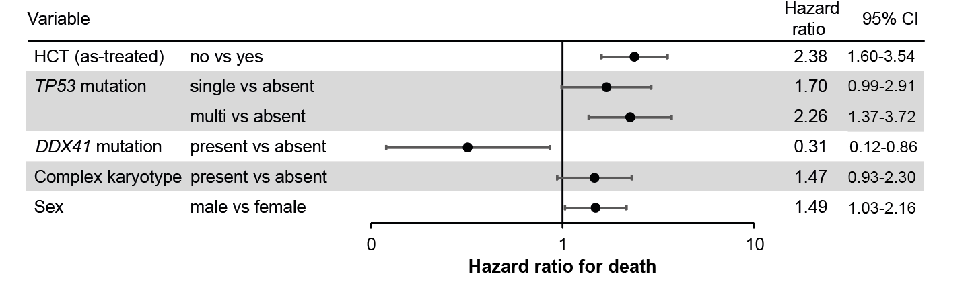
Somatic Mutation Analyses
Samples at enrollment in the BMT CTN 1102
HCT (n=197) compared with no HCT (n=78), with HCT as time varying covariate.
The overall distribution of gene mutations was similar in the donor and no donor arms
  TP53 (28% vs 29%, P=0.89)
  ASXL1 (23% vs 29%, P=0.37)
  SRSF2 (16% vs 16%, P=0.99)
  DNMT3A (17% vs 10%, P=0.20)
3-yr OS was worse with a TP53 mutation (21% vs 52%, P<0.001).
Improved OS with HCT compared with no HCT in patients with a TP53 mutation (HR 3.22; 95% CI 1.61-6.42; P=0.001)
Versluis et al. ASTCT abstract 2022
27

Slide 28
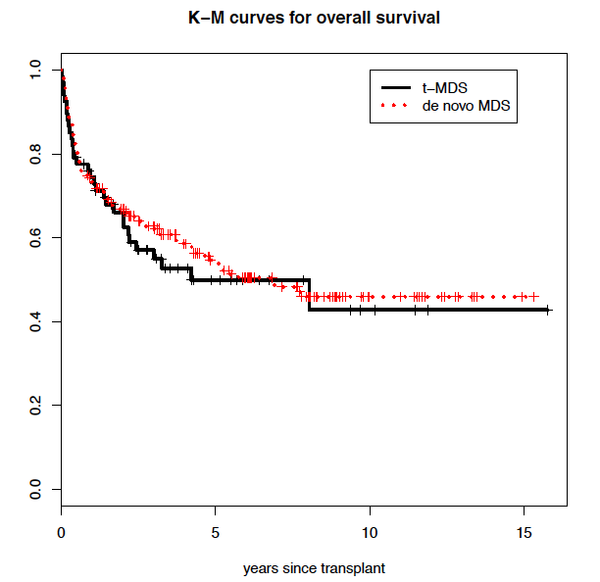
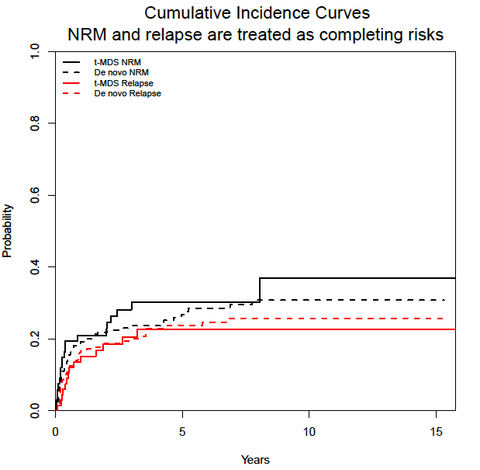
Allogeneic HCT for therapy-related MDS
Aldoss et al. Haematologica 2017

Slide 29
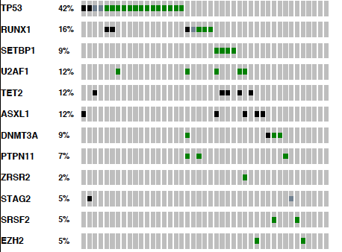
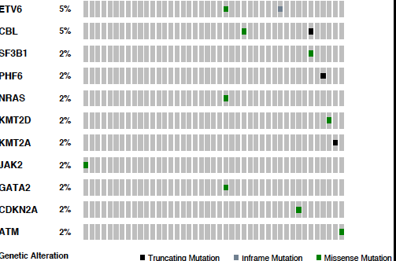
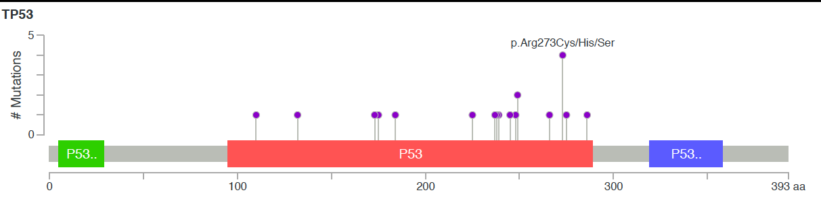
Somatic mutations in t-MDS
Aldoss et al. Haematologica 2017

Slide 30
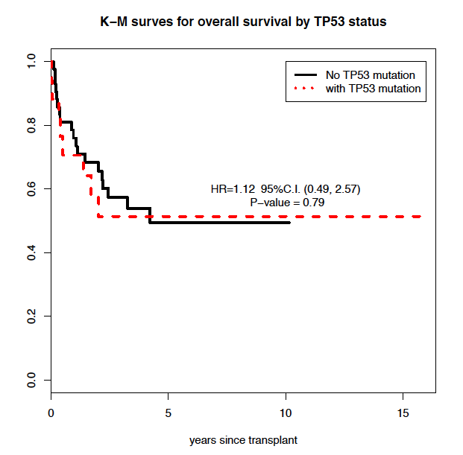
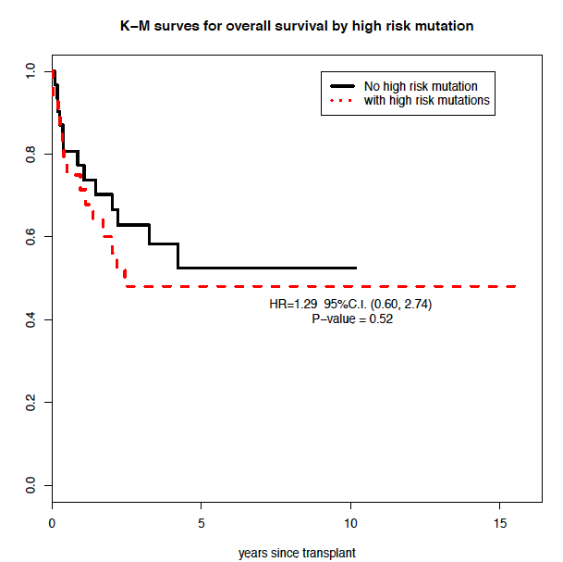
Impact of somatic mutations in HCT for t-MDS
TP53
TP53, EZH2, ETV6, RUNX1, or ASXL1
Aldoss et al. Haematologica 2017

Slide 31
How to Transplant?

Slide 32



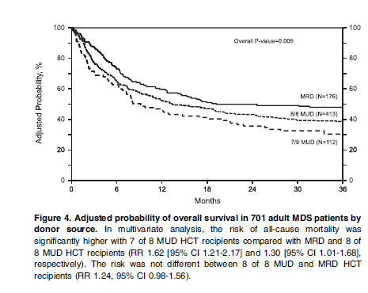
Impact of donor source (CIBMTR data)
Haploidentical relative vs. MUD
MRD, MUD, MMUD
NRM
Relapse
RFS
OS
Saber et a. Blood. 2013;122:1974-1982.
Grunwald et al. Blood Adv. 2021 Feb 23; 5(4): 985–993.

Slide 33
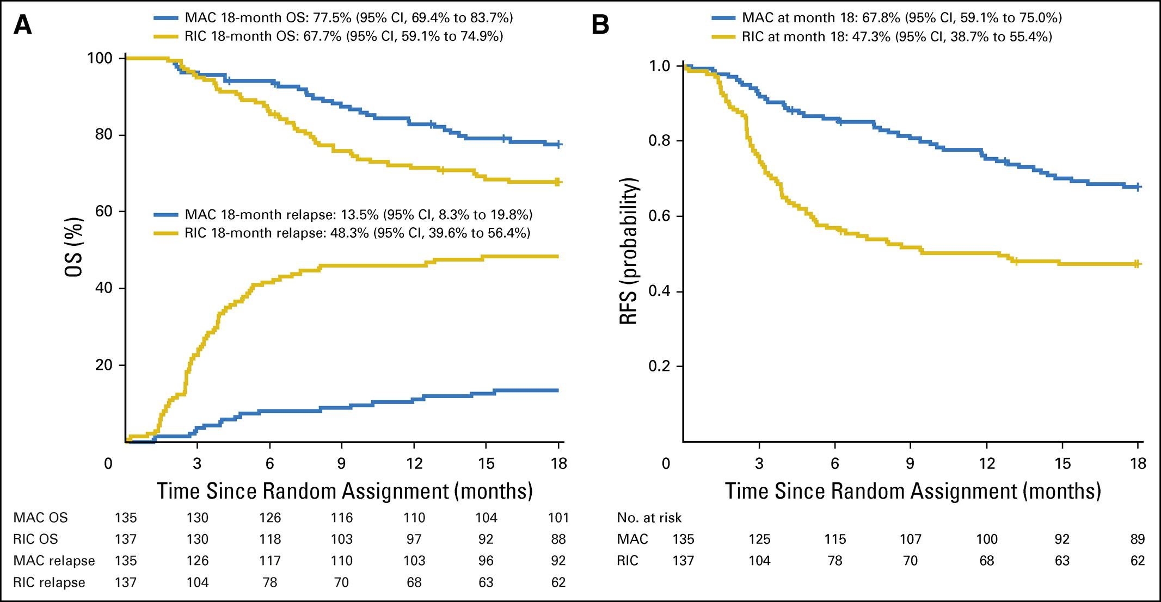
Impact of Conditioning Intensity
BMT CTN 0901: MAC vs. RIC
CIBMTR: age>=60, FluMel vs. FluBu
MDS: 20%, mostly BuFlu
Scott et al. J Clin Oncol 35:1154-1161, 2017
Oran et al. Transplant Cell Ther. 2021 Nov;27(11):921.e1-921.e10

Slide 34
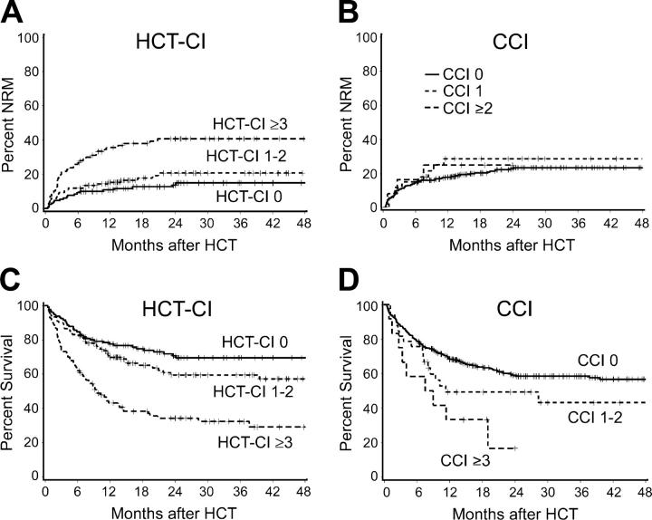
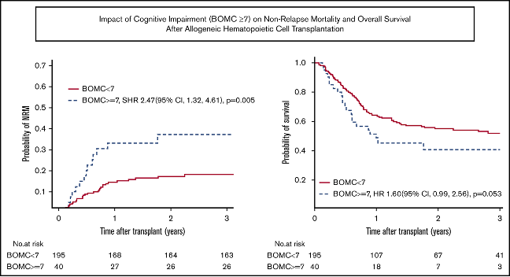
Risk Stratification for Recipient Comorbidity
HCT Comorbidity Index (HCT-CI)
Geriatric Assessment
Olin et al. Blood Adv (2020) 4 (12): 2810–2820
Sorror et al. Blood. 2005 Oct 15;106(8):2912-9.
34

Slide 35
Ongoing/Future Efforts
Improvement in MDS therapy (pre-HCT therapy) – more effective, less toxic
Improvement in risk stratification and access to HCT
  MDS risk
  Patient risk (age, comorbidity)
  Mismatched donors (haploidentical, mismatch unrelated)
Improvement in HCT strategy
  Conditioning, post-HCT maintenance
  GVHD prophylaxis/therapy
  Immune reconstitution

Slide 36
Older patients with MDS
Risk stratification of MDS
Higher risk? (IPSS/IPSS-R, symptomatic cytopenia, somatic mutations, etc.)
no
yes
Non-HCT therapy
HCT Referral
Risk stratification of the patient
Fitness as an HCT candidate? (performance status, comorbidity, geriatric assessment, organ functions, etc.)
Disease response?
yes
no
yes
no
Non-HCT therapy
Prehabilitation
Optimization of comorbid conditions
Donor search
Continue therapy
Disease progression
HCT
no
yes
Improvement?
36

Slide 37
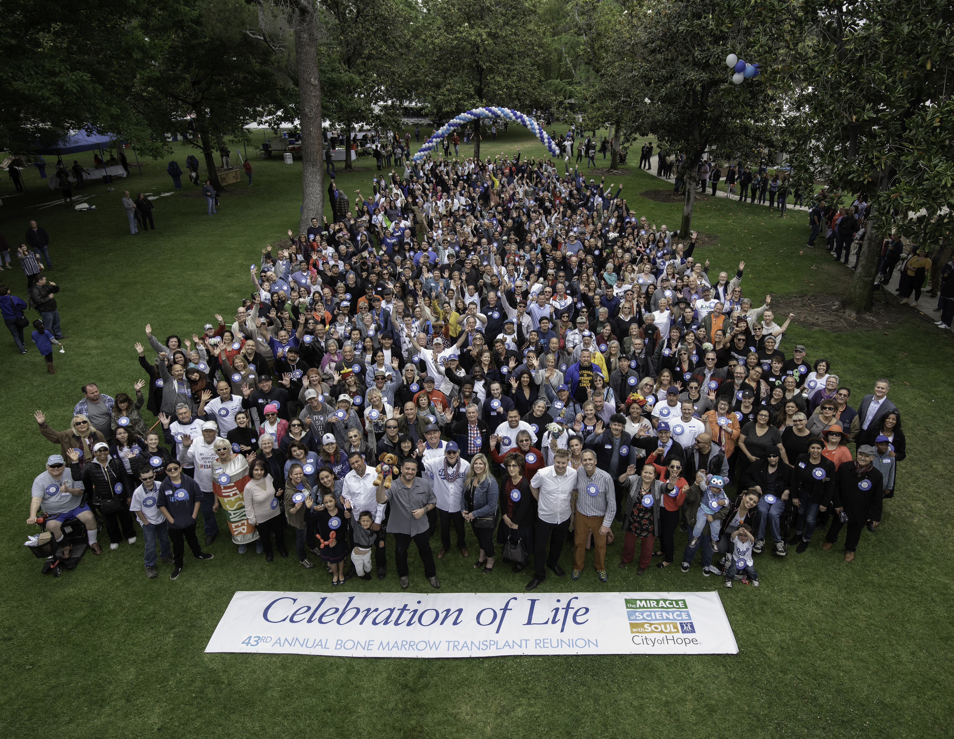
Thank you!

