Slide 1
Myelodysplastic Syndromes Non-Transplant Management
Paul J. Shami, M.D.
Division of Hematology and Hematologic Malignancies
Huntsman Cancer Center
University of Utah

Slide 2
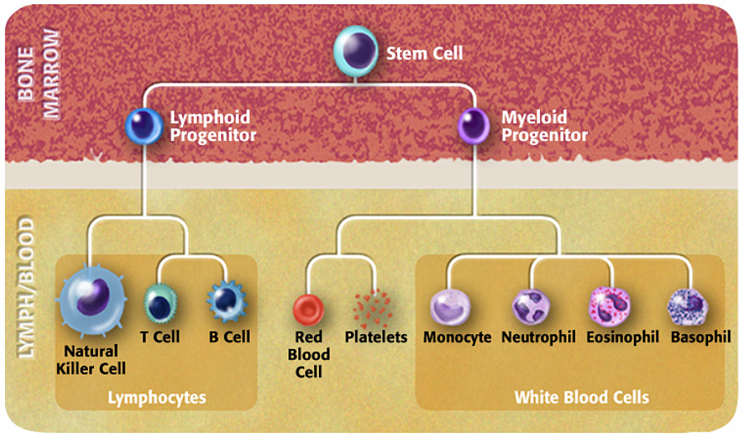
Blood Cells Production in the Bone Marrow

Slide 3
Myelodysplastic Syndromes
A type of bone marrow cancer
Manifested by low blood counts (low white blood cells, low red blood cells, low platelets)
Associated with a more or less high risk of developing acute myeloid leukemia

Slide 4
Myelodysplastic Syndromes
About 20,000 new cases per year in the USA (likely an underestimate)
Mostly seen older patients (> 60)
Incidence increases with age
Survival varies depending on risk category

Slide 5
Myelodysplastic Syndromes
Risk Factors
Cause generally unknown
Exposure to radiation
Certain chemotherapy drugs
Certain chemical exposures (benzene and others)

Slide 6
Myelodysplastic Syndromes
Symptoms
Frequently asymptomatic
Symptoms related to type and degree of low blood counts
Fatigue
Shortness of breath
Bruising and bleeding
Fevers and infections

Slide 7
Myelodysplastic Syndromes
Diagnosis
History and physical exam
Complete blood count
Iron, Vitamin B12, Folate level
Erythropoietin level
Bone marrow biopsy
Morphology (cell appearance under the microscope)
Flow cytometry (identification of abnormal cells)
DNA abnormalities (chromosomes and DNA mutations)

Slide 8
Myelodysplastic Syndromes
Classification

Slide 9
Myelodysplastic Syndromes
Revised International Prognostic System

Slide 10
Myelodysplastic Syndromes
International Prognostic System Molecular

Slide 11
Myelodysplastic Syndromes
Management – Low Risk
Treat if clinically significant low blood counts
Clinical trial if available
Transfusion support as needed
Iron chelation therapy if indicated
If significant anemia and 5q- present: Lenalidomide
Erythropoietin (if erythropoietin level below 500 mU/mL) +/- G-CSF
Luspatercept (SF3B1 mutation or ring sideroblasts >15%)
Antithymocyte globulin/cyclosporine/eltrombopag in selected patients
Chemotherapy (azacitidine or decitabine or decitabine/cedazuridine)

Slide 12
Myelodysplastic Syndromes
Management – High Risk
Clinical trial if available
Chemotherapy (azacitidine or decitabine or decitabine/cedazuridine)
Bone marrow transplant if feasible

