Slide 1
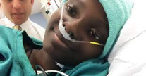



BMT for Severe Aplastic Anemia:
When, Who, How?
Michael A. Pulsipher, MD
Division Chief, Pediatric Hematology and Oncology
Director, Children’s and Adolescent Cancer Initiative at Huntsman Cancer Institute and Intermountain Primary Children’s Hospital
IPCH-HCI Presidential Chair in Pediatric Oncology and Hematology

Slide 2
Disclosures
Disclosure: I am a member of a steering committee that guides conduct of the Novartis 2205J and 2202 studies of CTL019 CAR T-cells.
I have performed advisory and/or educational activities for Novartis, Miltenyi, Adaptive, Mesoblast, Medexus, Vertex, Bluebird, and Equillium Pharmaceuticals.
I am receiving grant and/or product support for studies from Adaptive and Miltenyi.
My spouse and I have no relevant financial relationships with the other manufacturer(s) or any commercial product(s) and/or providers of commercial products or services discussed in this CME activity.

Slide 3
Overview
Defining SAA
  Ruling out other causes
Initial Therapy
  Matched Sibling BMT
  Immune Suppression
Improved Outcomes with URD and Haplo BMT
  URD BMT
  Haplo BMT
What is the best first therapy?

Slide 4
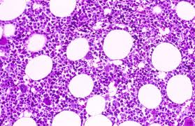
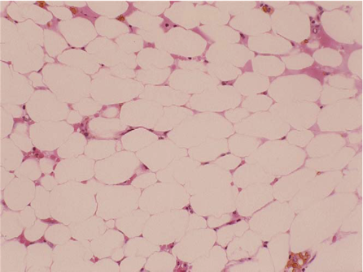
Marrow Failure: Sustained decrease in two of the three major parts of BM: WBC, blood or platelets

Slide 5
First Step: Rule out MDS or Inherited Marrow Failure Syndromes
MDS
  Premalignant Disease—can advance to AML
  May have high or low cellularity
  Cytogenetic and FISH testing
Hereditary BM Failure Syndromes
  Genetic disorders resulting in BM or single lineage failure
  Disorders often associated with phenotypic abnormalities
  Propensity to develop secondary MDS/Leukemia
Acquired Aplastic Anemia
  Loss of hematopoietic stem cells via immune attack or toxin exposure
  Non- vs. Severe Aplastic Anemia: Camitta Criteria
    ≥2 lines down: ANC < 500/μL, Plts < 20K/μL, Retic < 1%
    BM cellularity <25% or 25-50% with 30% hematopoietic cells
    “Very Severe AA” ANC < 200/μL

Slide 6
Hereditary Marrow Failure Syndromes
Fanconi Anemia (FA)
Shwachman-Diamond Syndrome (SDS)
Dyskeratosis Congenita (DC)
Congenital Amegakaryocytic Thrombocytopenia (CAMT)
Thrombocytopenia with Absent Radii (TAR)
Diamond-Blackfan Anemia (DBA)
Severe Chronic Neutropenia (Kostmann’s Syndrome)
Seckel Syndrome
Pearson Syndrome (mitochondrial disorders)

Slide 7

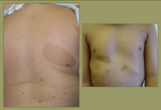
What BMF Patients should be further evaluated?
Patients who are short or have phenotypic abnormalities such as
  Radial anomalies (abnormal or missing thumbs, abnormal radius) (FA)
  Metaphyseal chondrodysplasia, narrow chest (SDS)
  Café au lait (FA), reticular upper chest pigmentation (DC)
  Small HC, hypo/hypertelorism, small eyes (FA)
  Abnormal ear shape & location, poor hearing
  Abnormally ridged and small nails, esp. toenails (DC)
  Leukoplakia (DC)
  Square blockish head (DBA)
  Developmental delays, school issues, ADHD (FA, SDS, Seckel)
  Neurological findings (mtDNA disorders)
  Hypospadius, cryptorchidism

Slide 8
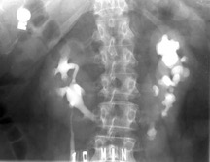
Patients with unusual findings on testing
  Cardiac anomalies (FA, DC)
  Horseshoe kidneys (FA)
  Pulmonary fibrosis (DC)
  Elevated LFTs (SDS)
  Liver fibrosis, cirrhosis, esophageal varices (DC)
  Small or fatty pancreas (SDS)
  Osteopenia in a young patient (SDS, DC)
  Severe dental anomalies (SDS)

Slide 9
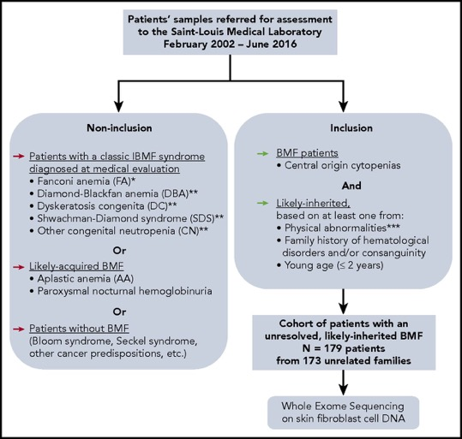

Genetic Screening
Olivier Bluteau et al. Blood 2018;131:717-732
©2018 by American Society of Hematology
Notes:
Constitution of a cohort of IBMF patients, likely inherited, with unresolved origin after initial evaluation. *FA diagnosis was performed at initial evaluation, for all patients whose samples were sent in our laboratory, as we previously described, for example, MMC sensitivity in peripheral blood and skin fibroblast cells.^{18,19} **Typical DBA, SDS, and other CN, and DC patients who were diagnosed up front with these syndromes based on a syndromic presentation were not included in the current “undiagnosed cases” WES study. Nevertheless, we subsequently identified additional patients with mutated DBA, SDS, or DC genes in our cohort through WES analysis. A posteriori, some of these patients had a presentation that might have been recognized as syndromic if fully evaluated. ***Physical abnormalities suggesting an inherited origin included skeletal abnormalities (thumb, jaw, or any limb malformation); neurological defects (developmental delay or intellectual disability, dyspraxia, attention deficit disorder, or abnormal MRI image); growth retardation; skin, nail, or hair abnormalities; genitourinary or renal malformations (renal agenesis, cryptorchidic testis); cardiac abnormalities (valvular heart disease, heart failure); lung abnormalities (mainly restrictive syndrome or fibrosis), liver abnormalities (cirrhosis, fibrosis). BMF, bone marrow failure; MMC, mitomycin C; WES, whole-exome sequencing.

Slide 10
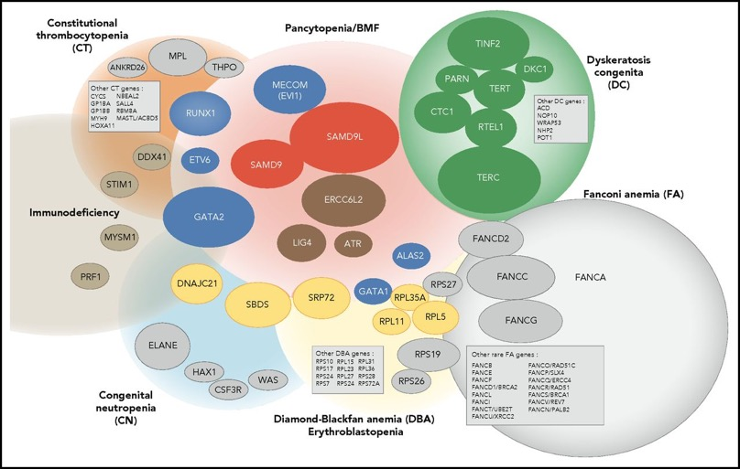
48% of these Patients had a disease: Subtypes below
Olivier Bluteau et al. Blood 2018;131:717-732
©2018 by American Society of Hematology
Notes:
Integrated portrait of IBMF diseases. Genetically defined entities are shown. The genes found mutated in our current IBMF cohort are shown as colored ellipses, the sizes of which correspond to patient frequency; these cases are integrated in an updated general portrait of IBMF diseases.

Slide 11
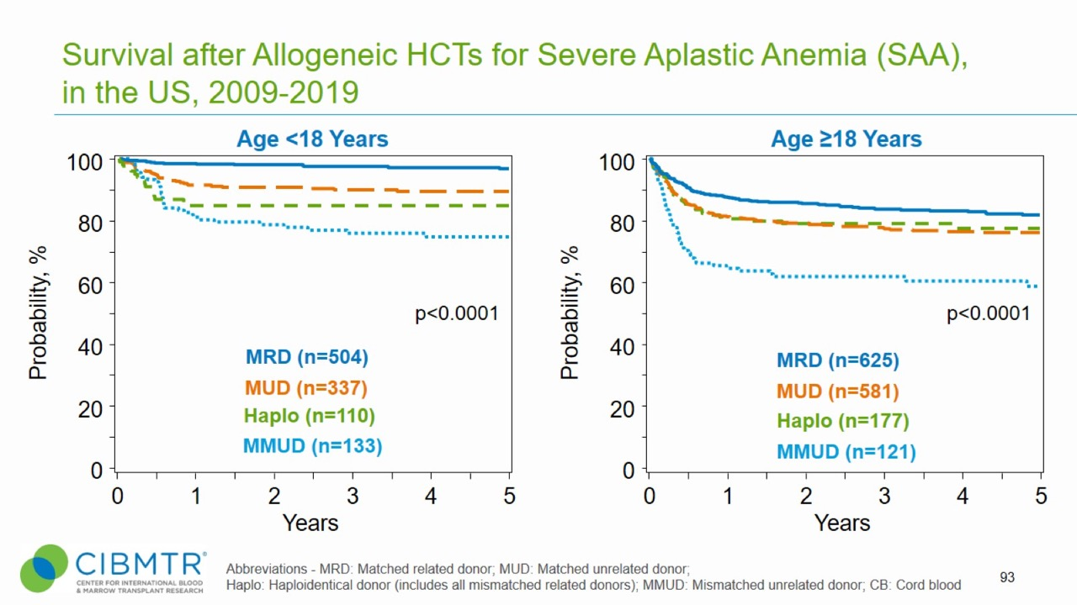
Survival after Allogeneic HCTs for Severe Aplastic Anemia (SAA), in the US, 2009-2019
Notes:
Slide 93: Allogeneic HCT is the treatment of choice for young patients with severe aplastic anemia who have an HLA-matched sibling donor.
Among 1,081 pediatric patients who underwent transplantation for SAA between 2009 and 2019, the 3-year probabilities (95%CI) of survival were 98% (96-99%), 86% (80-93%), 90% (95-99%), and 76% (69-84%) after transplants with Matched related donors, Matched unrelated donors, Haploidentical and mismatched unrelated donors, respectively.
Among 1,504 adult patients who underwent transplantation for SAA between 2009 and 2019, the 3-year probabilities (95%CI) of survival were 84% (81-87%), 80% (74-86%), 77% (74-81%), and 62% (54-71%) after transplants with Matched related donors, Matched unrelated donors, Haploidentical and mismatched unrelated donors, respectively.
Trend data only is presented and any significant p values reflect global differences between indicated groups and not any specific differences between indicated groups. Caution interpreting these univariate curves is important as adjustment for other relevant factors using multi-variable analyses has not been done.

Slide 12
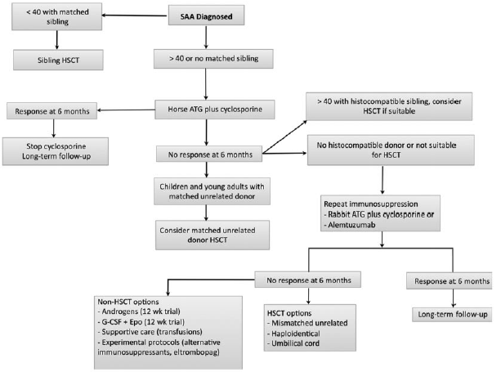




Initial Management of SAA Scheinberg Blood 2012
For age <40 and no sibling donor,
no randomized trials have addressed
best treatment modality: there is no
SOC

Slide 13

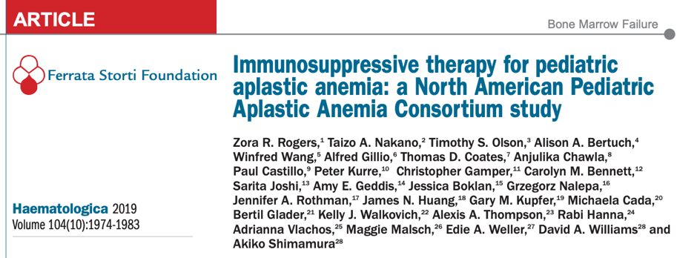
*The largest set of outcomes in pediatric aplastic anemia published to date.

Slide 14
NAPAAC AA: Response criteria
Partial response (PR) or better: 71%
  Hgb ≥ 8 g/dL, ANC ≥ 500/µL, Plts ≥ 20,000/µL
  Transfusion-independent
Very good partial response (VGPR) or better: 68%
  Hgb ≥ 8 g/dL, ANC ≥ 500/µL, Plts ≥ 50,000/µL
Complete response (CR): 60%
  Hgb ≥ 10 g/dL, ANC ≥ 1,000/µL, Plts ≥ 100,000/µL

Slide 15
NAPAAC AA: Survival post-hATG/CYA
Overall Survival
Event-free survival
OS at 5 years: 93% (95% CI:89,96)
EFS at 5 years: 64% (95% CI: 57,69)

Slide 16
NAPAAC AA: Duration of response (hATG/CYA)

Slide 17
Survival after Allogeneic HCTs for Severe Aplastic Anemia (SAA), in the US, 2009-2019
Notes:
Slide 93: Allogeneic HCT is the treatment of choice for young patients with severe aplastic anemia who have an HLA-matched sibling donor.
Among 1,081 pediatric patients who underwent transplantation for SAA between 2009 and 2019, the 3-year probabilities (95%CI) of survival were 98% (96-99%), 86% (80-93%), 90% (95-99%), and 76% (69-84%) after transplants with Matched related donors, Matched unrelated donors, Haploidentical and mismatched unrelated donors, respectively.
Among 1,504 adult patients who underwent transplantation for SAA between 2009 and 2019, the 3-year probabilities (95%CI) of survival were 84% (81-87%), 80% (74-86%), 77% (74-81%), and 62% (54-71%) after transplants with Matched related donors, Matched unrelated donors, Haploidentical and mismatched unrelated donors, respectively.
Trend data only is presented and any significant p values reflect global differences between indicated groups and not any specific differences between indicated groups. Caution interpreting these univariate curves is important as adjustment for other relevant factors using multi-variable analyses has not been done.

Slide 18
What about Chronic GVHD after Unrelate donor BMT?
Younger Children have low cGVHD rates
  5-20%, mostly limited
Older recipients, higher rates with traditional approaches
  20-35% with cGVHD
Use of post-transplant cyclophosphamide may decrease cGVHD risk in older patients
  Haplo BMT cGVHD rates with post-tx Cy are lower

Slide 19
BMT CTN 1502 Haplo for those failing IST
Dezern, Pulsipher Lancet Haematology 2022
DeZern et al BBMT 2016;
DeZern et al Blood Advances 2020

Slide 20
Patient Population
PATIENTS | Total (N=31) N (%)
Gender
Female | 12 (38.7%)
Male | 19 (61.3%)
Ethnicity
Hispanic or Latino | 7 (22.6%)
Not Hispanic or Latino | 24 (77.4%)
Race
American Indian/Alaska Native | 0 (0.0%)
Asian | 4 (12.9%)
Hawaiian / Pacific Islander | 1 (3.2%)
Black or African American | 7 (22.6%)
White | 16 (51.6%)
More than One Race | 1 (3.2%)
Unknown or Not reported | 2 (6.5%)
Age, yrs
Mean (SD) | 31.3 (23.2)
Median (Range) | 24.9 (2.1-70.3)
Donor Age, yrs
Mean (SD) | 37.9 (10.8)
Median (Range) | 38.6 (18.5-59.6)
Adult patients (age >=18): 18
Pediatric patients (age<18): 13

Slide 21
Patient Population
PATIENTS | Total (N=31) N (%)
Gender
Female | 12 (38.7%)
Male | 19 (61.3%)
Ethnicity
Hispanic or Latino | 7 (22.6%)
Not Hispanic or Latino | 24 (77.4%)
Race
American Indian/Alaska Native | 0 (0.0%)
Asian | 4 (12.9%)
Hawaiian / Pacific Islander | 1 (3.2%)
Black or African American | 7 (22.6%)
White | 16 (51.6%)
More than One Race | 1 (3.2%)
Unknown or Not reported | 2 (6.5%)
Age, yrs
Mean (SD) | 31.3 (23.2)
Median (Range) | 24.9 (2.1-70.3)
Donor Age, yrs
Mean (SD) | 37.9 (10.8)
Median (Range) | 38.6 (18.5-59.6)
>40% Non white

Slide 22
Overall Survival and Graft-Failure-Free Survival Favorable for Relapsed Population
OS 80.6%
GFFS 77.4%
Notes:
Events for Graft-Failure-Free Survival including death, primary graft failure, secondary graft failure
The survival shown in the single center experience (OS: 94% [90% CI, 88-100]) and multicenter results demonstrated here (OS: 81% [95% CI: 62%- 91%]) have overlapping confidence intervals which is reassuring for the broader applicability of this specific platform in SAA.

Slide 23
Manageable GVHD for Non-Malignant Disease Population
Acute Chronic
grade II-IV 16.1% 25.8% @ 1-year
(95% CI 5.7%, 31.1%) (95% CI 11.9%, 42.2%)
A) B)
All Chronic was mild and off IST by 18 months

Slide 24
Robust and Timely Engraftment
DAYS | Overall Median
Neutrophil engraftment | 17
Platelet engraftment | 23

Slide 25
What about Haplo for Upfront SAA Pts?
Dezern Blood 2023
Study looked at 27 patients receiving haplo as initial therapy
  3/7 of the initial cohort rejected using 200cGy TBI
  TBI was doubled to 400cGy
  20 additional patients enrolled, all engrafted and alive
New Study through the BMT CTN looking at this
  Vital to do this in a multi-center setting

Slide 26
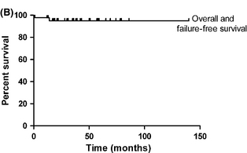
Improved out comes with Unrelated Donor BMT in Children—should you start with BMT?
Anderlini et al
Samarasinghe et al
Anderlini et al
Samarasinghe et al

Slide 27


Results of the North American Pediatric Aplastic Anemia Consortium (NAPAAC)/ Pediatric Transplantation and Cellular Therapy Consortium (PTCTC) Pilot Trial of Randomized Unrelated Donor Transplantation Vs Immune Suppressive Therapy (TransIT) for Treatment of Newly Diagnosed Pediatric/AYA Severe Aplastic Anemia (SAA)
Michael A. Pulsipher, Edie Weller, Paibel Aguayo-Hiraldo, Alison A. Bertuch, Ghadir Sasa, Bogdan Dinu, Leslie E. Lehmann, Timothy Olson, Taizo Nakano, Even Shereck, Alfred Gillio, Lauri M. Burroughs, Jeffrey M. Lipton, Jonathan Fish, James N. Huang, Kathryn Dickerson, Alice Bertaina, Roberta H. Adams, Inga Hofman, Marcin W. Wlodarski, Rabi Hanna, Nicholas J. Gloude, Maggie Malsch, Mark Fleming, Akiko Shimamura, and David A. Williams
Sponsored by the National Institutes of Health (NIH) National Heart, Lung, and Blood Institute (NHLBI)

Slide 28
TransIT Pilot Study Design
  Phase II Feasibility Pilot
    15 Centers opened, 41 enrolled patients
  Primary Objective
    To determine the feasibility of comparing outcomes of patients treated de novo with immunosuppressive therapy (IST) versus matched unrelated donor (MUD) hematopoietic stem cell transplant (HSCT) for pediatric acquired severe aplastic anemia.
  Primary Hypothesis
    Of patients screened, determined to be eligible, consented and randomized to HSCT, at least 60% will accept randomization and receive HSCT as primary therapy.

Slide 29
TransIT Pilot Study Design
Secondary Hypotheses
    Using fast track NMDP screening/donor acquisition, subjects randomized to HSCT will begin their preparative within 8 weeks of randomization
    Overall survival at one and two years from randomization will be similar between the two arms.
    Patients receiving HSCT will have a higher chance of full count recovery at one and two years from randomization.
    For patients treated with primary MUD HSCT, there will be acceptably low levels of graft rejection (<10%), grade III-IV acute GVHD (<15%), and extensive chronic GVHD (<20%).

Slide 30
R-34 Pilot Screening Data Pulsipher Pediatr Blood Cancer 2020
Screening Protocol Analysis-all patients suspected of SAA
  Initially opened at 8 centers
  67 consented for screening, 10 not SAA
  Of 57 SAA pts screened, 23 (40%) were randomized
  Reasons for pts not accepting randomization
Outcome of Screening | Number (Percentage)
Not Interested in Randomization | 6 (10.5%)
Did Not Want BMT Did Not want IST | 4 (6%) 3 (5%)
Medical Issues: Too Sick to wait/telomeres Too Low | 1 (2%) “too sick” 2 (3.5%) “telomeres too low”
Sibling Donor Available | 11 (19%)
MUD Donor Not Available | 7 (12%)

Slide 31
R-34 Pilot Clinical Results: Demographics
Demographics | IST Cohort (N=20) | BMT Cohort (N=20)
Age: median (range) | 9 (1-20) | 9 (1-19)
Sex: # of females (%) | 9 (45%) | 7 (35%)
Ethnicity
Non-Hispanic (%) | 14 (70%) | 15 (75%)
Hispanic (%) | 4 (20%) | 4 (20%)
Unknown/No Report (%) | 2 (10%) | 1 (5%)
Race
White (%) | 12 (60%) | 13 (65%)
Asian (%) | 1 (5%) | 3 (15%)
Black (%) | 1 (5%) | 1 (5%)
Native American (%) | 1 (5%) | 1 (5%)
Other (%) | 5 (5%) | 1 (5%)

Slide 32
R-34 Clinical Results: Randomization and Therapy Delivery
Ability to deliver therapy in a timely fashion
  IST started median 6d (1-12d) after randomization
  17 of 20 patients received BMT infusion median 36d (23-72d)
  13pts BMT by 39d, 16pts by 52d—one outlier at 72d
Three patients randomized to BMT received IST first
  1 patient had unacceptably high LFTs
  2 patients had donor delays anticipated to be >8 weeks
  All 3 treated with IST at 28, 30 and 40d after randomization

Slide 33
R-34 Results: Response and Clinical Outcomes
  IST Arm (intent to treat)
    13 (65%) patients with initial response
      10 with ongoing response, 3 on CSA
      3 failed at 12, 20, and 21m
        1 died after salvage BMT, alive (refused BMT)
    7 patients failed initial IST
      All 7 alive after BMT; 1 required second BMT
    IST Arm (as treated)
    As above, but 3 randomized to BMT received IST first
      2/3 responded, but eventually all failed IST
      All 3 alive after BMT
    10/23 with continued response at last f/u

Slide 34
R-34 Results: Response and Clinical Outcomes
  BMT Arm (intent to treat)
    3 received IST first, failed and are alive after BMT
    17 received BMT as first therapy
      2 acute rejection
        both alive after second BMT
      2 autoimmune pancytopenia
        1 rejected, autologous recovery
        1 near rejection/graft insufficiency, died after BMT #2
      13 alive, all off immune suppressio
  BMT Arm (as treated)
    13/17 with continued response at last f/u

Slide 35
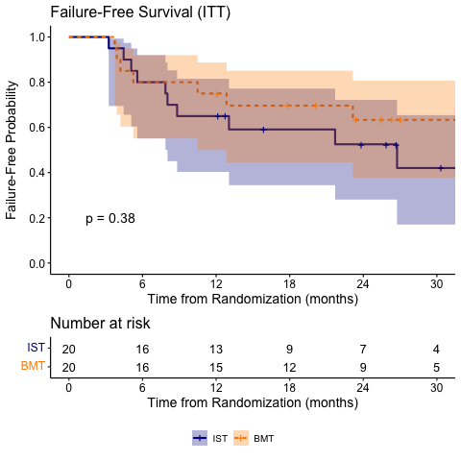
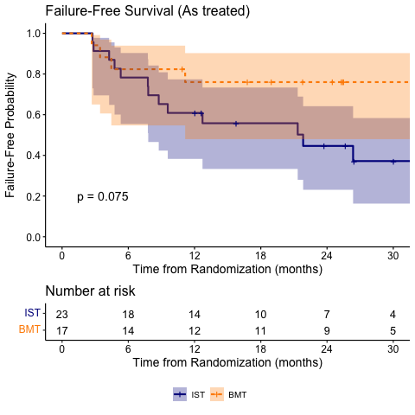
R-34 Results: Failure Free Survival
Pulsipher TCT 2022

Slide 36
R-34 Results: Summary
  Patients were rapidly and successfully screened to determine eligibility (median 16d)
  Over 40% of all SAA patients consented to randomization
  Patients on both arms received therapy quickly
    IST: Median 6 days to start
    BMT: Median 35 days to infusion
  Survival excellent (19/20 both arms, med f/u 30.3m)
    Rejection rate after BMT was concerning
  The Pilot trial was not powered to compare approaches
    Phase III trial 87% power to detect a 20% difference in FFS

Slide 37
Does SAA at Initial Diagnosis Require a More Intense Prep?
  Inadequate data on SAA receiving BMT at initial diagnosis
    For relapsed refractory—5-15% rejection published
      Not known if up front SAA HCT has higher rejection
      Proposal for CIBMTR Study to study this reviewed yesterday (Rayes, Pulsipher, Otoukesh, Namamura)
  Dezern Blood Advances 2020
    Relapsed refractory pts
      Using rATG/flu/cy12.5x2/TBI 200 post tx cy 50x2
      1/27 rejection
    Treatment Naïve patients
      Same Approach, TBI 200: 3/7 rejection
      Increase TBI to 400: 0/20 rejection

Slide 38
R-34 Pilot Experience with Graft Rejection
  Derivation of the Pilot preparative regimen
    BMT CTN 0301: Comparison of cyclophosphamide (Cy)doses
    0 and 150mg/kg eliminated early
    38 and 41 pts, respectively received 50mg/kg or 100mg/kg
    Both doses declared safe and effective and used currently
  Using rATG 9mg/kg, flu 120mg/m2, Cy 50mg/kg x 1, TBI 200
    4/17 patients—2 early, 2 late with autoimmune cytopenias
    23.5% rejection (95% CI: [6.8, 49.9])
  Unpublished experience with 100mg/kg regimen at CHOP in up front SAA, no rejection in 21 patients

Slide 39
Risks to Fertility/Gonadal Function with TBI or Cy
 | Low Risk Female | Low Risk Male | High Risk Female | High Risk Male
Radiation Dose | Prepubertal 1-10Gy Post pubertal 1-5Gy | 0.2-0.7Gy 1-3Gy reversible azoospermia. | 20Gy Failure | >3Gy risk of irreversible azospermia 20Gy Failure
Alkylators (Cyclophos- phamide equivalent dosing) | <7.5g/m2 CED (250mg/kg) | 4g/m2 CED (133mg/kg) | 15g/m2 CED (500mg/kg) | 7.5g/m2 CED (250mg/kg)
Refs:
1. Gerstl, B., Sullivan, E., Chong, S., Chia, D., Wand, H., & Anazodo, A. (2018). Reproductive outcomes after a childhood and adolescent young adult cancer diagnosis in female cancer survivors: a systematic review and meta-analysis. Journal of adolescent and young adult oncology, 7(6), 627-642. 2. Lambertini M, et al. (2016) Cancer and fertility preservation: international recommendations from an expert meeting. BMC Medicine. 14:1
3. Reinmuth S, et al. (2013) Impact of chemotherapy and radiotherapy in childhood on fertility in adulthood: the feCt-survey of childhood cancer survivors in Germany. J Cancer Res Clin Oncol. 139(12):2071-8.
4. Hudson, M. M. (2010). Reproductive outcomes for survivors of childhood cancer. Obstetrics and gynecology, 116(5), 1171.
5. Gracia, C. R., & Ginsberg, J. P. (2007). Fertility risk in pediatric and adolescent cancers. Oncofertility Fertility Preservation for Cancer Survivors, 57-72.

Slide 40

A Phase III Randomized Trial Comparing Unrelated Donor Bone Marrow Transplantation with Immune Suppressive Therapy for Newly Diagnosed Pediatric and Young Adult Patients with Severe Aplastic Anemia
Principal Investigators Michael A. Pulsipher, MD Bronwen Shaw, MD David A. Williams, MD
Co- Investigators
Akiko Shimamura, MD, PhD
Staci Arnold, MD
Edie Weller, PhD
Protocol Officer
Rachel Phelan, MD, MPH
CCC– Boston Children’s Hospital
Project Manager
Maggie Malsch
Sponsored by the National Institutes of Health (NIH) National Heart, Lung, and Blood Institute (NHLBI) In partnership with the Center for International Blood and Marrow Transplant Research (CIBMTR)

Slide 41


TransIT Phase III Trial: Study Design
This study is designed as a Phase III RCT comparing unrelated donor BMT with IST for newly diagnosed pediatric and young adult patients (<25 years old) with SAA. The design used for this study is unblinded, stratified, randomized phase III study design. The study is unblinded because one arm is a transplant arm.
Planned # of subjects: 234 children/adolescent/young adult (AYA) subjects
Planned # of sites: 52 investigational centers
Study Duration: Approximately 7 years (3.3 - 4.7 years enrollment, 2 years follow-up, 3 months close-out acitivites)

Slide 42

TransIT Phase III Trial: Primary Objective
  To compare time from randomization to treatment failure or death from any cause on the two arms
Hypothesis: Improvement of 20% in the URD HCT Arm

Slide 43
TransIT Phase III Trial Objective 2: Health Related Quality of Life (HR-QoL)
Objective: To compare HR-QoL on the two treatment arms at baseline, 100* days, 180* days, 1 year, 2 years and at one late time-point timepoint (3-5 years). Child and/or caregiver responses will also be compared.
Endpoint: The change in score between baseline and 2 years and the trajectory of change over all time points between both treatment cohorts.
Hypothesis: HR-QoL at 1 and 2 years after therapy will be similar in patients responding to IST compared to those receiving BMT. Patients failing IST or who develop cGVHD are at highest risk for poor HR-QoL.
*± 14days

Slide 44
TransIT Phase III Trial Objective 3: Gonadal Function
Objective: To compare hormonal markers of gonadal function on the two treatment arms at baseline, 1 year, 2 years and at one late timepoint (3-5 years)
Endpoint: Proportion of subjects with gonadal function marker values below the 25th percentile of normal range for that age and outside of the 95% confidence interval for an age appropriate normal
Hypothesis: Patients undergoing BMT will have decreased gonadal function markers compared to patients receiving IST.

Slide 45
TransIT Phase III Trial Objective 4: Genetics/Clonality
Objective: Assess for germline mutations in genes associated with bone marrow failure.
Endpoint: Proportion of subjects who do not have genetic BM failure.
Objective: Assess clonal hematopoiesis at baseline and 1 year, 2 years and at one late timepoint (3-5 years) following IST vs BMT in pediatric aplastic anemia.
Endpoint: Clonal hematopoiesis with IST vs BMT will be compared at baseline and at 1 year, 2 years and at one late timepoint (3-5 years). The proportion of subjects with clonal hematopoiesis, proportion of subjects with missense mutations, the frequency of mutated genes, the number of mutations per subject and the variant allele frequency (VAF) will be compared.

Slide 46
Summary
Sibling BMT = standard treatment for initially diagnosed SAA
  Older pts = higher risk for chronic GVHD
Unrelated donor BMT survival has improved over the past 20 years
  Risks of Chronic GVHD 10-35%, Risk of rejection 5-10%
Haplo BMT survival has improved over the past decade
  Risks of Chronic GVHD 10%, Risk of rejection 10-15%
Immune Suppressive Therapy with eltrombopag leads to responses in 70-80%
  Half will eventually fail, 10-15% will develop secondary MDS/AML
  Fertility is preserved after IST
Should we do unrelated donor or haplo BMT up front?
  The TransIT phase III trial is randomizing IST with BMT in children
  BMT CTN trial looking at up front haplo and unrelated BMT in older patients
  Risks of fertility loss, rejection, chronic GVHD must be weighed for up front BMT

Slide 47
Acknowledgments
Edie Weller
Paibel Aguayo-Hiraldo
Alison A. Bertuch
Ghadir Sasa
Leslie E. Lehmann
Timothy Olson
Taizo Nakano
Even Shereck
Alfred Gillio
Lauri M. Burroughs
Jeffrey M. Lipton
Jonathan Fish
James N. Huang
Amy Dezern
Mary Eapen
Joachim Deeg
Joe Antin
Paulo Anderlini
Kathryn Dickerson
Alice Bertaina
Roberta H. Adams
Inga Hofman
Marcin W. Wlodarski
Rabi Hanna
Nicholas J. Gloude
Maggie Malsch
Mark Fleming
Akiko Shimamura
David A. Williams
Bronwen Shaw & Phase III Team
Nancy DiFronzo & NHLBI

Slide 48
TransIT Phase III Trial: Statistical Design
Number of subjects randomized* | 234
Primary endpoint | 2-year ISFS-AC percentage
Primary Analysis** | Intent to treat
Alpha Power | 5% 85%
Clinically meaningful difference (2-year IST%) | 20% (65-70%)
Interim analysis-% information | 50, 100
Safety Monitoring : Treatment related mortality 100d Extensive chronic GVHD Excessive rejection rate | Monitored monthly, if rates exceed pre-defined guidelines, results will be discussed with DSMB
* Assume 10% dropout rate
** Two-sided Wald test statistic using the Aaelen-Johansen 2-year estimate from competing risks analysis

